Slide 1
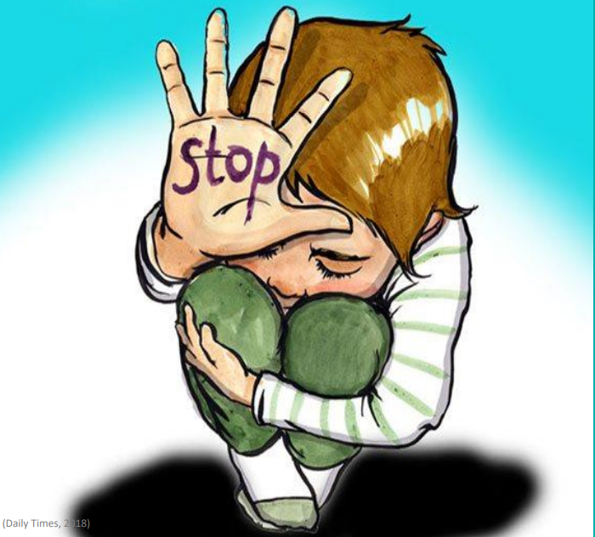
Violence against Children

Slide 2
Violence against children?
A Child is “Every human being under the age of 18 years”.
Violence against children is “the intentional use of physical force or power, threatened or actual, against a child, by an individual or group, that either results in or has a high likelihood of resulting in actual or potential harm to the child’s health, survival, development or dignity.” (World Report on Violence and Health)

Slide 3
A Global and Universal Problem
Violence against children cuts across boundaries of geography, race, class, religion and culture.
It occurs in homes, schools and streets; in places of work and entertainment, and in care and detention centers.
Perpetrators include parents, family members, teachers, caretakers, law enforcement authorities and other children.
Some children are particularly vulnerable because of gender, race, disability or social status. And no country is immune, whether rich or poor.

Slide 4
The Alarming Scale of the Problem (Global Statistics)
Globally, it is estimated that up to 1 billion children aged 2–17 years, have experienced physical, sexual, or emotional violence or neglect in the past year
Every 4 minutes, somewhere in the world, a child is killed by an act of violence.
Boys face a higher risk of dying from violence: 3 out of every 4 children and adolescents killed by violence were boys.

Slide 5
Child Risk Factors
Young children are at greater risk for abuse because they are more dependent on their caregivers which can leave a parent feeling overwhelmed and frustrated
Children between the ages of 14-17 are at higher risk for sexual abuse
Children with disabilities and illness are at higher risk of abuse due to increased levels of parental depression, stress, and anxiety. Cognitively disabled children may not comprehend abusive behaviors as wrong, while physically disabled children may not be able to defend against abuse
Children with attention deficiencies, conduct issues, or taxing temperaments are at higher risk for abuse, especially when parents have poor emotional control and coping skills

Slide 6
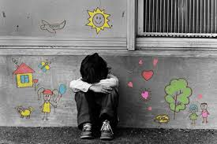
Where and How Does Violence Occur?
Violence against children occurs in the environments or settings in which childhood is spent :
Home and family (domestic violence is a form of child abuse)
Schools and educational setting
Care institutions and Justice systems
Work settings
the community.

Slide 7
Violence in the Home and Family
A family is supposed to take care of the child, but in recent years violence against children by parents and other family members has been documented. This can include physical, sexual and psychological violence as well as deliberate neglect.
Frequently, children experience physical, cruel or humiliating punishment in the context of discipline.
Children are most frequently sexually abused by someone they know, often a member of their own family. Much of this violence is hidden behind closed doors or because of shame or fear.

Slide 8
Violence in Schools and Educational Settings
Schools have an important role in protecting children from violence. For many children, though, educational settings expose them to violence and may teach them violence.
They are exposed to corporal punishment, cruel and humiliating forms of psychological punishment, sexual and gender-based violence, and bullying.
Although many countries have banned corporal punishment in schools, often this ban is not adequately enforced.
Fighting and bullying are also examples of violence against children in schools. Often bullying is associated with discrimination against students from poor families or marginalized groups, or those with personal characteristics such as appearance or a disability.

Slide 9
Violence in Care and Justice Systems
As many as 8 million of the world's children are in residential care. Relatively few are there because they have no parents; most are in care because of disability, family disintegration, violence in the home and social and economic conditions such as poverty.
Children in some institutions face violence from care-givers and other children. Staff may 'discipline' them with beatings or restraints, or by locking them up.
In some institutions, children with disabilities face violence in the process of treatment, such as being subjected to electric shock to control their behavior or given drugs to make them more 'compliant’.
Children in detention are frequently subjected to violence by staff.

Slide 10
Violence in Work Settings
Across all regions, violence affects many millions of children who are working, both legally and illegally.
It may be used to force children to work or punish or control them in the workplace.
Most workplace violence is inflicted by employers, although those who inflict violence may also include co-workers, customers, police, criminal gangs and intermediaries.
Many girls work in domestic labor, which is often unregulated. They report maltreatment such as physical punishment, humiliation and sexual harassment.

Slide 11
Violence in the community
The community is a source of protection and solidarity for children but it can also be a site of violence – including peer violence, violence related to guns and other weapons, gang and police violence, physical and sexual violence, and trafficking.
Community violence often affects marginalized groups of children, such as street children.
The mass media sometimes portray violence as normal.

Slide 12
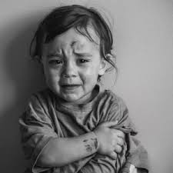
The Many Forms of Violence Against Children
Abuse and Violence against children includes:
Physical violence
Sexual abuse
Emotional and verbal harm
Neglect and abandonment

Slide 13
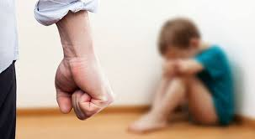
Physical Violence
Physical abuse of a child is when a parent or caregiver causes any non-accidental physical injury to a child.
Physical abuse includes striking, kicking, burning, biting, hair pulling, choking, whipping or any other action that injures a child. Physical abuse can result in:
Bruises, blisters, burns, cuts and scratches
Internal injuries, brain damage
Broken bones, sprains, dislocated joints
Emotional and psychological harm
Lifelong injury, death

Slide 14
Sexual Abuse:
Sexual abuse occurs when an adult uses a child for sexual purposes or involves a child in sexual acts.
Sudden changes in the child's behavior will be noticed, bedwetting, fears and phobia, significant changes in school performance, hesitancy to be alone with a certain person, age-inappropriate sexual knowledge; self-destructive behavior- this can be Sexual Abuse.

Slide 15
Emotional and Verbal Harm:
It includes calling a child names, yelling, screaming, threats, bullying, comparing kids negatively to others, public and private humiliation and shaming, unrealistic and extreme demands made on a child, intentional withholding of a parent's love and affection, and telling them "they're no good, worthless, bad or a mistake" ... this is extremely harmful to children.
It undermines a child's foundation, spirit, and psychological and social development. Their self-esteem is destroyed — possibly throughout their adulthood and can affect their whole lives.

Slide 16
Child neglect and abandonment:
Is when a parent or caregiver does not give the care, supervision, affection and support needed for a child’s health, safety and well-being. Child neglect includes: Physical neglect and inadequate supervision, Emotional neglect, Medical neglect, Educational neglect.
Adults that care for children must provide clothing, food, and drink, safe, healthy shelter, and adequate supervision.
Children require enough affection and attention to feel loved and supported. If a child shows signs of psychological illness, it must be treated.
Parents and caregivers must provide children with appropriate treatment for injuries and illness. They must also provide basic preventive care to make sure their child stays safe and healthy.

Slide 17
Signs of Child abuse and violence
The Child
Has many unusual injuries or injuries that can't be explained and wear long sleeves to cover the bruises.
Seems sad and cries a lot, has self-destructive behavior
Fights with classmates, acts out in the classroom, or destroys things
Seems very tired; talks about trouble sleeping and often has nightmares
Seems afraid of a parent or other adults, like teachers or baby-sitters
Eating disorders and drug abuse.

Slide 18
Signs of Child abuse and violence
The Child's Parents
Stay away from other mothers and fathers in the neighborhood
Not take part in school activities, and may have a drinking or drug abuse problem
Don't want to talk about the child's injuries or seem nervous when they do.
Parents who were victims of violence and neglect as children, can often continue the cycle when they punish their own children
Being poor, sick or on drugs, or have history of violence, increases the risk of harming and neglecting a child

Slide 19
The Adverse Childhood Experiences (ACE) Study
The ACE Study is a major public health research collaboration between the Centers for Disease Control and Prevention (CDC) and Kaiser Permanente.
It investigates the effects of multiple forms of childhood adversity on health and well-being across the lifespan. With over 17,000 participants, it is the largest study of its kind.
The ACE Pyramid: This model illustrates the life-course pathway: Adverse Childhood Experiences → disrupt neurodevelopment → lead to social, emotional, and cognitive impairment → increase adoption of health-risk behaviors → result in disease, disability, social problems, and early death.

Slide 20
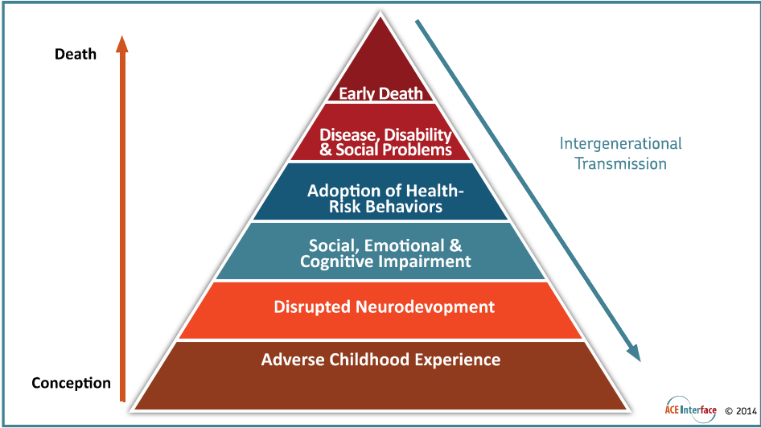

Slide 21
Key Findings
  ACEs Are Common: Two-thirds of participants reported at least one ACE. They occur across all socioeconomic and cultural lines.
  ACEs Are Interrelated: Individuals with one ACE category are likely to have experienced others.
  Impact is Cumulative: The ACE Score (0-10) counts the number of ACE categories experienced. As the ACE Score increases, the risk for numerous health and social problems increases in a strong, graded "dose-response" fashion.
  ACEs Are a Powerful Determinant of Health: They are a leading cause of health and social problems, with a significant portion of many conditions—from asthma to life dissatisfaction—linked to ACEs.

Slide 22
Biological Impact: How ACEs Affect Development
Toxic stress from ACEs (prolonged high levels of stress hormones like cortisol) can damage developing brain cells, impair neural network formation, and disrupt the function of brain regions.
During childhood, different brain regions have sensitive periods where they are most vulnerable to toxic stress, which can affect language, social perception, emotional regulation, and coordination.
The impairments caused by toxic stress are the biological pathways that lead to increased risk for health problems, disability, and disease throughout life.

Slide 23
Associated Health and Social Problems
ACEs are linked to a wide range of issues, including:
Risk Behaviors: Smoking, alcoholism, drug abuse, obesity, high-risk sexual behavior.
Mental Health: Depression, anxiety, suicide attempts, hallucinations.
Chronic Diseases: Heart disease, chronic obstructive pulmonary disease (COPD), liver disease, cancer.
Social Outcomes: Intimate partner violence, workplace problems, unintended pregnancy, fetal death, poor quality of life.

Slide 24
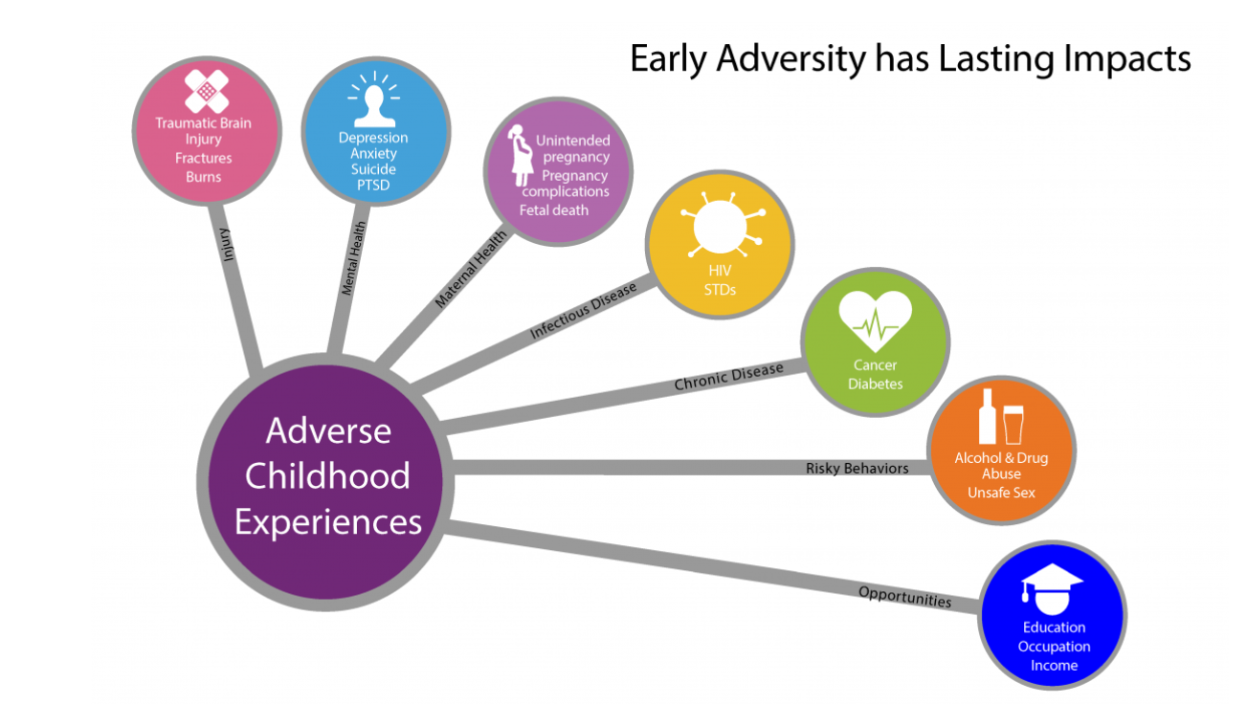

Slide 25
Prevention
Preventing ACEs is presented as the greatest opportunity for improving population well-being, as it would reduce all associated problems.
Positive adaptation is guided by three nested protective systems:
  Individual capabilities.
  Attachment and belonging (family).
  Community, faith, and cultural processes.
Global Relevance: The World Health Organization (WHO) has adopted the ACE framework, collaborating with the CDC to study the global impact of adverse childhood experiences.

Slide 26
Jordan Population and Family Health Survey 2023
In Jordan, Twenty percent of children age 1–14 experienced only nonviolent discipline during the month prior to the interview, 72% experienced psychological aggression, 53% experienced physical punishment, and 10% experienced severe physical punishment. Overall, 75% of children age 1–14 experienced at least one form of violent discipline (JPFHS, 2023).

Slide 27
Jordan Population and Family Health Survey 2023
Fourteen percent of respondents believe that a child needs physical punishment to be raised or educated properly(JPFHS, 2023).

Slide 28
