Slide 1

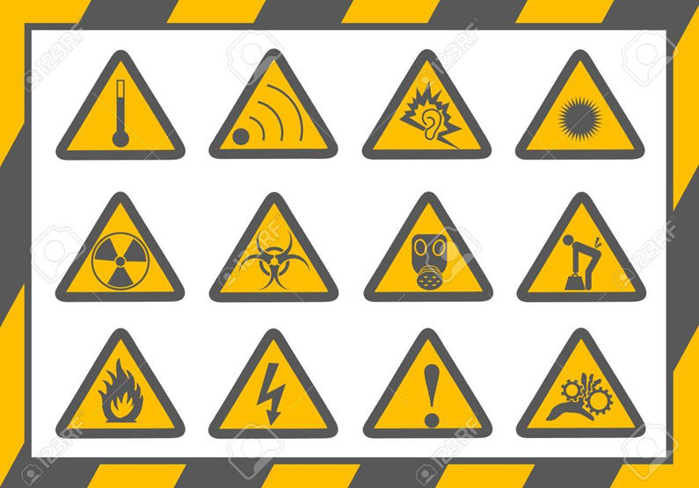
Occupational
Health

Slide 2
Definition
Since 1950, the International Labour Organization (ILO) and the World Health Organization (WHO) have shared a common definition of occupational
Occupational Health is the promotion and maintenance of the highest degree of physical, mental and social well-being of workers in all occupations by preventing departures from health, controlling risks and the adaptation of work to people, and people to their jobs.
(ILO / WHO 1950)

Slide 3
Why is occupational health and safety important?
Work plays a central role in people's lives, since most workers spend at least eight hours a day in the workplace, whether it is in an office, outdoors or in the factory, etc.
Therefore, work environments should be safe and healthy. Yet this is not the case for many workers.
Everyday workers all over the world are faced with a multitude of health hazards, such as: dusts; gases; noise; vibration; extreme temperatures and stress.

Slide 4
Workers represent ½ the world’s population and are the major contributors to economic and social development.
Their health is determined not only by workplace hazards but also by social and individual factors and access to health services.
Occupational hazards cause or contribute to the premature death of millions of people worldwide and result in the ill health or disablement of hundreds of millions more each year.

Slide 5
Occupational Health, History
The first written discussions specifically directed toward matters of occupational safety and health were those of Paracelsus, in the fifteenth century.
In the early eighteenth century, Bernadino Ramazzini, an Italian physician, wrote the first book on occupational medicine, De morbis artificium diatribe (Diseases of Workers), and he is generally regarded as the "father of occupational medicine."
Ramazzini wrote about the health hazards for dozens of occupations.

Slide 6
Occupational Health, History
In the United States, in the early twentieth century, Dr. Alice Hamilton became the first woman physician appointed to a faculty position at Harvard University, where she worked at the School of Public Health promoting safe and healthful work practices in the United States.
She has been recognized as the leader of the occupational medicine movement in the United States
Which came relatively late compared with that in Europe.

Slide 7
So, what is the problem with occupational health?
Unfortunately, some employers assume little responsibility for the protection of workers' health and safety.
In fact, some employers do not even know that they have the moral and often legal responsibility to protect workers.
As a result of the hazards and a lack of attention given to health and safety, work-related accidents and diseases are common in all parts of the world.

Slide 8
What is occupational health and safety (OHS)?
Occupational health & safety is a discipline with a broad scope involving many specialized fields. In its broadest sense, it should aim to:
Promoting and maintaining the highest degree of physical, mental and social well-being of workers in all occupations by:
Preventing adverse effects on workers’ health caused by their working conditions
Placing workers in an occupational environment adapted to physical and mental needs.
Adapting work environment suitable for humans.

Slide 9
Identifying Safety and Health Hazards
The terminology used in Occupational Safety and Health (OSH) varies, but generally speaking:
A hazard is something that can cause harm if not controlled.
The outcome is the harm that results from an uncontrolled hazard.
A risk is a combination of the probability that a particular outcome will occur and the severity of the harm involved.
The calculation of risk is based on the likelihood or probability of the harm being realized and the severity of the consequences.

Slide 10
Identifying Safety and Health Hazards
For example, repetitively carrying out manual handling of heavy objects is a hazard.
The outcome could be a musculoskeletal disorder (MSD) or an acute back or joint injury.
The risk can be expressed numerically (e.g. a 0.5 or 50/50 chance of the outcome occurring during a year), in relative terms (e.g. "high/medium/low").

Slide 11
Risk assessment
Modern occupational safety and health legislation usually demands that a risk assessment be carried out prior to making an intervention.
It should be kept in mind that risk management requires risk to be managed to a level which is as low as is reasonably practical.
This assessment should:
Identify the hazards
Identify all affected by the hazard and how
Evaluate the risk
Identify and prioritize appropriate control measures

Slide 12
Risk Assessment
The assessment should include practical recommendations to control the risk.
Once recommended controls are implemented, the risk should be re-calculated to determine if it has been lowered to an acceptable level.
Generally speaking, newly introduced controls should lower risk by one level, i.e., from high to medium or from medium to low.

Slide 13
Common workplace hazard groups
1- Mechanical hazards.
  By type of agent:
  Falling from a height (construction workers)
  Confined Space
  Impact force
  Slips and trips
  Falling on a pointed object
  Compressed air/high pressure
  Entanglement
  Equipment-related injury
  By type of damage:
Crushing, Cutting, Friction and abrasion, Shearing , Stabbing and puncture

Slide 14
2. physical hazards .
Noise
Vibration
Barotrauma (hypobaric/hyperbaric pressure)
Ionizing radiation
Electricity
Asphyxiation
Cold stress (hypothermia)
Heat stress (hyperthermia)

Slide 15
3- Biological Hazards:
Bacteria
Virus
Fungi
e.g. Blood-borne pathogens
e.g. Tuberculosis

Slide 16
4- Chemical hazards
include:
Acids
Bases
Heavy metals
Solvents
Particulates: Fumes (noxious gases/vapors), silica particles (pneumoconiosis)
Highly-reactive chemicals
Fire and explosion hazards.

Slide 17
Pneumoconiosis
In China, the number of workers exposed to silica containing dusts was estimated to be as high as 12 million .
Pneumoconiosis has been the most serious and preventable occupational disease for a long time.
In recent years, new cases were estimated at 12,000–15,000 annually, representing 70–80% of the total number of cases of reported occupational diseases.
Most of the cases were found in coal-mining industries, followed by the construction materials manufacturing industry, the metallurgical industry, non-ferrous metal industries, and machinery industries (Zhang, 2010).

Slide 18
5- Psychosocial hazards include
Work-related stress, whose causal factors include excessive working time and overwork .
Violence from outside the organization .
Bullying, which may include emotional and verbal abuse
Sexual harassment
Burnout
Exposure to unhealthy elements during meetings with business associates, e.g. tobacco, uncontrolled alcohol

Slide 19
In 1986, the National Institute for Occupational Safety and Health (NIOSH) listed psychological disorders among the ten leading work-related diseases and injuries among U.S. workers.
Psychosocial hazards, however, have received little attention over the past decades. This is mainly because of the focus on controlling physical, chemical and biological hazards in workplaces.

Slide 20

6. Musculoskeletal Disorders
Avoided by the employment of good ergonomic design.
Musculoskeletal diseases are a major industrial problem in terms of both disability and cost.
These diseases cause a large number of permanent disability ratings and a burden to medical services.
Low back pain occurs in 50% of workers in heavy industries.
Repetitive loadings appear to fatigue and weakens
the tissues.
The need to reduce musculoskeletal injuries in
the workplace has become acute.

Slide 21
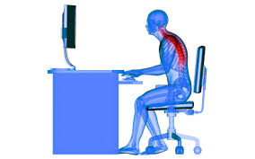
Occupational HAZARDS IN DENTISTRY
Biological health hazards
Physical hazards
Chemical hazards
Musculoskeletal disorder
Radiation exposure
Psychological hazards

Slide 22
Biological Health Hazards
Dental practitioners as other healthcare workers confront an identified risk of occupational exposure to blood-borne pathogens like the Human Immunodeficiency Virus (HIV), the hepatitis B virus (HBV), hepatitis C virus (HCV) and Herpes.
In dentistry, sharp injuries occur because of a small operating field, frequent patient movement, and the variety of sharp instruments used in dental procedures.

Slide 23
Other Transmissible disease/agent:
BACTERIAL AGENTS-tuberculosis (mycobacterium tuberculosis), Staphylococcus aureus, Corynebacterium diptheriae.
Carriers of these agents may be asymptomatic.
Thus proper preventive steps should be considered.

Slide 24
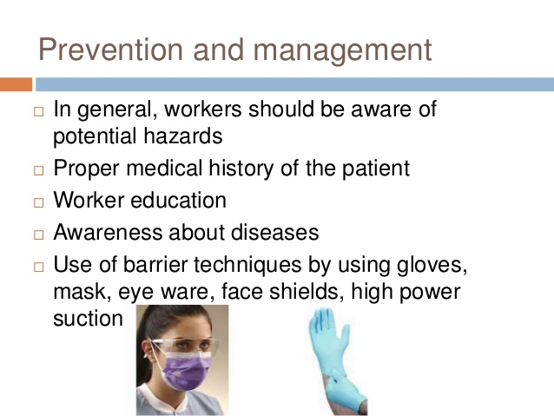

Slide 25
Prevention is better than cure
Proper immunization of the workers
Golden rule-
All patients should be treated as if they are infectious, and routine cross-infection control is necessary dealing with every patient.

Slide 26
PHYSICAL HAZARDS:
Dentists are at a high risk of physical injuries during treatment.
Use of sharps may cause physical injuries to the practitioner.
Debris from the oral cavity might strike the eye.
Cut from sharp instruments.
Puncture wounds from needles and sharp objects: PER-CUTANEOUS EXPOSURE INCIDENT (PEI) - Broad descriptive term that include sharp injuries as well as cutaneous and mucous exposure to blood and serum
Remember: one-hand technique for recapping the needle.

Slide 27
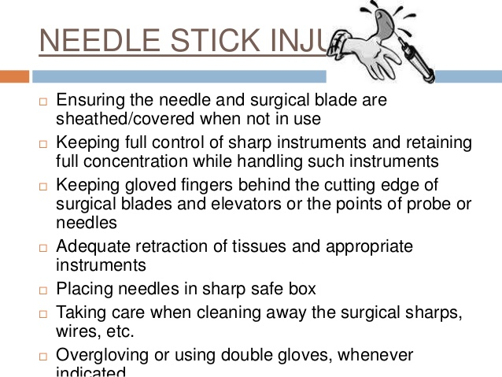
NEEDLE STICK INJURY
Ensuring the needle and surgical blade are sheathed/covered when not in use
Keeping full control of sharp instruments and retaining full concentration while handling such instruments
Keeping gloved fingers behind the cutting edge of surgical blades and elevators or the points of probe or needles
Placing needles in sharp safe box
Taking care when cleaning away the surgical sharps, wires, etc. Over-gloving or using double gloves, whenever needed.

Slide 28
CHEMICAL HAZARDS
Chemicals and substances used in dental clinics pose a major health hazard to a dental practitioner.
Direct contact with chemicals such as- Eugenol, Phenol, Iodine, formalin, some impression materials, topical anesthesia can cause adverse reactions to the practitioner, like contact dermatitis and latex hypersensitivity.
The routine use of latex gloves and other personal protective equipment significantly reduced the chance of HIV/blood-borne disease transmission; however, as more and more Healthcare Workers (HCWs) were exposed to latex-containing products on a regular basis, problems began to be reported.

Slide 29
Dealing Safely with Mercury
Amalgam used in dentistry contain mercury- which is a highly toxic metal-may lead to mercury poisoning.
Use of water sprays, high velocity evacuation and rubber dam to reduce exposure. Dental staff should wear face-mask.
Carpeting and rugs should be avoided as it is a major repository for mercury.
Never rinse elemental mercury down the drain. Never dispose elemental mercury in the trash. Never dispose elemental mercury in the sharp container or as medical waste. Keep the filling cool during removal.
Cutting the amalgam into chunks: while drilling into amalgam make sure only chunks of amalgam is cut and the latter is then removed by hand instruments-this result in less formation of aerosols.

Slide 30
Musculoskeletal disorder (MSD)
Dental surgeons are normally included in the group of professional at a high risk of suffering from MSDs.
Pain in neck, shoulders and other extremities due to strained posture of a dentist at work, with the neck bend and twisted, repetitive movement of hands can cause neck syndrome and pain in the upper extremities and shoulders.
Why MSDs are common in dentistry???
Repetitive motions(ex. Scaling and polishing)
Static neck, back and shoulder position
Grasping small instruments for prolonged periods
Prolonged use of vibrating hand tools.

Slide 31
The key to prevent work related MSDs is (Ergonomics):
a science dealing with designing of a workplace, equipment and the surrounding to ensure comfort and efficiency for the practitioner.
Dental chair should be adjusted in a manner that the position of the doctor is neutral and muscles are relaxed.
Instrument design- the handle should be thicker, round, and hollow.

Slide 32
RADIATION EXPOSURE
In dentistry low level of radiation is used, but even this low level of radiation exposure over a prolonged period of time may cause potential hazards to health.
CONSEQUENCE OF X- RADATION: radiation dermatitis on hands - And squamous cell carcinoma on fingers.
Proper principles should be followed while taking an X- ray:
Dentists should not hold the film in patient’s mouth.
Proper technique can ensure correct X-ray, thus repetition is avoided.
High quality film, should be used, as they ensure good quality image.
Workplace should be properly designed.
Appropriate shielding (use of lead apron).
Replacement of older X-ray equipment.
Monitoring the exposure.
Proper education of workers.
Curing lights are also a potential hazard to those who place restorative resins due to phototoxic and photoallergic reactions originating from absorbed radiation (non-ionizing radiation).

Slide 33
Psychological hazards
Stress is the leading psychological condition that occurs in the dental profession.
Job-related psychological disorders may also affect dentist's health. Risk factors affect dentist's psychological conditions that include job-related stress, tension, depression, emotional exhaustion, and depersonalization.
83% of dentists believed that dentistry is “very stressful,” and nearly 60% believed that dentistry is more stressful than other professions.
Dentists indicated running behind schedule, causing pain, and heavy work load, late and anxious patients are the most intense stressors in their work.
A large number of factors are responsible for stress situations including low autonomy, work overload, and imbalance between power and responsibility.

