Slide 1
Introduction to Community Medicine and
Primary Healthcare (PHC)

Slide 2
What is Community Medicine?
“ A science and art of promoting health, preventing diseases and prolonging life by range of interventions (promotive, preventive, curative, rehabilitative and palliative) in close partnership or association with health care delivery system and with active community participation and inter-sectoral coordination.”
Its primary objective is prevention of disease and promotion of health.
The provider of services in community medicine, can be a physician, advanced practice nurse or, in some settings, a physician’s assistant.

Slide 3
Core subjects in community medicine
The practice of Community Medicine requires a multidisciplinary approach.
The core subjects in Community Medicine are:
Epidemiology,
health-care delivery system including primary health care.
Biostatistics.
Public health nutrition.
Social, behavioural, environmental, and management sciences.
(Joseph et al., 2018)

Slide 4
Definitions of Health
A state of being sound
Absence of disease
A level of functional and metabolic efficiency of a living being
According to WHO :
It’s a state of complete physical, mental, social well being & not merely the absence of disease or infirmity.
Recent Definition (by WHO):
It’s a dynamic state of complete physical, mental, social & spiritual well being & not merely the absence of disease or infirmity.

Slide 5
Health cannot be defined as a state because it is everchanging.
Therefore, health is defined as a dynamic state or condition of the human organism who is multidimensional in nature (i.e. physical, mental, emotional, social, spiritual, and environmental).
A person's health is dynamic in part because of the many different factors that determines one health.
Health results from a person's interactions with and adaptations to his, her environment.
Health status is determined by interaction of five domains: genetic makeup, social circumstances (e.g. education, income, poverty), environmental conditions (toxic and microbial conditions), behavioural choices (diet, physical activity, substance use and abuse), and the availability of quality medical care.

Slide 6
Health Dimensions
Physical well being.
Mental well being.
Social well being.
Spiritual well being.
Emotional well being.
Environmental well being.

Slide 7
Physical Health
It implies “ perfect functioning “ of the body
A state where every cell & every organ is functioning at optimum level & with harmony with the rest of the body
Mental Health
Free form internal conflicts
Confidence in one’s ability
Relaxed and free form any worries( coping with stress)
Aware about himself
Having good self control (control on emotions)

Slide 8
Social Health
Harmony and integration between the individual and other members of the society
Gets along well with people around
Has pleasant manners & fulfills responsibility towards others
Can move in the society confidently with others

Slide 9
Spiritual Health
Something transcends physiology and psychology
Feeling as part of a greater spectrum of existence
Emotional Health
Self efficacy and self esteem
Environmental Health
Appreciation of the external environment and one’s role in caring for it

Slide 10
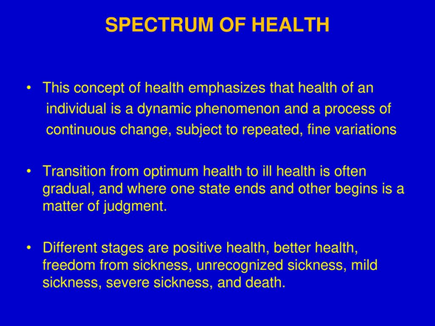

Slide 11
Spectrum Of Health
Positive Health
Better
Health
Freedom from Disease
Unrecognized Disease
Mild Disease
Severe
Disease
Death

Slide 12
Determinants of Health
They are factors which determine the health of an individual
Internal ( genetic make up ) & external ( environmental : biological, physical , social, health services….etc.)
The social determinants of health (SDOH) are defined by the World Health Organization as "the conditions in which people are born, grow, work, live, and age, and the wider set of forces and systems shaping the conditions of daily life".

Slide 13

Social determinants of health (SDOH)
SDOH can be grouped into 5 domains:
Economic stability
Education access and quality
Healthcare access and quality
Neighborhood and Built Environment
Social and community context

Slide 14
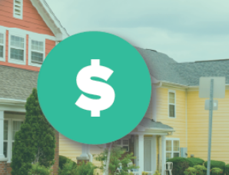

Economic Stability :
People with steady employment who earn steady incomes that allow them to meet their health needs ,are less likely to live in poverty and more likely to be healthy.
Education access and quality :
People with higher levels of education are more likely to be healthier and live longer.
Efforts to Increase educational opportunities and help children and adolescents do well in school should be done

Slide 15

Healthcare access and quality:
People without insurance are less likely to have a primary care provider, and they may not be able to afford the health care services and medications they need.
Strategies to increase insurance coverage rates are critical for making sure more people get important health care services, like preventive care and treatment for chronic illnesses and to increase access to comprehensive, high-quality health care services.

Slide 16
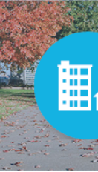
Neighbourhood and Built Environment:
Create neighbourhoods and environments that promote health and safety.
Many people in the United States live in neighbourhoods with high rates of violence, unsafe air or water, and other health and safety risks.
Racial/ethnic minorities and people with low incomes are more likely to live in places with these risks. In addition, some people are exposed to things at work that can harm their health, like second-hand smoke or loud noises.

Slide 17

Social and community context :
People’s relationships and interactions with family, friends, co-workers, and community members can have a major impact on their health and well-being.
social and community support must be increased
Healthy People 2030 focuses on helping people get the social support they need in the places where they live, work, learn, and play.

Slide 18
Health Care
It’s defined as multiple services rendered to individuals, families or communities by the agents of health services or professionals for the purpose of promoting, maintaining, monitoring or restoring health

Slide 19
Levels of Health Care
Tertiary health care
Secondary health care
Primary health care

Slide 20
Primary Health Care (PHC)
It’s the first level of contact between recipient of care and the health care delivery system.
Majority of the problems at this level are solved by the people with some guidance and assistance of health workers
Services like: Health education, preventive health services and referral to other levels of health care are provided.
Preventive services are the main responsibility of PHC sector
Examples: PHC Centre, CHC Centre, maternal &child health Centre , dispensaries.

Slide 21
Secondary Health Care
At this level of care, more complex problems are provided for those cases which can’t be handled at PHC sector.
The first level of referral where patients (cases) having various abnormalities are referred to.
It provides patients with curative health care facilities
Examples: district health centers

Slide 22
Tertiary Health Care
The second referral level that provides patients with more advanced curative health care facilities
For management of cases which can’t be handled at the secondary level
Could serve as a teaching institution for education and training of various categories of health professionals

Slide 23
Concept of PHC
It was introduced at the international level joint by WHO and UNICEF at the Alma Atta conference in 1978 to achieve the goal of Health For All (HFA) by the year 2000

Slide 24
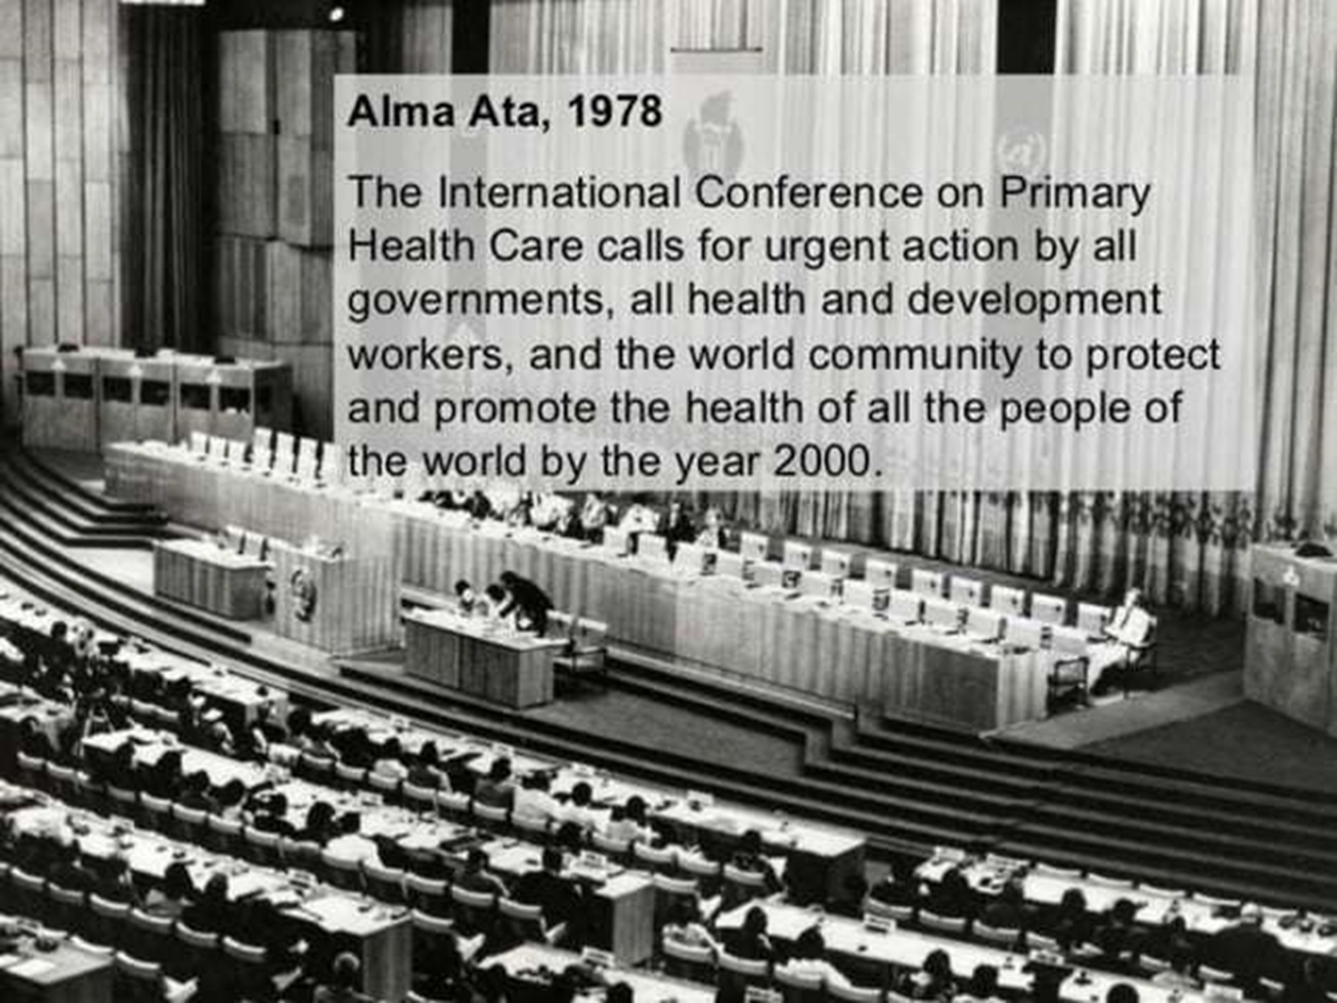

Slide 25
Alma Atta Declarations
Health is a fundamental human right and that the attainment of the highest possible level of health is a most important worldwide social goal.
The existing gross inequality in the health status of the people particularly between developed and developing countries is politically, socially and economically unacceptable.
The people have the right and duty to participate individually and collectively in the planning and implementation of their health care.

Slide 26
CONT’
Government have a responsibility for the health of their people which can be fulfilled only by the provision of adequate health and social measures.
All government should formulate national policies, strategies and plans of action to launch and sustain primary health care.
All countries should cooperate in a spirit of partnership and service to ensure PHC for all people. An acceptable level of health for all the people of the world by the year 2000 can be attained through a further and better use of the world’s resources

Slide 27

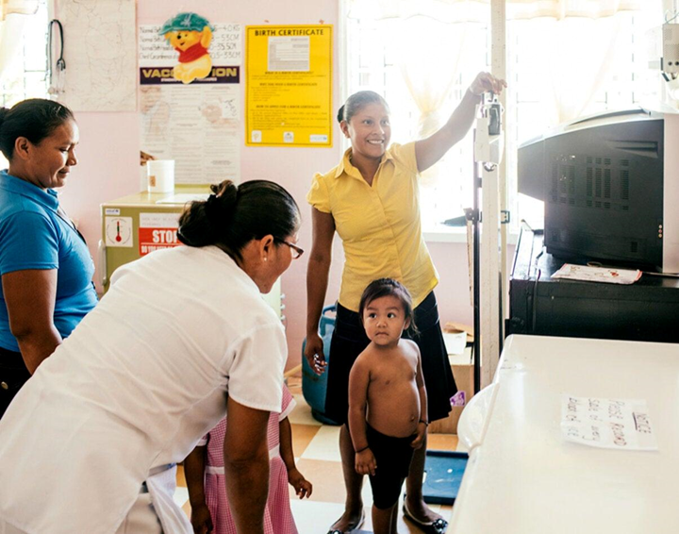

Slide 28
Thank you

