Slide 1
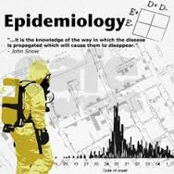

Introduction to Epidemiology
Dr. Sireen Alkhaldi, BDS, MPH, DrPH
Community Medicine, first semester 2025/ 2026
School of Medicine, The University of Jordan

Slide 2
Lecture Contents….
1. Epidemiology defined.
2. The components of epidemiology
3. 5W’s of epidemiology
4. Common steps of epidemiologic investigations.
5. Sources of data in epidemiology.

Slide 3
Definitions…
Epidemiology is a core science of public health.
It is the scientific method of disease investigation − Typically, it involves the disciplines of biostatistics and medicine.
Public health is The science & art of Preventing disease, prolonging life, and promoting health & efficiency through organized community effort (Winslow, 1920)

Slide 4
Definitions
Health: A state of complete physical, mental and social well-being and not merely the absence of disease or infirmity (WHO,1948)
Disease: A physiological or psychological dysfunction. (Literally, dis-ease, the opposite of ease, when something is wrong with a bodily function).
Illness: A subjective state of not being well (subjective state of a person who feels aware of not being well)
Sickness: A state of social dysfunction (i.e., a role that the individual assumes when ill).

Slide 5
Definitions
Epidemiology
The science of the mass phenomena of infectious diseases or the natural history of infectious diseases. (Frost 1927)
The science of infective diseases, their prime causes, propagation and prevention. (Stallbrass 1931.)

Slide 6
Definitions…
Epidemiology
“The study of the distribution and determinants of health-related states or events in specified populations, and the application of the study to the control of health problems”.
(J.M. Last 1988)

Slide 7
Epidemiology as a Science and a Method
Epi- demio- logy: The word itself comes from the Greek epi, demos, and Logos……
literally translated it means the study (logos) of what is upon or among (epi) the people (demos).
Epidemiology: the science of the study of epidemics

Slide 8
Objectives of Epidemiology
Investigate the etiology of disease and modes of transmission
Determine the extent of disease problems in the community
Study the natural history and prognosis of disease
Evaluate both existing and new preventive and therapeutic measures and modes of health care delivery
Provide a foundation for developing public policy and regulatory decisions

Slide 9
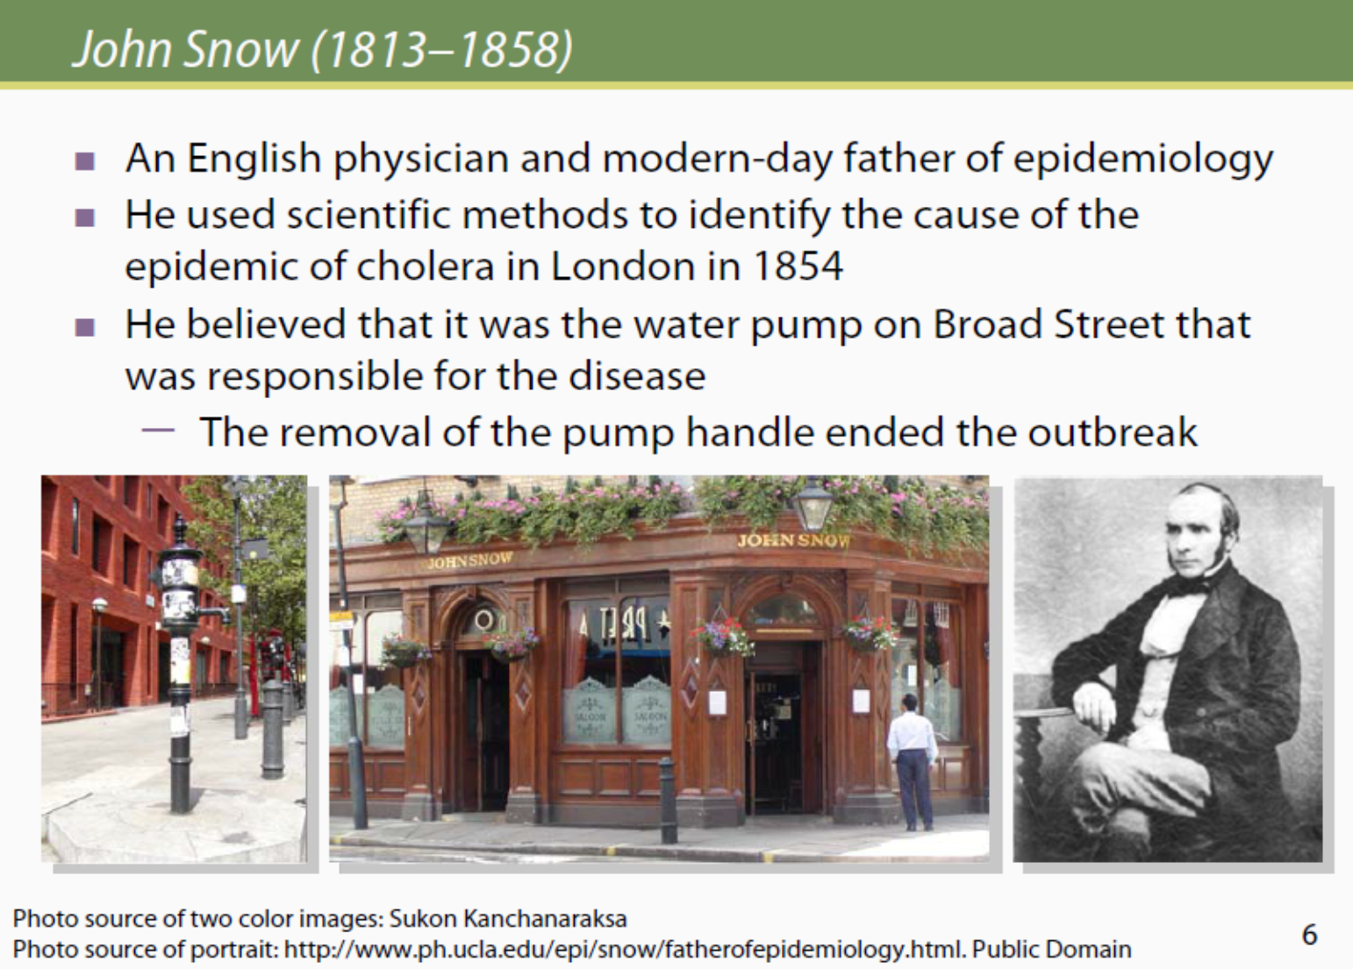

Slide 10
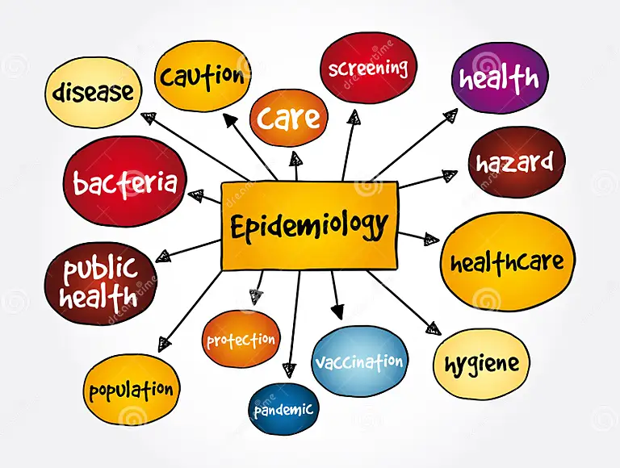
Components of the definition
Study: Systematic collection, analysis and interpretation of data
Epidemiology involves collection, analysis and interpretation of health related data
Epidemiology is a science.

Slide 11
Components of epidemiology
Distribution: Epidemiology is concerned with the frequency and pattern of health events in a population:
Frequency: A core characteristic of epidemiology is to measure the frequency (number of cases) of diseases, disability or death in a specified population.
It also refers to the relationship of that number to the size of the population.
This falls in the domain of biostatistics, which is a basic tool of epidemiology.

Slide 12
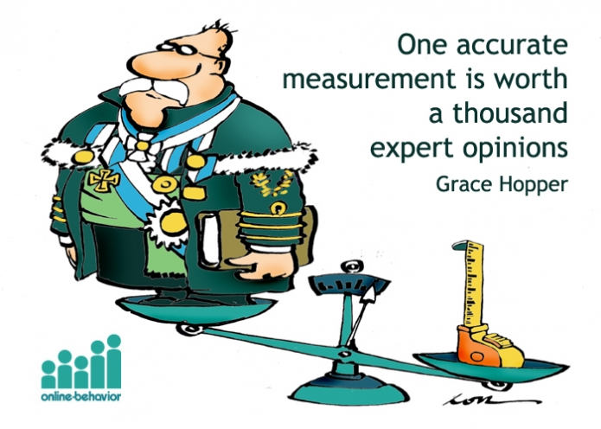
Components of epidemiology
Disease frequency:
E.g. Number of cases, Proportion (%), Prevalence, Incidence rates, Death rate etc.
These rates are essential for comparing the disease frequency in different populations or sub groups of the same population
(rate: number of cases occurring during a specific period; always dependent on the size of the population during that period).

Slide 13
EPIDEMIC CURVE
EXPOSURE
NUMBER OF CASES
TIME

Slide 14
Components of epidemiology
Distribution….. The study of the pattern of an event by person, place and time.
Epidemiology studies distribution of diseases among subgroups of the population, in different geographic areas, and also any increase or decrease over time.
It answers the question who, where and when? This is descriptive epidemiology.
An important outcome of this step is formulation of etiological hypothesis

Slide 15
PERSON DISTRIBUTION
In descriptive studies disease is further characterized by defining the persons who develop the disease by age, gender, ethnicity, occupation, marital status, habits, social class & other host factors.
These host factors help us to understand the natural history of disease.

Slide 16
PLACE DISTRIBUTION
Study of the geography of the disease (geographical pathology) is one of the important dimensions of epidemiology.
With the geographical pathology we learn the disease patterns according to geographical areas (e.g. international, national, or urban/rural differences).
These variations may be due to variations in population density, social class, deficiencies in health services, levels of sanitation, education & environmental factors.

Slide 17
TIME DISTRIBUTION
The pattern of a disease may be described by the time of occurrence
The occurrence of disease changes over time.
Some of these changes occur regularly, while others are unpredictable.
Two diseases that occur during the same season each year include influenza (winter) and West Nile virus infection (August– September).
In contrast, diseases such as hepatitis B and salmonella can occur at any time.
Day of the week or time of the day may be important.

Slide 18
TIME DISTRIBUTION
Epidemiologists have identified three kinds of time trends or fluctuations in disease occurrence:
Short term fluctuation: Single (one incubation period and one peak)(e.g. food poisoning)
or multiple or continuous exposure (well of contaminated water-cholera)
2. Periodic fluctuation:
Seasonal: GI infection in Summer
Cyclic: Human coronavirus every 7-10 years..antigenic variations. (e.g. SARS-CoV in 2003, MERS-CoV in 2012, SARS-CoV-2 (COVID-19) in 2019).
3. Long–term or Secular trend (e.g. CVD, lung cancer)

Slide 19
Components of the Definition of Epidemiology
Determinants:
Factors the presence/absence of which affect the occurrence and level of a health event (Risk Factor) (Causes).
Epidemiology studies what determines or influences health events:
It answers the question: how disease happens and why?
Epidemiology analyzes health events “analytical epidemiology”. Here we test a hypothesis to prove right or wrong.
Analytical strategies help in developing scientifically sound health programes, interventions & policies.

Slide 20
The Five Ws of Epidemiologic Studies

Slide 21
Components…
Health-related states and events
Epidemiology is not only the study of diseases.
It studies Health, Disease and Injury.
The focus of Epidemiology is not only peoples’ health as individuals, but anything in the environment that may affect their health and well-being in any way.
It studies all health related conditions
Epidemiology is a broad science

Slide 22
Components…
Specified population
Epidemiology diagnoses and prevents disease in communities/ populations
The unit of study is a population (groups of people)
Clinical medicine diagnoses and treats patients after they get sick and go seek physician’s help.
Epidemiology is a basic science of public health.

Slide 23
Components…
Application
Epidemiological studies have direct and practical applications for prevention of diseases & promotion of health
Epidemiology is a science and practice
Epidemiology is an applied science
Epidemiology provides data essential to the planning, implementation & evaluation of services for the prevention, control & treatment of disease.

Slide 25
Common Steps in the Epidemiologic Approach
The steps in the epidemiologic approach to study a problem of disease etiology are:
– Perform an initial observation to confirm the epidemic (outbreak)
– Define the disease (or health problem)
– Describe the disease by time, place, and person
– Create a hypothesis as to the possible etiologic factors
– Conduct analytic studies
– Summarize the findings
– Recommend and communicate the interventions or
preventative programs
Notes:
judgment: causal-effect association (causal inference) magniude of the association, the consistency of findings, and biologic credibility
25

Slide 26
Epidemiology
In Epidemiology, we ask the following questions related to the health action:
What can be done to reduce this health problem and/ or its consequences?
How can it be prevented in future?
What action should be taken by the community? By whom should these activities be carried out?

Slide 27
Sources of information (data) in Epidemiology
Registration of births, deaths and diseases
Population censuses
Routine health information systems
Surveillance
Investigation of epidemics
Sample surveys
Notes:
27

