Slide 1
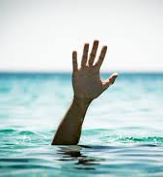
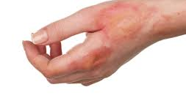
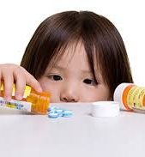
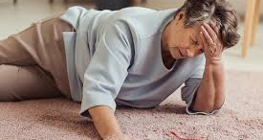
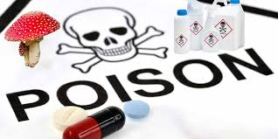
INJURIES

Slide 2
What is an Injury?¹
Injury: "The result of an act that damages, harms, or hurts; unintentional or intentional damage to the body resulting from acute exposure to thermal, mechanical, electrical, or chemical energy or from the absence of such essentials as heat or oxygen."
Unintentional Injuries: Subset where there is no evidence of predetermined intent.
Intentional Injuries: Self-harm, Interpersonal violence, Conflict & terrorism
Notes:
1. Global Health 101, Fourth Edition; Richard Skolnik

Slide 3
Key Definitions
Largest causes of unintentional injuries globally:
Road injury
Poisonings
Falls
Fires
Drowning
Notes:
Global Health 101, Fourth Edition; Richard Skolnik

Slide 4
Global Burden of Injuries 2019
  Injuries – due to both unintentional causes and violence – took the lives of 4.4 million people around the world in 2019 and constitute 8% of all deaths.
  For people age 5–29 years, 3 of the top 5 causes of death are injury-related, namely road traffic injuries, homicide and suicide.
  Tens of millions of people suffer non-fatal injuries each year which lead to emergency department and acute care visits, hospitalizations, and treatment by general practitioners and can often result in temporary or permanent disability and the need for long-term physical and mental health care and rehabilitation.
Notes:
https://iris.who.int/server/api/core/bitstreams/61d409eb-68c6-4e20-8d5b-a1ce82819b83/content

Slide 5
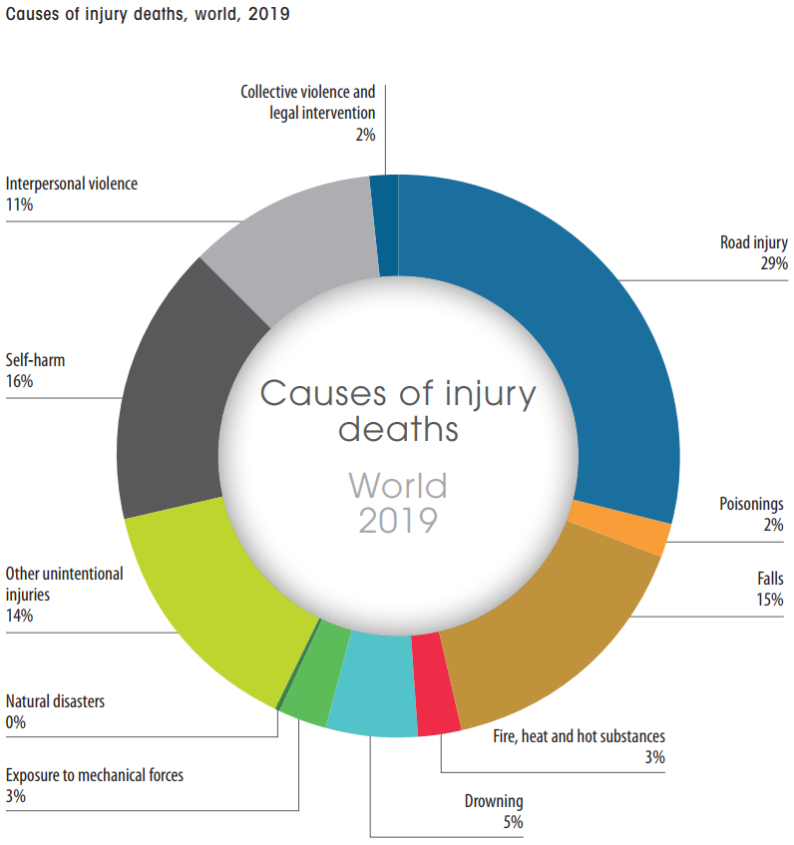
Causes of injury deaths, world, 2019
Notes:
https://iris.who.int/server/api/core/bitstreams/61d409eb-68c6-4e20-8d5b-a1ce82819b83/content

Slide 6
Global Burden of Injuries 2019
Injuries and violence place a massive burden on national economies, costing countries billions of US dollars each year in health care, lost productivity and law enforcement.
Injuries and violence are not evenly distributed across or within countries – some people are more vulnerable than others depending on the conditions in which they are born, grow, work, live and age; in general, being young, male and of low socioeconomic status all increase the risk of injury
Notes:
https://iris.who.int/server/api/core/bitstreams/61d409eb-68c6-4e20-8d5b-a1ce82819b83/content

Slide 7
Global Burden of Injuries 2019
Providing high-quality support and care services to victims of injuries and violence can prevent fatalities, reduce the amount of short-term and long-term disability, and help those who are affected cope with the impacts of the injury or violence on their lives.
Preventing injuries and violence will facilitate achievement of several Sustainable Development Goal targets
Notes:
https://iris.who.int/server/api/core/bitstreams/61d409eb-68c6-4e20-8d5b-a1ce82819b83/content

Slide 8
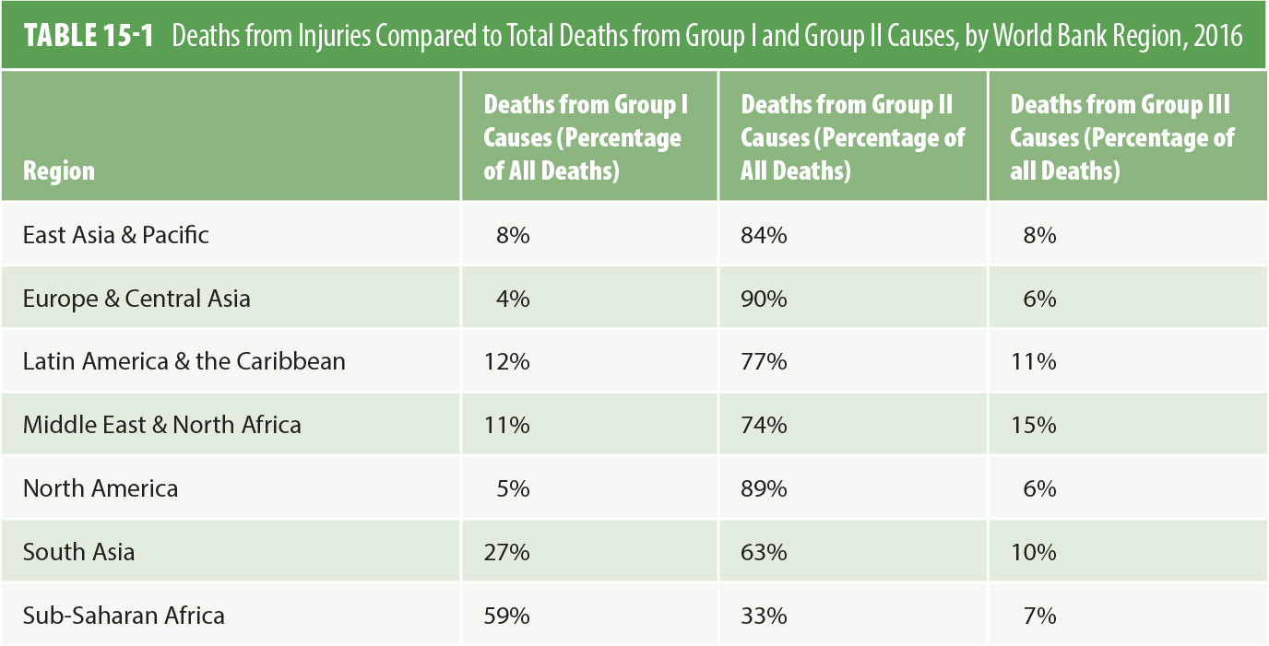
The Burden of Injuries is Not Equal: Variation by Region
Note: group I communicable, maternal, neonatal and nutritional disorder; Group II= Non communicable diseases: Group III= Injuries
Notes:
Global Health 101, Fourth Edition; Richard Skolnik

Slide 9
The Burden of Injuries is Not Equal: Variation by Region
The share of deaths from injuries (Group III) varies significantly.
Highest Burden: Middle East & North Africa (15% of all deaths are from injuries).
Lowest Burden: Europe & Central Asia & North America (6%).

Slide 10
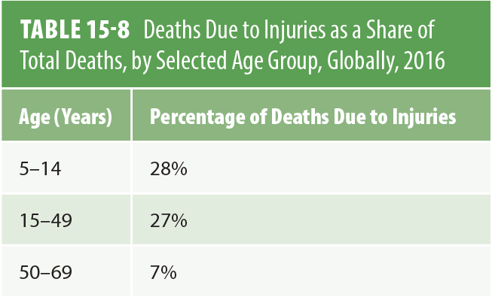
Who is Most Affected? The Critical Dimension of Age
Notes:
Global Health 101, Fourth Edition; Richard Skolnik

Slide 11
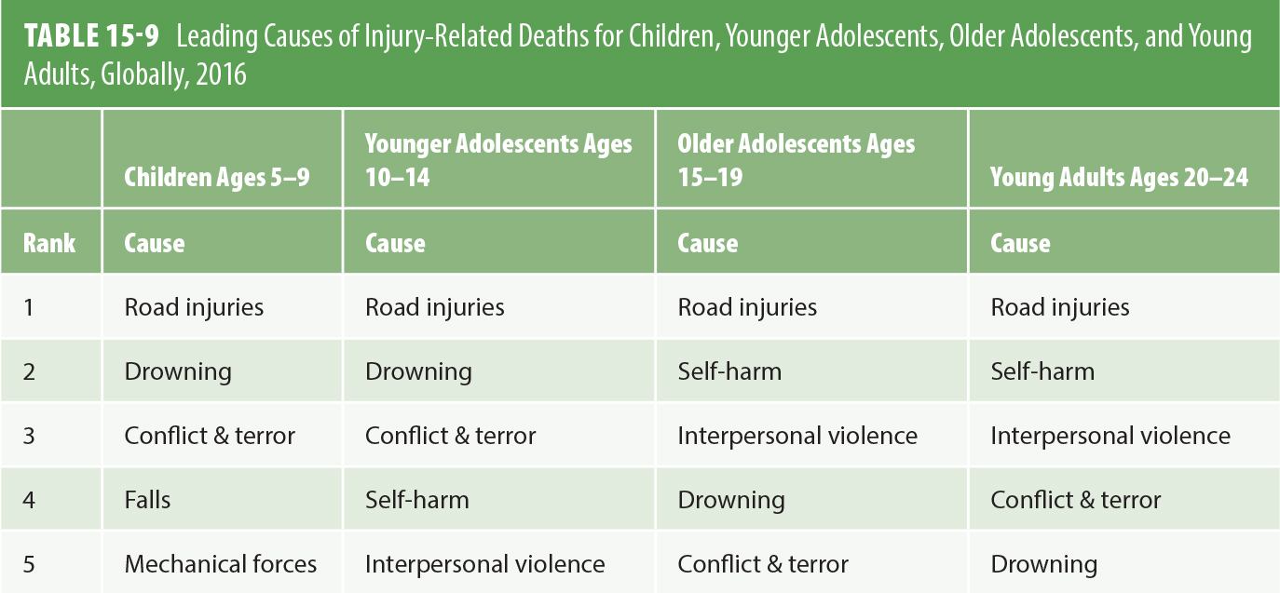
Child, Adolescent, and
Young Adult Injury
  Road Injuries are the #1 cause across all young age groups (5-24 years).
  Drowning is a major threat to younger children (5-14 years).
  Self-harm and Interpersonal Violence emerge as critical causes for older adolescents and young adults (15-24 years).
Notes:
Global Health 101, Fourth Edition; Richard Skolnik

Slide 12
Who is Most Affected? The Critical Dimension of Sex
Males die from injuries at significantly higher rates than females across all country income groups.
Males are about three times more likely to die from road injuries than females.
Exception: In some lower-middle-income countries, more females die from fires and burns than males, often linked to domestic cooking responsibilities and "dowry deaths."

Slide 13
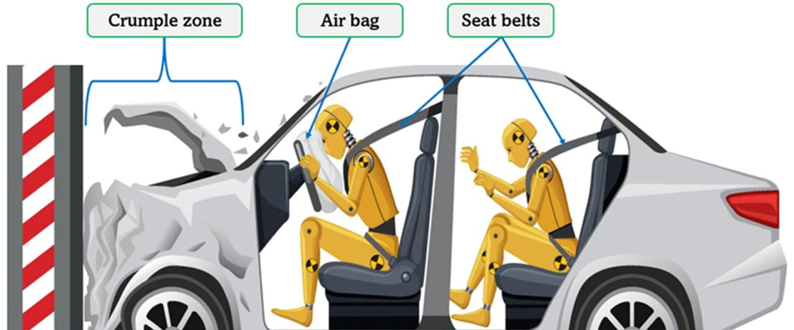
Road traffic injuries

Slide 14
Risk Factors for Road Traffic Injuries (LMICs)
Rapid Motorization: Increase in vehicles without supporting infrastructure.
Unsafe Vehicle Fleet: Prevalence of unsafe 2/3-wheelers; lack of safety features (airbags, crumple zones).
Poor Road Infrastructure: Lack of planning, engineering, signage, pedestrian lanes, and traffic management.
Weak Enforcement: Lack of enforcement of speed limits, drunk driving laws, and helmet/seatbelt use.
Unsafe Road User Behavior: Low use of helmets, seatbelts, and child restraints

Slide 15
PTW and bicycle riders are not surrounded by protective steel enclosures; they are susceptible to serious injuries which can lead to death in the event of crashes with other vehicles and fixed objects.
The increased risk is also because they often share traffic space with fast-moving cars, buses and trucks, and they are less visible.
Powered two wheelers ( PTWs) are motor-operated two- or three-wheeled vehicles, powered by either a combustion engine or rechargeable batteries

Slide 16
The Burden of Road Traffic Injuries in Jordan; JUNE 2024 (don’t memorize)
Road Traffic Injuries (RTIs) represent a significant public health burden in Jordan. According to the 2022 Annual Report:
A total of 169,409 crashes occurred.
11,510 of these resulted in injuries, leading to 562 deaths, 805 severe injuries, 6,739 moderate injuries, and 9,552 mild injuries.
Mortality due to RTIs has increased by 1.9 percent over the past five years.
RTIs are the leading cause of death for children (5–14) and young people (15–19) and the second-leading cause for adults aged 20–64.
Notes:
THE BURDEN OF ROAD TRAFFIC INJURIES IN JORDAN: EVIDENCE FOR POLICY; https://www.globalroadsafetyfacility.org/sites/default/files/2024-08/Burden%20of%20Road%20Traffic%20Injuries%20in%20Jordan_0.pdf

Slide 17
The Burden of Road Traffic Injuries in Jordan; JUNE 2024
Demographics
Most patients were male (79%).
The average age was 34 years
Crash Characteristics
Most crashes occurred during early morning hours and at night.
They primarily took place on main roads.
A critical finding was that most patients were not using any safety equipment (seatbelts or helmets).

Slide 18
The Burden of Road Traffic Injuries in Jordan; JUNE 2024 (don’t memorize)
Disability Outcomes
One month after injury, 79% of patients experienced some form of disability:
  3% Extreme disability
  21% Severe disability
  35% Moderate disability
  21% Mild disability
Significant improvement was seen by the third month, with 73% reporting no disability. However, 26% still experienced mild disability.

Slide 19
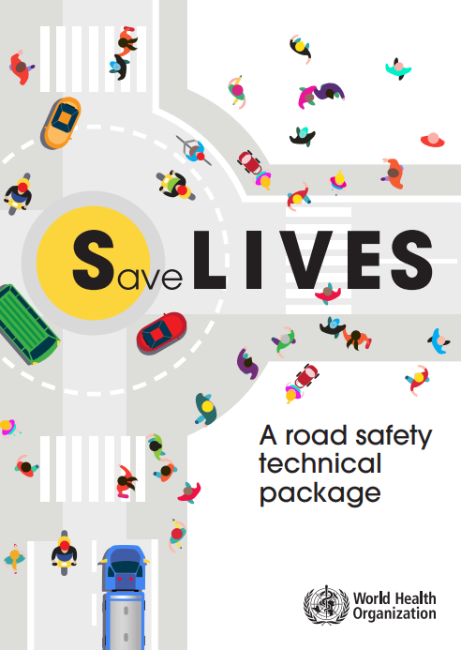
The Save LIVES technical package has been developed to support road safety decision-makers and practitioners in their efforts to significantly reduce the number of road traffic deaths in their countries.
Save LIVES provides an evidence-based inventory of priority interventions to be implemented towards achieving the SDG targets.
The core components of Save LIVES are Speed management, Leadership on road safety, Infrastructure design and improvement, Vehicle safety standards, Enforcement of traffic laws and Survival after a crash.
These components are interrelated and need to be implemented in an integrated manner.
Notes:
https://iris.who.int/server/api/core/bitstreams/7a2adf80-ea62-4aa6-98a3-fb84d9de8d7f/content

Slide 20
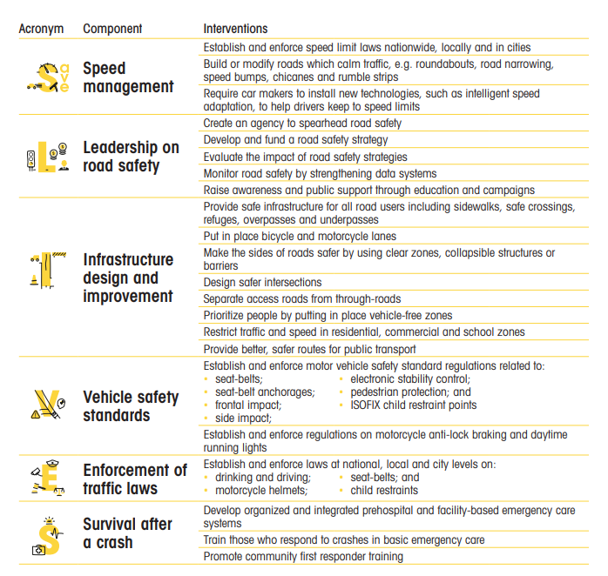
Notes:
https://iris.who.int/server/api/core/bitstreams/7a2adf80-ea62-4aa6-98a3-fb84d9de8d7f/content

Slide 21
Drowning
Is defined as the process of experiencing respiratory impairment from submersion or immersion in liquid, with outcomes ranging from death to morbidity.
Risk Factors
Age: Young children (0-4 years) are at the highest risk due to underdeveloped risk assessment and lack of swimming skills.
Sex: Males are more than twice as likely to die from drowning as females, due to greater exposure to water and riskier behaviors (e.g., swimming alone, alcohol use).
Poverty and Inequality: Marginalized populations face higher exposure through daily activities like collecting water from open wells or bathing in unsafe natural bodies of water.
Migration and Displacement:
  People fleeing conflict or climate impacts often resort to dangerous, irregular water routes on unsafe vessels.

Slide 22
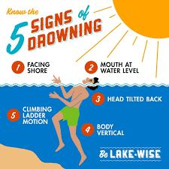
Signs of drowning
Glassy or Empty Eyes: A drowning person may have glassy, unfocused, or empty eyes.
Hyperventilation or Gasping: Rapid or labored breathing is common as the person struggles to get air.
Vertical Position: Drowning individuals often remain vertical in the water and might not use their legs to kick.
Unresponsiveness: If you call out to someone and they do not respond, they could be in trouble.
Quiet Struggle: Most drowning incidents are silent.

Slide 23
BURNS
A burn is an injury to the skin or other organic tissue caused by heat (thermal burns from hot liquids, solids, or flames) or other sources like radiation, electricity, friction, or chemicals.
Global Burden: Burns cause an estimated 180,000 deaths annually, with the vast majority occurring in low- and middle-income countries (LMICs).
Morbidity: Prolonged hospitalization, Disfigurement and permanent disability, Stigma and social rejection
Economic Burden: Burn treatment is very expensive.
Who is at Risk?
Females: Unlike most injuries, burn death rates are slightly higher in females. This is linked to: Open fire cooking and unsafe cookstoves igniting loose clothing.
Children: Risks include inadequate adult supervision and child maltreatment.
Socioeconomic Status: Risk is highest in LMICs and, within all countries, correlates with poverty.

Slide 24
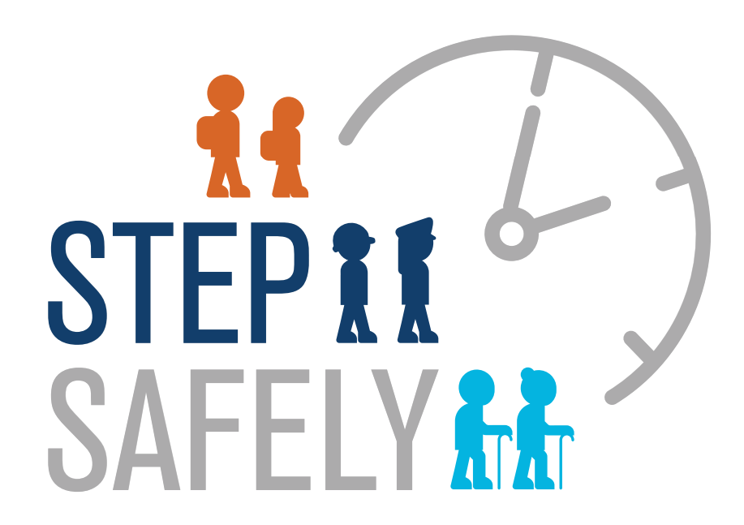
FALLS
Is defined as an event which results in a person coming to rest accidentally on the ground, floor, or a lower level.
Global Burden: Falls are a major public health problem and the second leading cause of unintentional injury death worldwide after road traffic injuries.
Mortality: An estimated 684,000 fatal falls occur each year. Majority in LMICs.
Morbidity (Non-Fatal Impact): Approximately 37.3 million falls each year are severe enough to require medical attention.

Slide 25
Key Risk Factors for Falls
Individual Characteristics: Age, gender, physical and cognitive capacity, developmental stage, socioeconomic status, and culture.
Environmental Hazards: trip hazards in homes, high-rise dwellings without window guards, unsafe steps, stairs and inappropriate ladder use.
Policy Gaps: Lack of occupational health and safety legislation, or laws requiring safety features like window guards.
Populations Most at Risk:
Older People (aged 60+): Highest risk of death or serious injury. Risk increases with age.
Children and Adolescents: Infants have high fall morbidity rates.
Workers in High-Risk Occupations: Certain jobs predispose workers to fall-related injury (e.g., construction).

Slide 26
Poisoning
A serious condition that results from swallowing, inhaling, injecting or absorbing a harmful substance into the body.
Poisoning is a significant global public health problem.
Effects of poisoning range from short-term illness to brain damage, coma and even death.
Poisonous substances can be found in and around your home, work and public places.

Slide 27
Poisoning in Young Children
Medication is the leading cause of poisoning in children.
Button batteries
Household cleaners (detergent pods, bleach)
Personal hygiene products
Poisoning in Teenagers and Adults
Alcohol
Antidepressants
Poisoning in Older Adults
Prescribed or over-the-counter medications or Consuming the wrong medication or incorrect dose
Alcohol

Slide 28
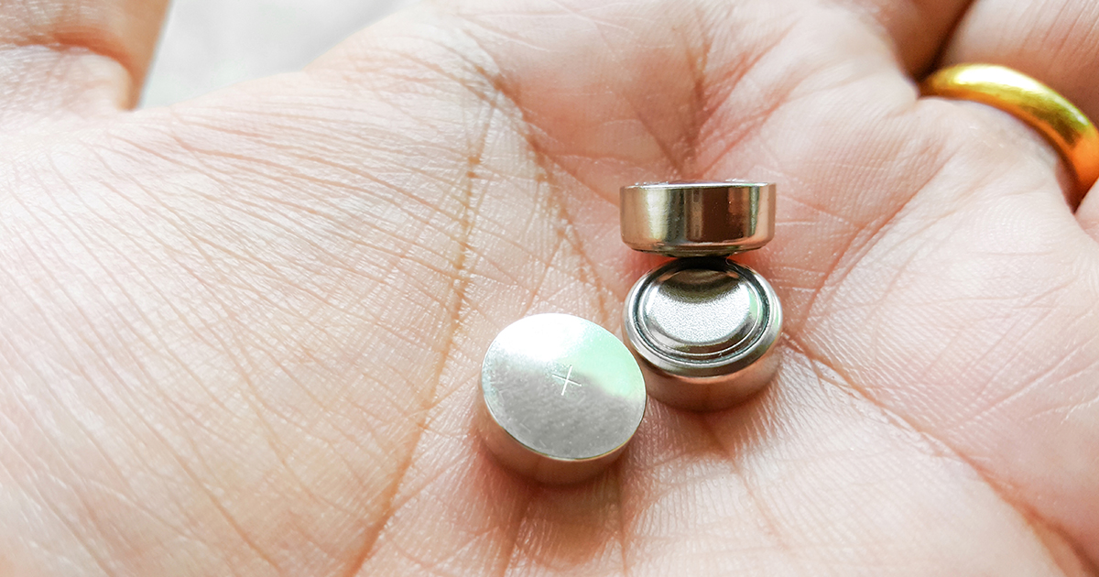
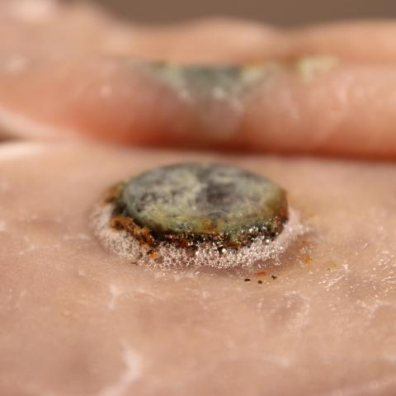
Button Battery (A Critical Emergency):
Disk (button) battery ingestion is a common and potentially serious problem, primarily affecting young children under six. While most cases are benign, severe and fatal complications (like Esophageal or intestinal perforation) have increased nearly seven-fold in the last decade, largely due to the use of more powerful, larger lithium batteries.
Key Risk Factors:
Age: Peak incidence in children 1-3 years old; a second peak in the elderly.
Battery Type: Larger batteries (>20mm) and lithium batteries (due to higher capacitance) pose a greater risk.
Location: Lodgment in the esophagus is the most dangerous site.
Time: Tissue damage can begin in as little as 2 hours after lodgment.
Pathophysiology: The primary mechanism of injury is electrical discharge, causing electrolysis and liquefactive necrosis. The battery creates an electrical current in the moist GI tract environment, leading to rapid tissue damage.
Notes:
https://www.ncbi.nlm.nih.gov/books/NBK470298/

Slide 29
The Devastating Costs of Injuries
Economic Costs:
  Direct: Medical care, hospitalization, rehabilitation.
  Indirect: Lost wages, disability payments, insurance costs.
  Road traffic injuries alone cost an estimated 1-2% of GDP in LMICs
Social & Psychological Costs:
  Long-term physical disability, chronic pain, and mental health issues.

