Slide 1
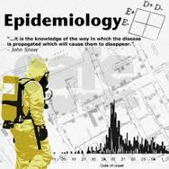

Historical Evolution of Epidemiology
Dr. Sireen Alkhaldi, BDS, MPH, DrPH
Community Medicine, first semester 2025/ 2026
School of Medicine, The University of Jordan

Slide 2
History of Epidemiology
Seven land marks in the history of Epidemiology:
Hippocrates (460BC): In his essay entitled “On Airs, Waters, and Places,”: Environment & human behaviors affect health. Used rational approach instead of supernatural viewpoint.
John Graunt (1662): Quantified births, deaths and diseases (Statistician, founder of demography in London).
James Lind (1747): Scottish naval doctor, treated scurvy among sailors with fresh fruit (lemons)…first Clinical trial in history (Findings officially adopted by the navy in 1795).
Sir Percival Pott (1775): observed chimney sweeps had high incidence of scrotal cancer (due to contact with soot). He recommended that chimney sweeps bathe once a week.

Slide 3
History…
4) William Farr (1839): Established application of vital statistics to evaluate health problems…Founder of medical statistics.
5) John Snow (1854): tested a hypothesis on the origin of an epidemic of cholera in London.
Alexander Louis (1872): French physician, Systematized application of numerical thinking (quantitative reasoning and clinical trials).
Sir Bradford Hill (1965): Suggested criteria for establishing causation.
Epidemiology flourished as a scientific discipline in 1940s

Slide 4
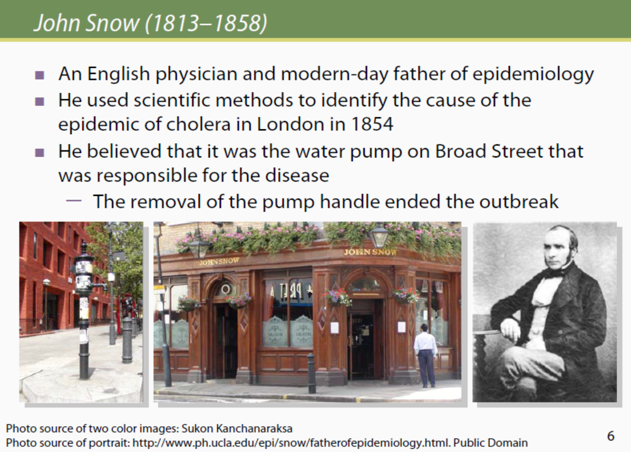

Slide 5
Cholera Outbreak in London, 1854
John Snow conducted a series of investigations in London. Snow conducted his classical study in 1854 when an epidemic of cholera developed in the golden square of London.
During the time of microscope development, snow conducted studies of cholera outbreak both to discover the cause of cholera and how to prevent its recurrences.
During that time Farr and Snow had major disagreement about the cause of cholera. Farr adhered to what was called the miasmatic theory of diseases, according to this theory, which was commonly held at that time, diseases were transmitted by a miasma or a cloud with bad smell that clung low on the earth surface.

Slide 6
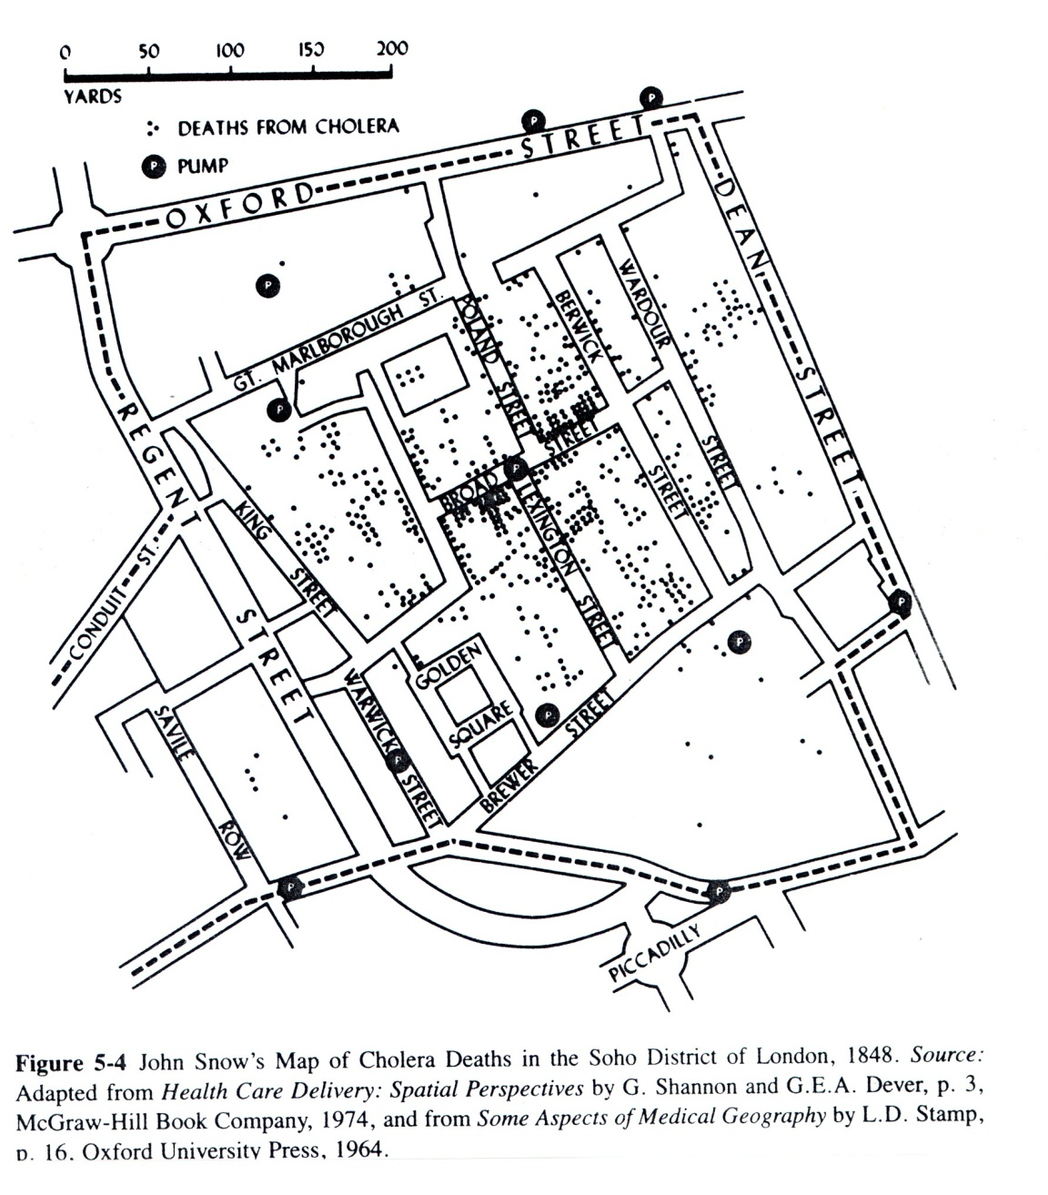

Slide 7
Cholera Outbreak in London, 1854
However, Snow did not agree, he believed that cholera is transmitted through contaminated water. He began his investigation by determining where in this area in London persons with cholera lived and worked. He then used this information to map for distribution of diseases.
Snow believed that water was the source of infection for cholera. He marked the location and searched the relationship between cases and water sources (water pumps).
He found most cases clustered around the Broad Street pump.
So, he decided to break the pump handle, which stopped the outbreak.
He found that cholera was transmitted through contaminated water. This was a major achievement in epidemiology.

Slide 8
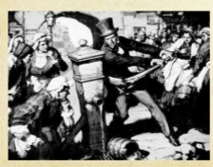
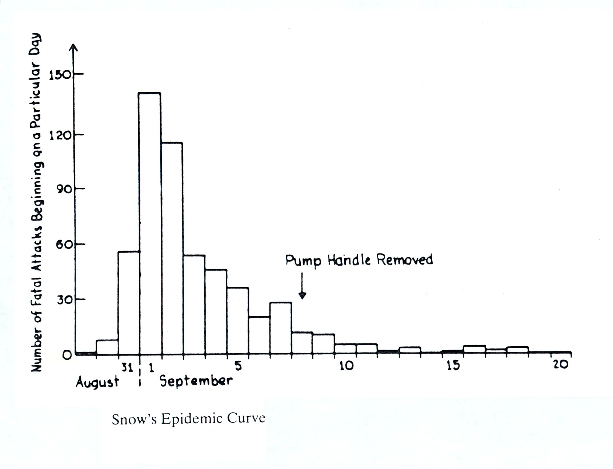

Slide 9
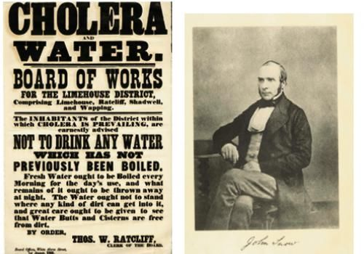
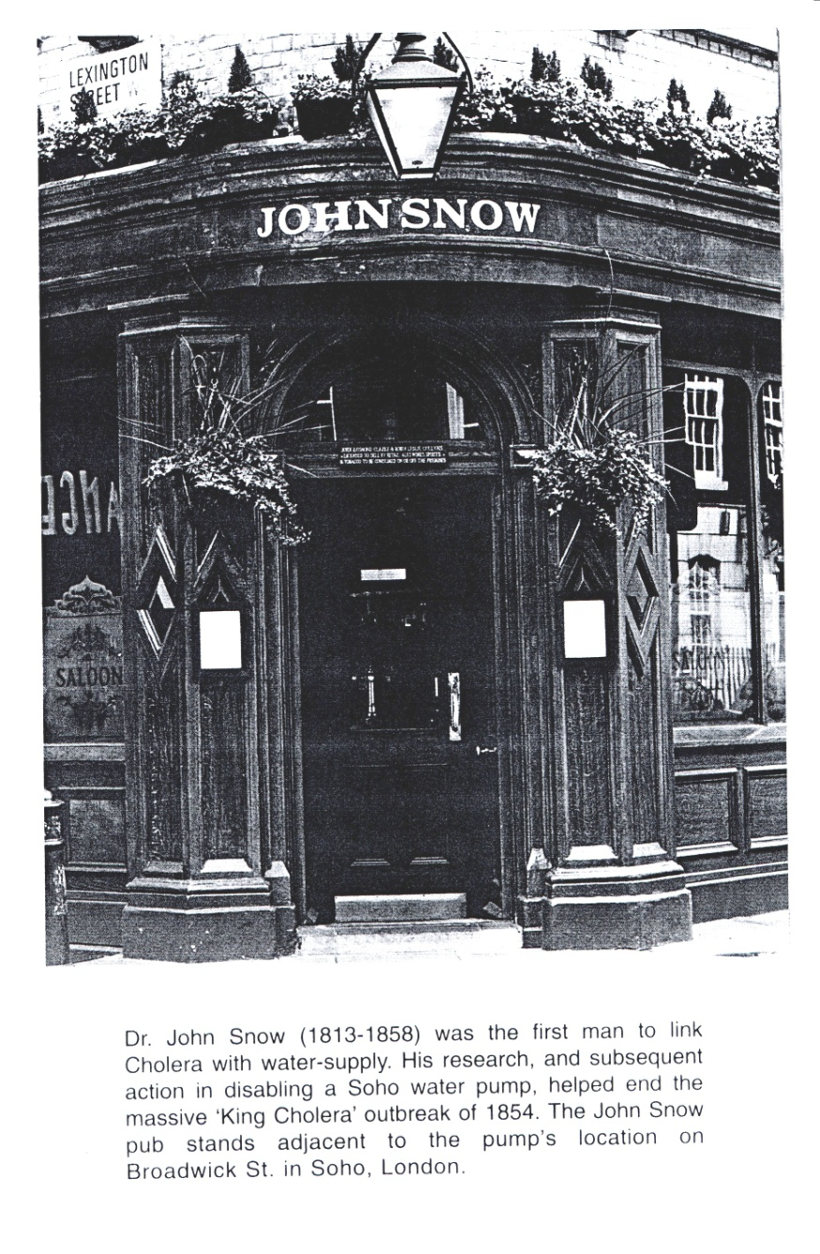

Slide 10
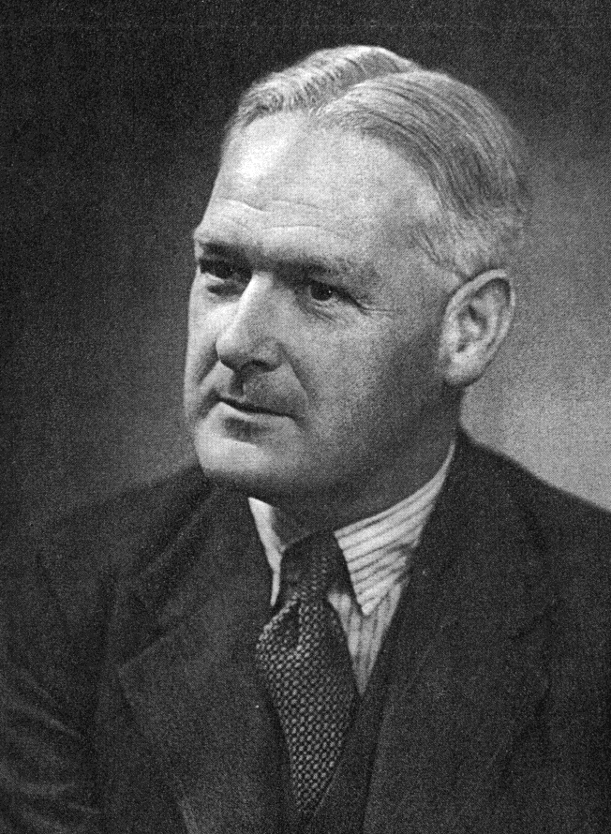
Sir Austin Bradford Hill, 1965
In what circumstances can we pass from [an] observed association to a verdict of causation? Upon what basis should we proceed to do so?

Slide 11
Guidelines for judging whether an association is causal
Hill’s Criteria: Nine criteria useful in establishing epidemiologic evidence of a causal relationship between a presumed cause and an effect:
  Temporality: cause precedes effect.
  Strength of association: large relative risk.
  Consistency: repeatedly observed by different persons, in different places, circumstances, and times.

Slide 12
Guidelines for judging whether an association is causal
  Biological gradient (dose response): larger exposures to cause associated with higher rates of disease. And reduction in exposure is followed by lower rates of disease (reversibility).
  Biological plausibility: makes sense, according to biologic knowledge of the time.
  Experimental evidence.
  Other criteria: Analogy (cause & effect relationship already established for a similar exposure or disease).
  Specificity (one cause lead to one effect) and
  Coherence (not seriously conflict with the generally known facts of the natural history and biology of the disease).

Slide 13
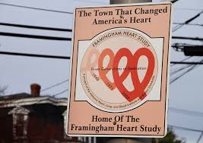
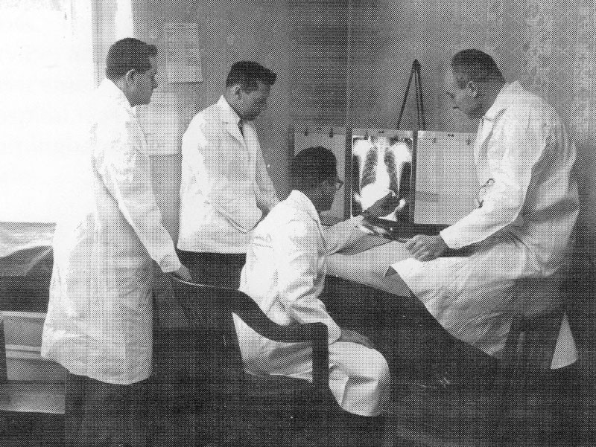

Framingham Study,
Started 1948
What is the Framingham study?
Where did it start?
What was the disease studied?
What are the most important findings?
How many people participated?
When did it end?

Slide 14
Doll and Hill study, 1950
Richard Doll and Bradford Hill:
One of the first large scale epidemiological studies to establish a link between smoking and lung cancer.
(British Doctors’ study in 1951): provided conclusive evidence that led to changing public perception and government policy regarding smoking.

Slide 15
London Smog Disaster, 1952
Air pollution causes respiratory illnesses and death.
When fog and soot from coal burning created a dense smog in Winter, 1952, in London, the smog was around for five days from December 5–10.
There was a substantial increase in mortality
The death rate in London in the previous week was around 2,062
In the week of the smog, 4,703 died

Slide 16
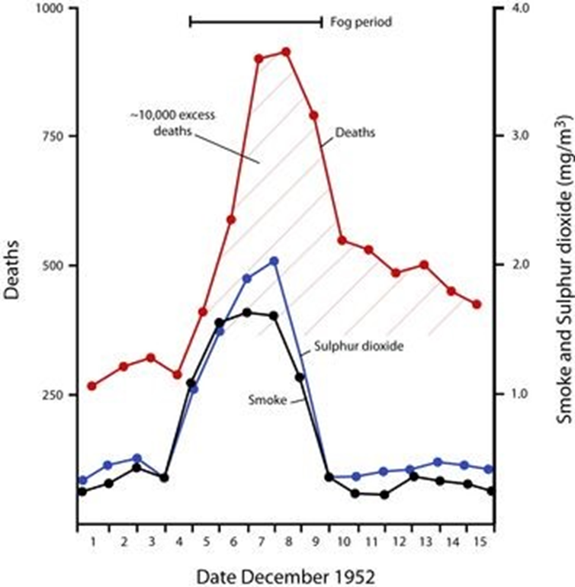

Slide 17
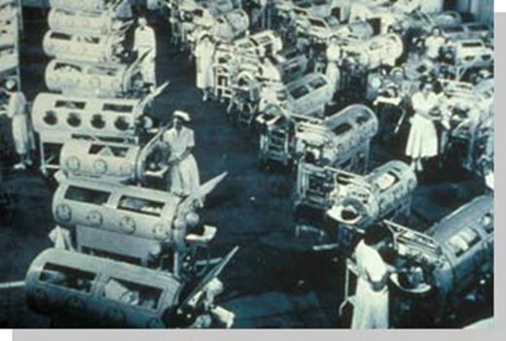
Epidemiology and Polio Vaccine
In April, 1955, Dr. Thomas Francis,
director of Poliomyelitis Vaccine
Evaluation Center at the University
of Michigan, announced that the
two-year field trial of the Salk vaccine
against polio was up to 90% effective
“The results announced by Francis effectively marked the beginning of the end of polio as the most life-threatening and debilitating public health threat to the children of the United States“.

Slide 18
Breast cancer screening (Swedish two country trial)
Screening with mammography was started in 1977 in the counties of Kopparberg and Ostergotland.
The results at 29-year follow-up: A substantial and significant reduction in breast cancer mortality was associated with an invitation to screening (31% lower mortality rate in women diagnosed via mammography).
At 29 years of follow-up, the number of women needed to undergo screening for 7 years to prevent one breast cancer death was 414
Notes:
The Swedish two county trial of mammographic screening for breast cancer: recent results and calculation of benefit.
L Tabar, G Fagerberg, S W Duffy, and N E Day
J Epidemiol Community Health. 1989 June; 43(2): 107–114.

Slide 19
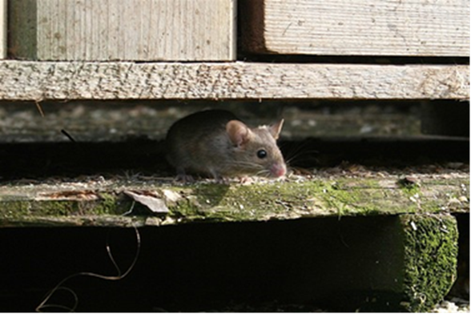
Mysterious virus in the Four Corners Region of US
An outbreak of sudden respiratory illness occurred in the Four Corners region of the southwestern U.S. in 1993
• In similar outbreaks in 1918 and 1936, there was an increase in the number of mice in the region due to the abundance of pi-on nuts (from pine trees), (food for rodents) brought on by increased rainfall
• Epidemiologic study confirmed the connection between rodents and households with sick occupants

Slide 20

Mysterious virus in the Four Corners Region of US
Hanta virus was discovered in rodents that excreted the virus in their feces and urine
• People inhaled the dust particles that contained the virus and became ill
(hantavirus pulmonary syndrome)
• To prevent the spread of the virus:
– Mice-proof the home
– Wear a mask while sweeping in the home
– Wash the floor with an antiseptic solution

Slide 21
Legionnaire’s disease outbreak
Members of the American Legion gathered for the annual American Legion Convention held July 21 through 24, 1976, in Philadelphia.
Soon after the convention began, a substantial number of attendees were admitted to hospital emergency departments or were examined in doctors’ offices with acute onset of fever, chills, headache, malaise, dry cough, and muscle pain.
More troublesome is that during July 26 to August 1, a total of 18 conventioneers died, reportedly from pneumonia.
On the morning of August 2, a nurse at a veterans’ hospital in Philadelphia called CDC to report cases of severe respiratory illness among convention attendees.
Subsequent conversations that day with public health officials uncovered an additional 71 cases among persons who had attended the convention.
The goal was to find out why these conventioneers were becoming ill and, in some cases, dying!!!

Slide 22
Legionnaire’s disease outbreak
American Legion Convention,
Philadelphia, Pennsylvania
Health care provider at a veterans’ hospital in Philadelphia calls CDC to report cases
of severe respiratory illness among attendees of the American Legion Convention
July 21–24
August 2
(Morning)
August 2
(Evening)
July 26–Aug 1
18 deaths reported among conventioneers
71 additional cases reported
Fraser DW, Tsai, T, Orenstein W, et al. Legionnaires’ disease: description of an epidemic of pneumonia. New Engl J Med 1977;297:1189–97.
22
Notes:
SAY:
Let’s look at an example of how the rates were calculated in an actual case of unexplained pneumonia.
<CLICK for timeline animation to begin.>
SAY:
Members of the American Legion gathered for the annual American Legion Convention held July 21 through 24, 1976, in Philadelphia.
Soon after the convention began, a substantial number of attendees were admitted to hospital emergency departments or were examined in doctors’ offices with acute onset of fever, chills, headache, malaise, dry cough, and muscle pain.
<CLICK for timeline animation to continue.>
SAY:
More troublesome is that during July 26 to August 1, a total of 18 conventioneers died, reportedly from pneumonia.
<CLICK for timeline animation to continue.>
SAY:
On the morning of August 2, a nurse at a veterans’ hospital in Philadelphia called CDC to report cases of severe respiratory illness among convention attendees.
<CLICK for timeline animation to continue.>
SAY:
Subsequent conversations that day with public health officials uncovered an additional 71 cases among persons who had attended the convention.
The goal was to find out why these conventioneers were becoming ill and, in some cases, dying.
GO to next slide.

Slide 23
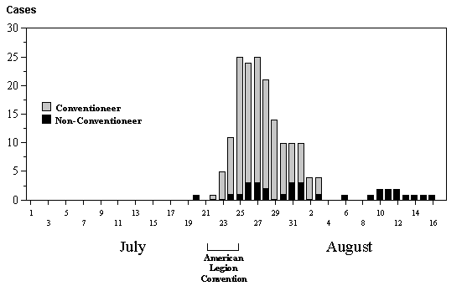
Legionnaires’ Disease Cases, by Day
23
Fraser DW, Tsai, T, Orenstein W, et al. Legionnaires’ disease: description of an epidemic of pneumonia. New Engl J Med 1977;297:1189–97.
Notes:
SAY:
This graph indicates the number of Legionnaires’ disease cases by day in July and August 1976. Remember these are the number of cases, not the disease rate.
<CLICK for arrow to appear.>
The arrow indicates that the number of cases peaks from July 25 to July 27, and the number declines thereafter.
We can infer that the number of cases started soon after the convention began. By the end of the convention, the number of cases had reached its peak.
However, this descriptive analysis only tells us what can be read directly from the graph and data. Analytic processes take us one step further to a hypothesis and assessment of the causes for the trend identified by the descriptive analysis.
GO to next slide.

Slide 24
Legionnaires’ Disease Attack Rates by Place
Hotel A
Hotel B
Hotel C
Age (yrs) |  | Ill | Total | Percent ill |  | Ill | Total | Percent ill |  | Ill | Total | Percent ill
≤39 |  | 3 | 44 | 6.8 |  | 3 | 116 | 2.6 |  | 6 | 160 | 3.7
40–49 |  | 9 | 160 | 5.6 |  | 11 | 232 | 4.7 |  | 20 | 392 | 5.1
50–59 |  | 27 | 320 | 8.4 |  | 25 | 523 | 4.8 |  | 52 | 843 | 6.2
60–69 |  | 12 | 108 | 11.1 |  | 19 | 207 | 9.1 |  | 31 | 315 | 9.8
≥70 |  | 11 | 54 | 20.4 |  | 5 | 76 | 6.5 |  | 16 | 130 | 12.3
Unknown |  | 0 | 2 | 0 |  | 0 | 7 | 0 |  | 0 | 9 | 0
Total |  | 62 | 688 | 9.0 |  | 63 | 1,161 | 5.4 |  | 125 | 1,849 | 6.8
Those who stayed in Hotel A have the highest percentage of illness — 9.0% versus 5.4% and 6.8 at other hotels (% Ill in Hotel A= 62 / 688 = 9.0%).
The age group that has the highest percentage of ill persons is those aged 70 years or older (% Ill in >70y in Hotel A = 11 / 54 = 20.4%)
24
Notes:
SAY:
This table lists the rates of illness among American Legion delegates by age and where they were staying — Hotel A or another hotel.
Let’s see what the data tell us.
<WALK participants through the rows and columns of the table.>
<CLICK to advance animation.>
SAY:
The age group that has the highest percentage of ill persons is those aged 70 years or older, regardless of where they were staying.
<CLICK to advance animation.>
SAY:
Combining all age groups, those who stayed in Hotel A have the highest percentage of illness — 9.0% versus 5.4% at other hotels.
We can infer, therefore, that a connection exists between staying in Hotel A and becoming ill; we can also infer that older persons are somehow more susceptible to the disease.
GO to next slide.

Slide 25
Legionnaires’ Disease Rate by Age Group
Hotel A Residents
Time: July 21–24, 1976
Frequency
Unit
Rate
Age (yrs) | Sick | Total | Percentage
≥39 | 3 | 44 | 6.8
40–49 | 9 | 160 | 5.6
50–59 | 27 | 320 | 8.4
60–69 | 12 | 108 | 11.1
≥70 | 11 | 54 | 20.4
Unknown | 0 | 2 | 0
Those who stayed in Hotel A have the highest percentage of illness — 9.0% versus 5.4% and 6.8 at other hotels (% Ill in Hotel A= 62 / 688 = 9.0%)..
The age group that has the highest percentage of ill persons is those aged 70 years or older
(% Ill in >70y in Hotel A = 11 / 54 = 20.4%)
25
Notes:
SAY:
We can calculate the rate at which each age group became ill after staying at or attending a meeting at Hotel A during the convention by using a basic formula.
<ASK: Among which age group did the largest number become ill?>
<CLICK for highlighted answer to appear.>
SAY:
Those aged 50 to 59 years.
<ASK: Which age group had the highest rate of persons becoming ill?>
<CLICK for highlighted answer to appear.>
SAY:
Those aged 70 years or older.
At times, raw numbers can tell you valuable information. However, as you can see displayed in this table, without examining the rates associated with those raw numbers, those data can be misleading.
GO to the next slide.

Slide 26
Legionnaires’ Disease
The age group that has the highest percentage of ill persons is those aged 70 years or older, regardless of where they were staying.
Combining all age groups, those who stayed in Hotel A have the highest percentage of illness — 9.0% versus 5.4% at other hotels.
We can infer, therefore, that a connection exists between staying in Hotel A and becoming ill; we can also infer that older persons are somehow more susceptible to the disease.

Slide 27
Legionnaires’ Disease
Five months after the first cases of Legionnaires’ disease occurred, results of the case-control study indicated that spending time in the lobby of Hotel A was a risk factor for illness
In January 1977, the Legionella bacterium was finally identified and isolated and was found to be breeding in the cooling tower of the hotel’s air-conditioning system; the bacteria then spread through the building whenever the system was used.
Similar bacteria grew in warm waters in nature, such as hot springs, and also had been identified in air-conditioning cooling towers.
The finding from this outbreak investigation lead to development of new regulations worldwide for air conditioning systems.

