Slide 1
PHC IN JORDAN & HEALTH EDUCATION

Slide 2

Current health status and health care in Jordan according to population and family health survey (JPFHS)
Health status has improved significantly during the past quarter century. Some important indexes to go with that are:
Life expectancy at birth increased from 49 years in 1965 to 66 years in 1990 to 73 yrs (71.6 males and 74.4 females) in 2012, and 73.3 in 2023 (72.3 males and 75.1 females) according to HPC publications
Ranging from 57 in developing countries to 78 years in developed countries).

Slide 3
b. Infant mortality decreased from 130 in 1960 to 35 per 1000 live births in 1992 to 17 in 2012 ,
Dropped to 14 per 1000 live births in 2023(HPC )
Infant mortality: The probability of dying between birth and the first birthday.

Slide 4

Selected Indicators 2023
Total Population 11,800,000 . (HPC ,2025)
2.1% Population Growth Rate. (HPC ,2025)
Population Doubling Time (years) 29
34.4% Population Less Than 15 Year of Age (HPC ,2023)
3.7% Population Age 65+years
75.3 yrs. Life Expectancy at Birth (73.8 yrs. Male , 77 yrs. Female (HPC ,2025)
Jordanian women median age at marriage is 22.4 years, for males would marry 5 years later.
Total fertility rate dropped from 5.6 to 3.7 to 3.5 to 2.6 on 1990 and 2002 ,2012 , 2023 respectively

Slide 5
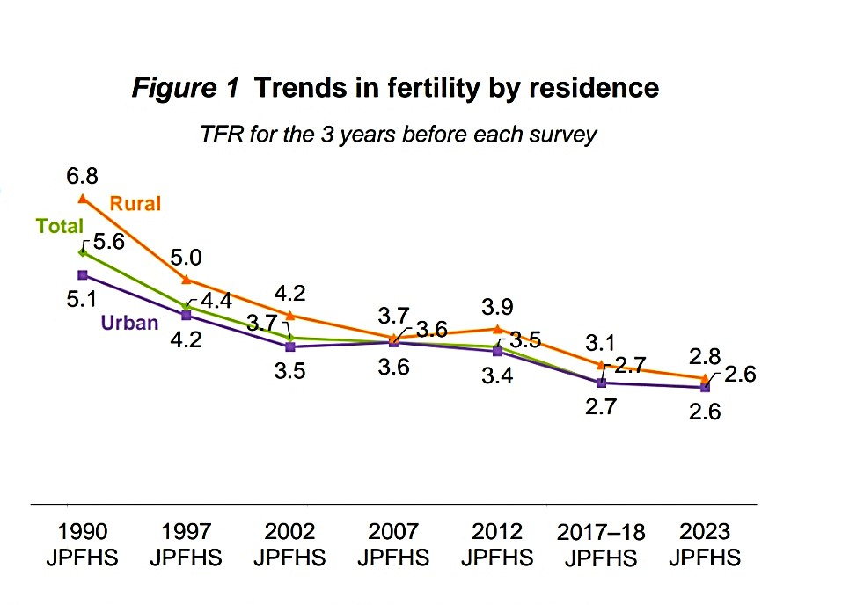

Slide 6
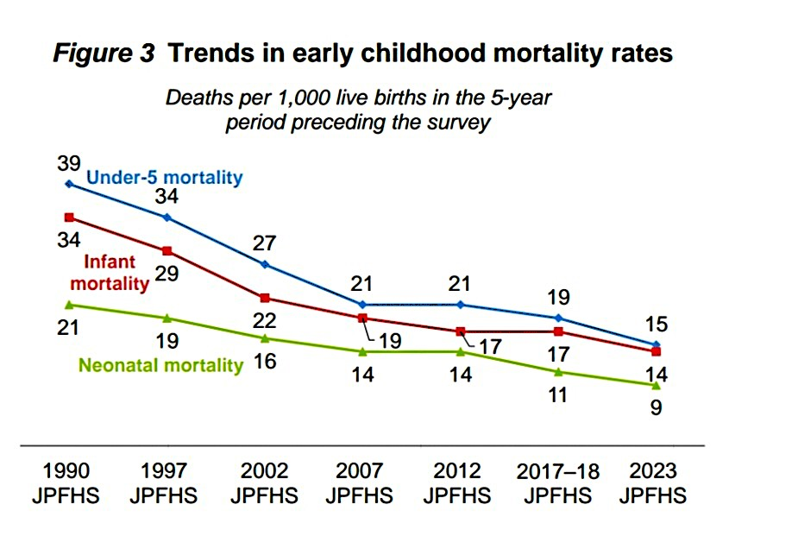

Slide 7
Primary Health Care Provision in Jordan: Summary, Update and Challenges
As a result of changes in fertility, mortality, and migration dynamics, the proportion of the population under 15 years of age declined from 51 percent in 1979 to 39 percent by 2002 to 37.3% by 2012 to 34.4 by 2023, while the proportion of those age 65 and over has been rising from 2.1% (JPFHS, 2002) to 3.2 % by the year 2012 to 3.7% by the year 2023.

Slide 8
While low infant mortality rates and high life expectancy - are among the best in the region, the population growth rate continues to be a major development constraint - especially when analyzed considering the quantity and quality of services to be provided to accommodate this rapid increase in population.

Slide 9
Causes of Death ( Mortality )

Slide 10
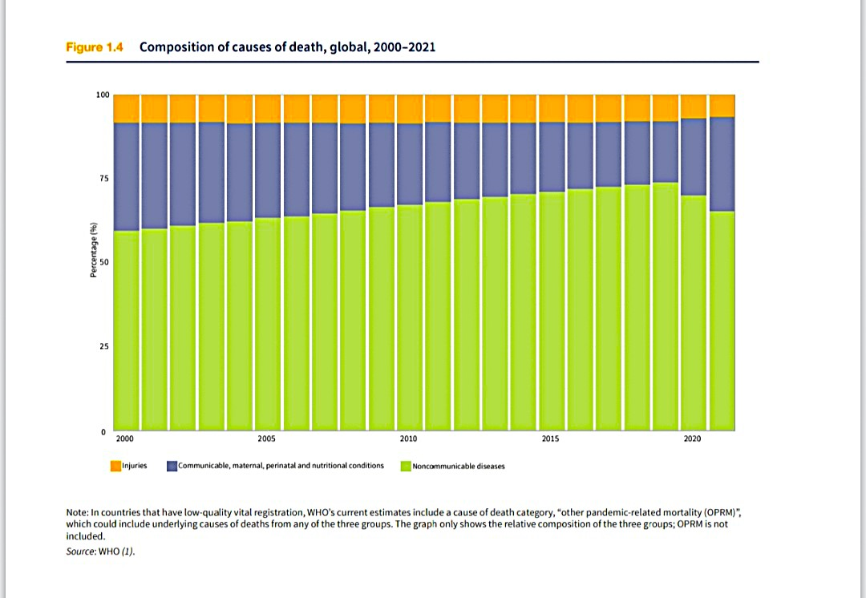

Slide 11
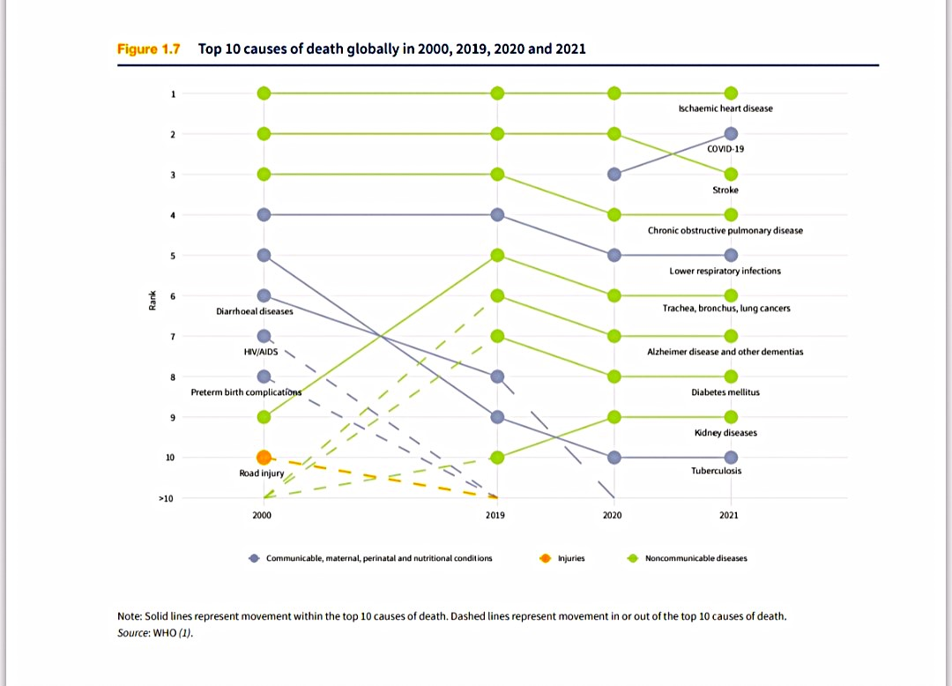

Slide 12
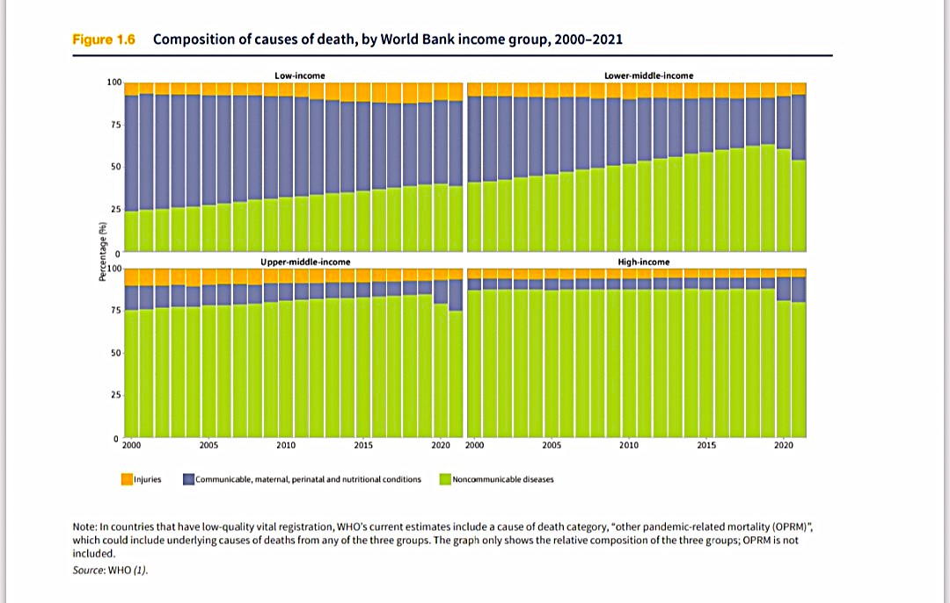

Slide 13
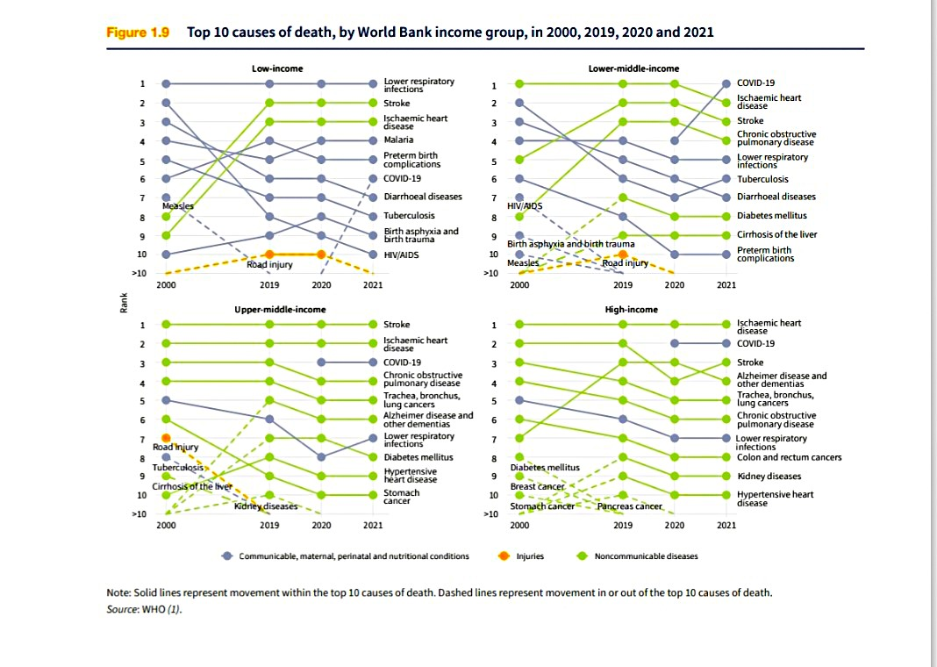

Slide 14
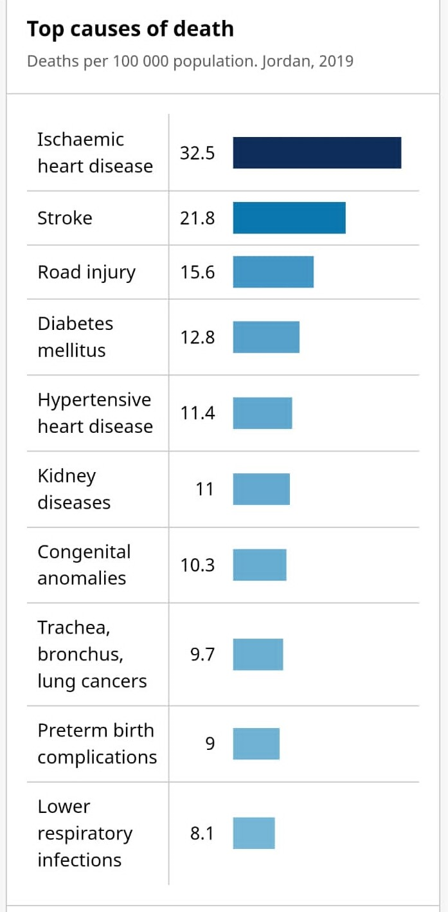

Slide 15
Health promotion
Health promotion encompasses a variety of activities aiming at improving the health status of the individual and the community .
And if successful, it will affect the lives of people, so health promoters should be equipped with practical skills, and should understand the values and ethics implicit in their work.

Slide 16
Health Education (HE) in Jordan
In Jordan, health education (HE) is an important pillar of the work of the Ministry of health.
Recently the HE division was promoted to a full directorate, where qualified experts develop their HE plans, based on priorities, community needs, and information collected from different reports, surveys and studies. Their work also includes training of health workers and preparation of different HE media
Unfortunately , the traditional health education approach used in Jordan , and many other countries, was aimed solely at changing people to fit the environment, and did little to make the environment a healthier place to live in.

Slide 17
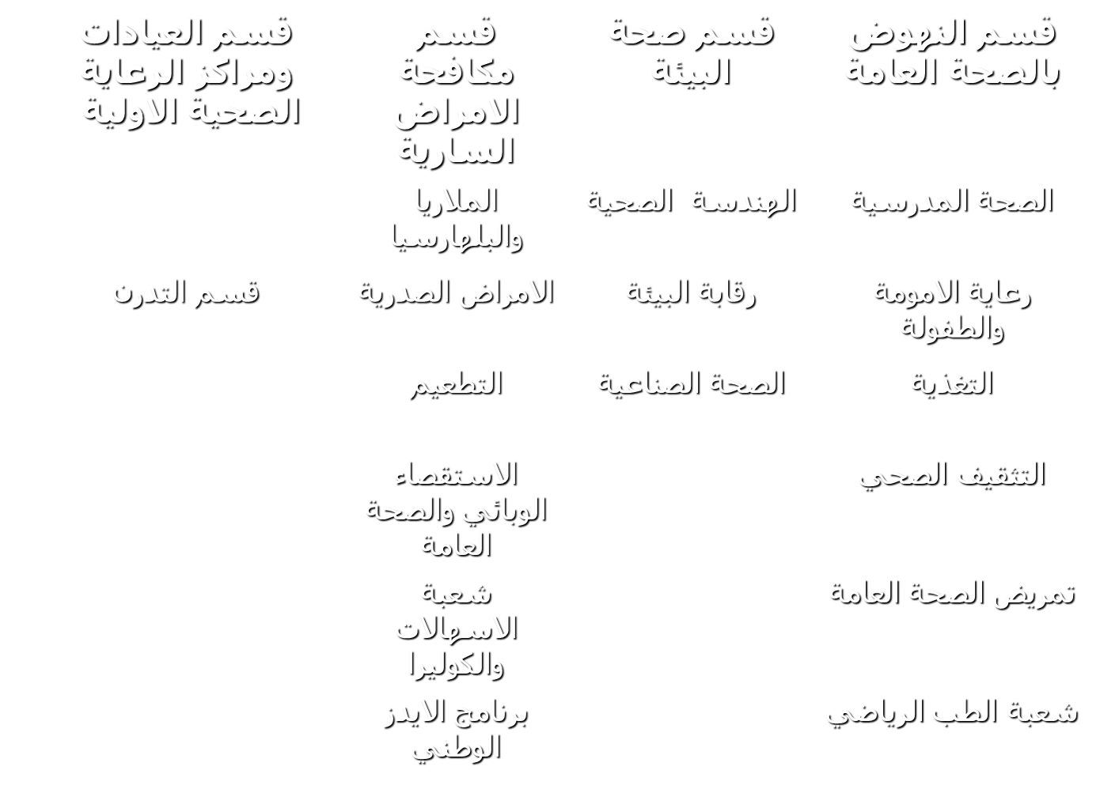
مديرية الرعاية الصحية الاساسية

Slide 18
Health Education (HE)
IMPORTANCE OF HE:
First line of Prevention
Skeleton of primary health care services.
Essential for Health Promotion and Preventive Services.
Helping people to understand their behavior and how it may affect their health.

Slide 19
Main goal of health education is:
To improve the quality of life individual and Community in all aspects: health, social, economic and political, taking in consideration that health is a state of complete physical, psychological and social well being and not the mere absence of diseases.

Slide 20
Who is the health educator?
Specialist : person who is especially trained to do health education work.
Any health worker who is concerned with helping people to improve their health knowledge and skills.
Any person in the Community can participate in health education process, like teacher, mothers… etc.

Slide 21
Target groups for health education programs
women have the role of raising children and teaching them practices and concepts as the personal hygiene and nutrition. also, women must be aware of the basics of preventive of health services.
Children: any concept learned in childhood will affect behavior in adult life major subjects in health education for children are sanitation, nutrition, personal hygiene and environment.
Elderly.

Slide 22
Approaches of HE
Specialists identify five approaches that can be used individually or in combination to achieve the desired goal:
1- The medical approach involves medical intervention to prevent ill health using a persuasive method and expects patients to comply with the recommended intervention.

Slide 23
2. The educational approach provides information and helps people to explore their values and make their own decisions.
3. The change in behavior approach involves changing people’s attitudes so that they adopt healthy lifestyles as defined by the health promoters. This approach can be applied using locally available methods and media such as leaflets and posters.

Slide 24
4.The individual -centered approach considered the individual to have a right to control his own health, so he should be helped to identify his concerns, and gain the knowledge he needs to make changes happen.
5. The change in society approach aims at changing the society rather than the individual by putting health on the political agenda at all levels, and by shaping the environment so that it becomes conductive to health.

Slide 25

Primary health care is the first point of contact between a community and its country’s health system.
The World Bank estimates that 90% of all health needs can be met at the primary health care level.
Investment in primary health care is a cost-effective investment – it helps reduce the need for more costly, complex care by preventing illness and promoting general health

Slide 26
Health education is the translation of health knowledge into desirable individual and Community behavioral patterns by means of educational process.
Health education is the skeleton of PHC system –since no other activity can be performed without health education.
The needs and interests of individuals, families, groups, organizations and communities are at the heart of health education program.
Health education is the responsibility of every person in the Community.

Slide 27
THANK YOU

