Slide 1
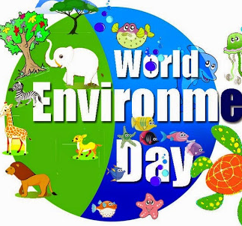
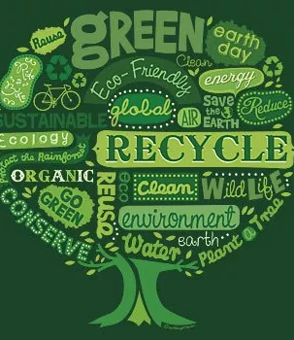
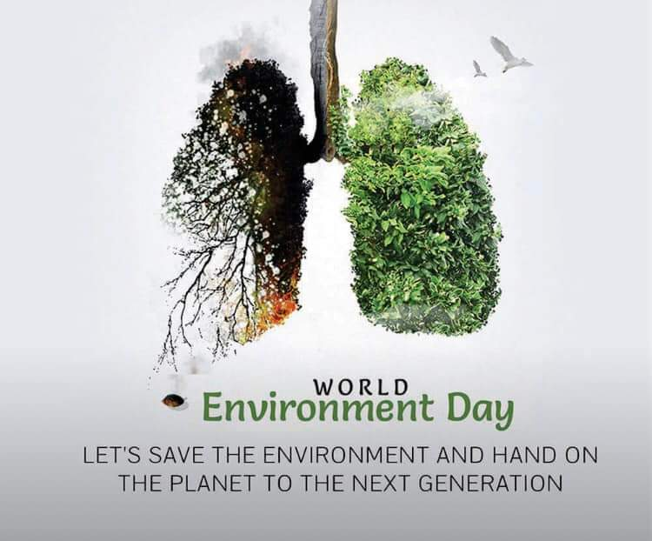

Environmental Health

Slide 2
Environmental Health
Across the world, the environment is a key determinant of health and well-being.
Clean air, stable climate, adequate water, sanitation and hygiene, safe use of chemicals, protection from radiation, healthy and safe workplaces, sound agricultural practices, health-supportive cities and built environments, and a preserved nature are all prerequisites for good health (WHO).
Globally, nearly 25% of all deaths and total disease burden can be attributed to environmental factors.
Unimproved water and sanitation, ambient air pollution, indoor pollution from solid fuels, and lead exposure are among the leading contributors to global burden of disease.
In addition, many current and emerging exposures in food, water, soil, air, and consumer products adversely affect human health.

Slide 3
Why Is Environmental Health Important?
Maintaining a clean healthy environment is central to increasing quality of life and years of healthy life.
lower the burden of preventable environmental diseases that are disproportionately felt by residents of poor developing countries.
***The reasons for this disproportionate effect in poor countries include lack of modern technology, weak protective environmental laws and regulations, a lack of awareness, and poverty.
Healthier environments could prevent almost one quarter of the global burden of disease. The COVID-19 pandemic is a further reminder of the delicate relationship between people and our planet )WHO).

Slide 4
WHO Definition of Environmental Health
It refers to the theory and practice of assessing, correcting, controlling, and preventing those factors in the environment that can potentially affect adversely the health of present and future generations.

Slide 5
What Is Environmental Health Science?
“The study of those factors in the environment that affect human health” under these conditions:
Factors (“pollutants” or “toxicants” = Hazard) in air, water, soil, or food … that human activities produce.
Transferred to humans by inhalation, ingestion, or absorption (exposure).
Production of adverse health effects as a result of that exposure.

Slide 6
Basic Requirements for a Healthy Environment
Clean air
Safe and sufficient water
Safe and adequate food
Safe and peaceful settlements
Stable global environment

Slide 7
World Environment Day (WED)
In 1972, the UN General Assembly designated 5 June as World Environment Day (WED). The first celebration, under the slogan “Only One Earth” took place in 1973. In the following years, WED has developed as a platform to raise awareness on the problems facing our environment such as air pollution, plastic pollution, illegal wildlife trade, sustainable consumption, sea-level increase, and food security and others. Furthermore, WED helps drive change in consumption patterns and in national and international environmental policy.

Slide 8
Why take part?
Time is running out, and nature is in emergency mode. To keep global warming below 1.5°C this century, we must halve annual greenhouse gas emissions by 2030. Without action, exposure to air pollution beyond safe guidelines will increase by 50 per cent within the decade and plastic waste flowing into aquatic ecosystems will nearly triple by 2040.
We need urgent action to address these pressing issues.

Slide 9
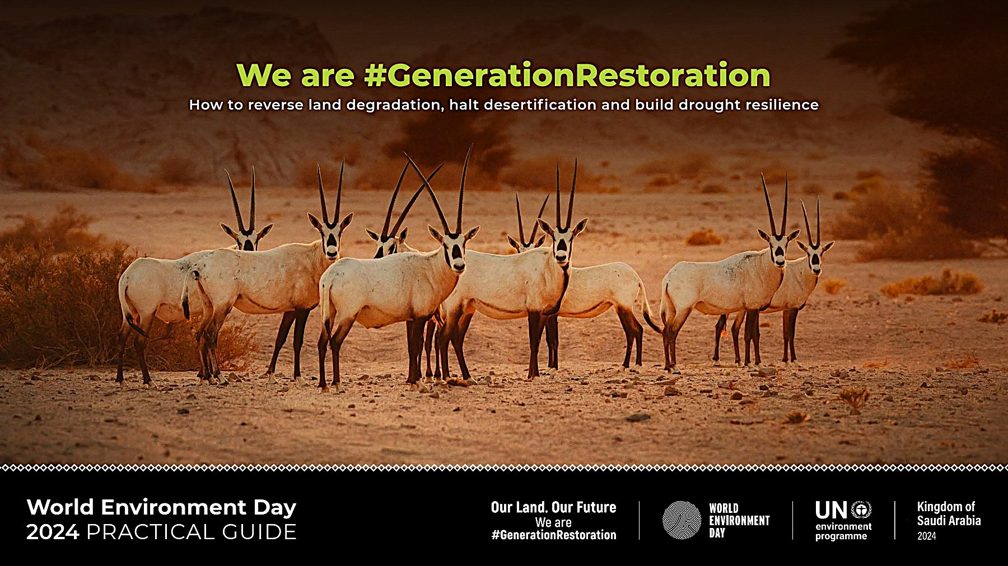
WED, 2024
Host: The Kingdom of Saudi Arabia
The theme for 2024, "Our Land, Our Future. We are #GenerationRestoration," emphasizes the importance of restoring land, combating desertification, and enhancing resilience to drought.
** Currently, up to 40% of the world's land is degraded, impacting around 3.2 billion people globally due to desertification. Moreover, projections suggest that by 2050, over three-quarters of the world's population will be affected by drought.

Slide 10
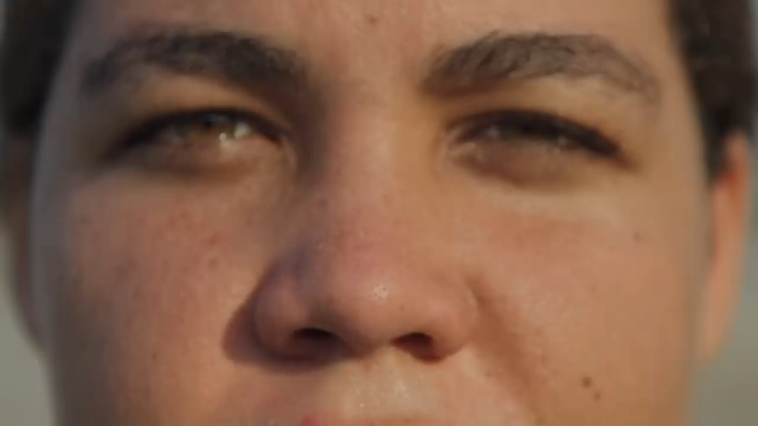

Slide 11
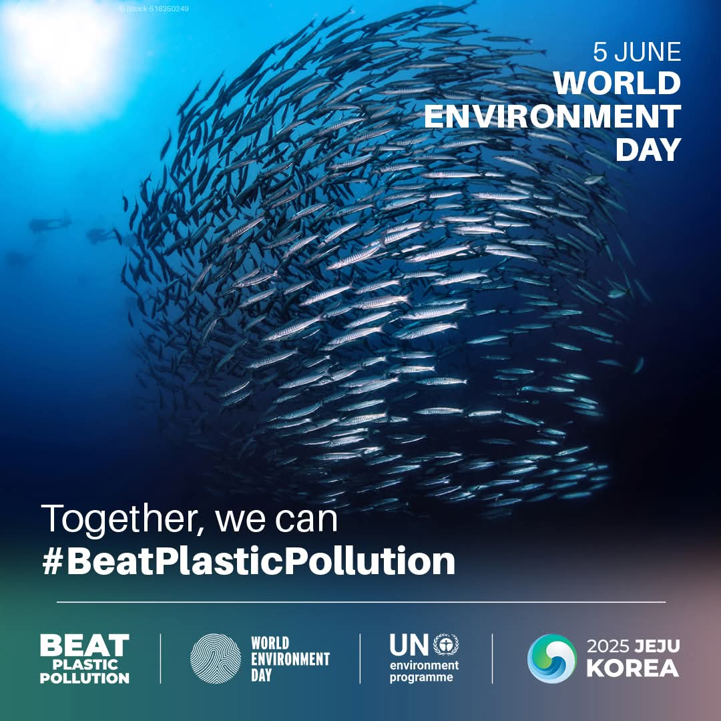
WED, 2025
Host country: Republic of Korea (South Korea).
Theme: Ending plastic pollution.
Slogan: "Shared Challenge, Collective Action".

Slide 12


Slide 13
Hazards in the Environment
What are Hazards?
Things in the environment that are harmful are called hazards and include things like chemicals, disease-causing bacteria, loud noises and even stress in our life.
hazards can be natural or human-made.

Slide 14
Types of Hazards in the Environment
Chemical: Air pollutants, toxic wastes, pesticides, VOCs
Biological: Disease organisms present in food and water, also Insect and animal allergens
Physical: Noise, ionizing and non-ionizing radiation
Socioeconomic: Access to safe and sufficient health care

Slide 15
Routs
of exposure
How do hazards get transformed to our bodies????

Slide 16
Health Effects of Hazards
Acute vs. delayed onset
Clinical vs. subclinical manifestations
Transient (reversible) vs. chronic (irreversible)

Slide 17
Examples of Manifestations
Lung disease
Reproductive effects
Teratogenic effects
Neurologic effects
Immunosuppression and hypersensitivity
Cancer

Slide 18
Vulnerable Groups (susceptible)
Low socioeconomic status
Women
Children
Elderly
Ethnic minorities
Disabled
Indigenous peoples
All of whom are often more vulnerable because of Genetics or They are not empowered to change their environment

Slide 20
Improving Human Health and Environment: 3 Models

Slide 21


Slide 22
COP
The conference of the Parties(COP) to the UN Framework Convention on Climate Change (UNFCCC )is an international climate summit which is held annually unless the Parties (the countries involved )decided otherwise. At COPs , world leaders gather to work together on solutions to tackle climate change.

Slide 23
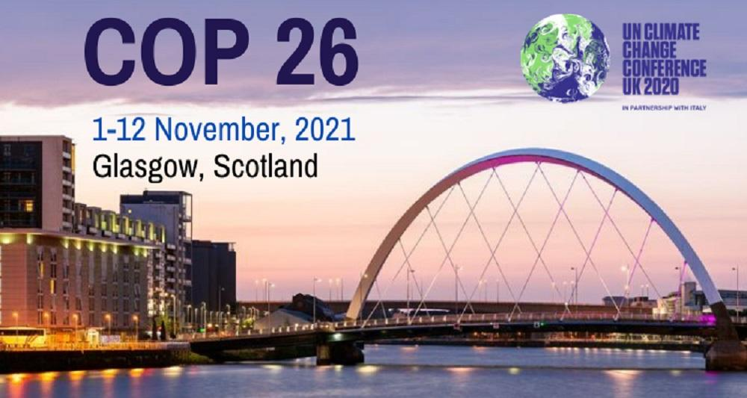
For the first time, world leaders promise to end deforestation by 2030, and to reduce emissions by 30% by 2030 (compared to 2020 levels).

Slide 24
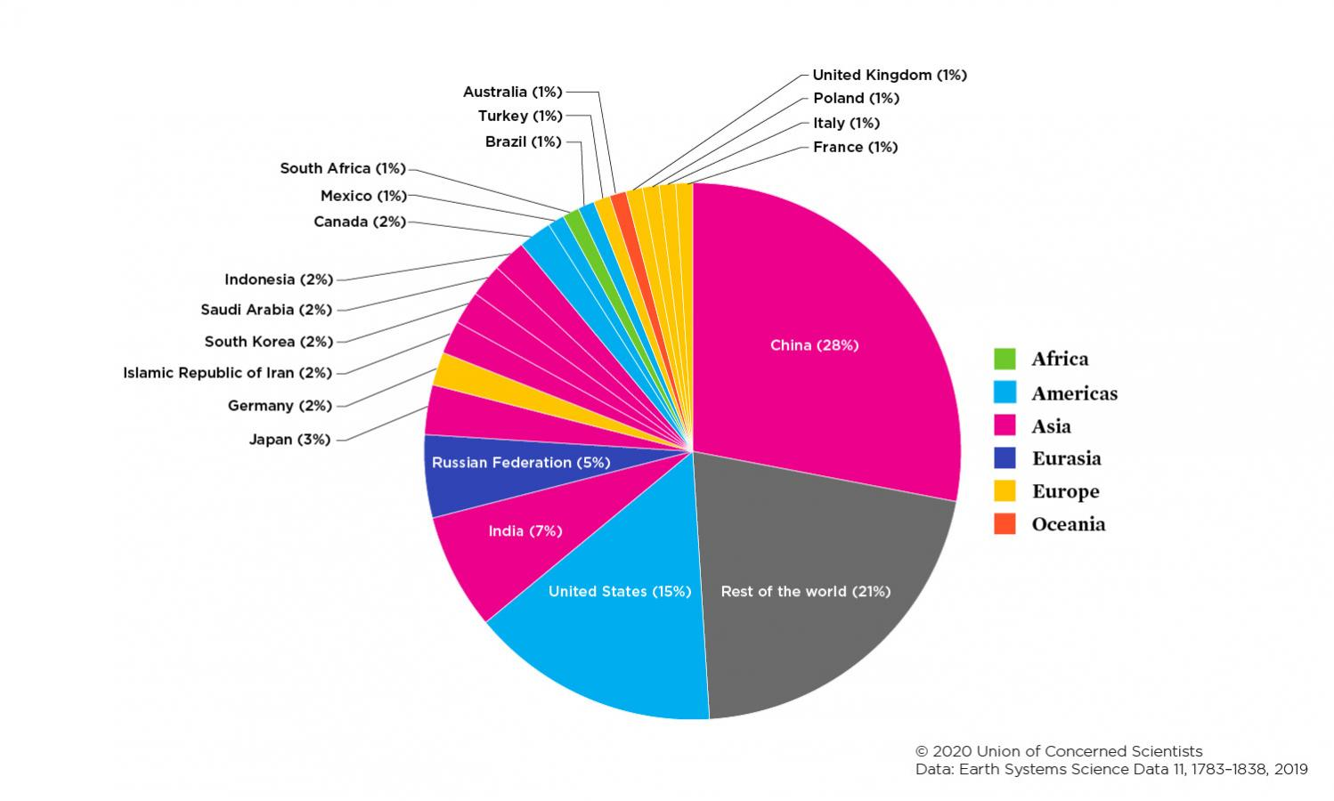
Share of CO2 emissions by country: Carbon Footprint

Slide 25
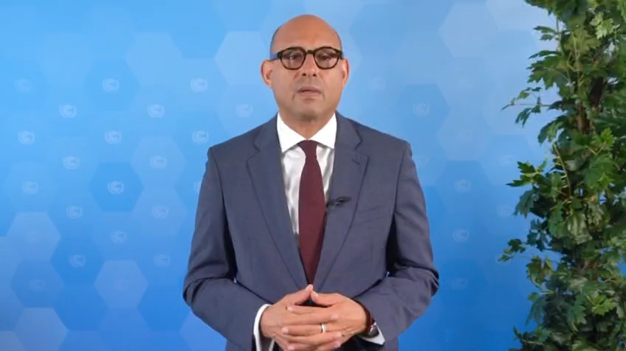

COP 29

Slide 26
THE END

