Slide 1

Disease Causation
Dr. Sireen Alkhaldi, DrPH
Community Medicine 2024/ 2025
School of Medicine/ The University of Jordan

Slide 2
Cause of Disease
Cause defined as “anything producing an effect or a result”. [Webster]
Cause in medical textbooks discussed under headings like- “etiology”, “Pathogenesis”, “Mechanisms”, “Risk factors”.
Important to physician because it guides their approach to three clinical tasks- Prevention, Diagnosis & Treatment.

Slide 3
Causal Relationships
A causal pathway may be direct or indirect
In direct causation, A causes B without intermediate effects (very rare)
In indirect causation, A causes B, but with intermediate effects
In human biology, intermediate steps are virtually always present in any causal process

Slide 4
Theories of Disease Causation
Supernatural Theories: curse, evil force of the demon.
Hippocratic Theory
Miasma
Theory of Contagion
Germ Theory (cause shown via Henle-Koch postulates)
Classic Epidemiologic Theory
Multicausality and Webs of Causation (cause shown via Hill’s criteria)

Slide 5
Hippocratic Theory
Hippocrates promoted the concept that disease was the result of an imbalance among four vital "humors" within us:
Yellow Bile, Black Bile, Phlegm, Blood
Hippocrates believed that if one of the humors became excessive or deficient, health would deteriorate and symptoms would develop.
Hippocrates was a keen observer and tried to relate an individual's exposures (e.g., diet, exercise, occupation, and other behaviors) to subsequent health outcomes.

Slide 6
Henle-Koch Postulates (Germ Theory)
Even though there was a "germ" of truth in miasmatic theory, in that it focused attention on environmental causes of disease and partly explained social disparities in health (poor people being more likely to live near foul odors), the theory began to fall into disfavor as the germ theory gained acceptance.
Louis Pasteur introduced the germ theory in 1878, that was developed later into Henle-Koch postulates:
  The agent is present in every case of the disease
  It does not occur in any other disease (one agent one disease)
  It can be isolated and if exposed to healthy subjects will cause the related disease
Notes:
…then it can no longer be a random accident of the disease, but between the parasite and the disease can be conceived no relation except that the parasite is the cause of the disease -- Robert Koch (1890)

Slide 7
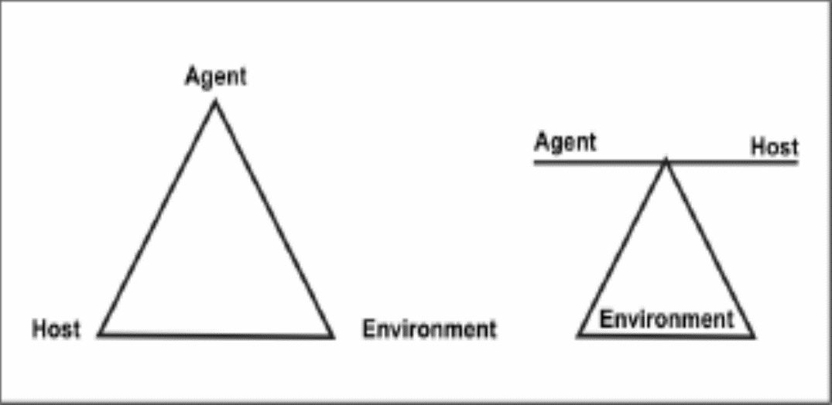
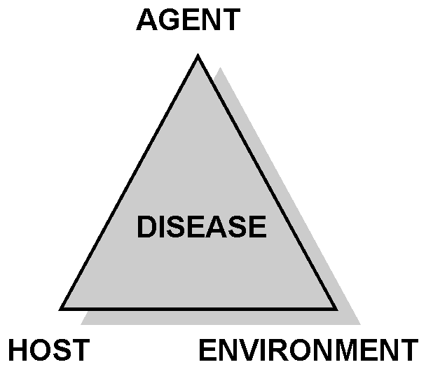
Classic Epidemiologic Theory: Epidemiologic Triad
Disease is the result of forces within a dynamic system consisting of:
1. Agent of disease
2. Susceptible Host
3. External environment

Slide 8
Classic Epidemiologic Theory (Epidemiologic Triad)
Agent, host, and environmental factors interrelate in a variety of complex ways to produce disease.
Different diseases require different balances and interactions of these three components.
Development of appropriate, practical, and effective public health measures to control or prevent disease usually requires assessment of all three components and their interactions.

Slide 9
Classic Epidemiologic Theory
Agent originally referred to an infectious microorganism or pathogen: a virus, bacterium, parasite, or other microbe.
Generally, the agent must be present for disease to occur; however, presence of that agent alone is not always sufficient to cause disease.
A variety of factors influence whether exposure to an organism will result in disease, including the organism’s pathogenicity, infectivity, virulence, and dose.

Slide 10
An Infectious Agent:
For an infectious agent:
Infectivity refers to the proportion of exposed persons who become infected.
Pathogenicity refers to the proportion of infected individuals who develop clinically apparent disease.
Virulence refers to the proportion of clinically apparent cases that are severe or fatal.

Slide 11
Classic Epidemiologic Theory
Agent: Over time, the concept of agent has been broadened to include chemical and physical causes of disease or injury.
These include chemical (poison, smoke, alcohol) , as well as physical forces (such as repetitive mechanical forces associated with carpal tunnel syndrome, radiation), and nutritional (vitamin deficiency).

Slide 12
Classic Epidemiologic Theory
Host refers to the human who can get the disease.
A variety of factors intrinsic to the host, sometimes called risk factors, can influence an individual’s exposure, susceptibility, or response to a causative agent.
Opportunities for exposure are often influenced by behaviors such as sexual practices, hygiene, smoking, physical exercise, dietary habits, and other personal choices as well as by age and sex.
Susceptibility and response to an agent are influenced by factors such as genetic composition, nutritional and immunologic status, anatomic structure, presence of disease or medications, and psychological makeup.

Slide 13
Classic Epidemiologic Theory
Environment refers to extrinsic factors that affect the agent and the opportunity for exposure.
Environmental factors include
physical factors such as geology and climate,
biologic factors such as insects that transmit the agent, socioeconomic factors such as crowding, sanitation, and the availability of health services.

Slide 15
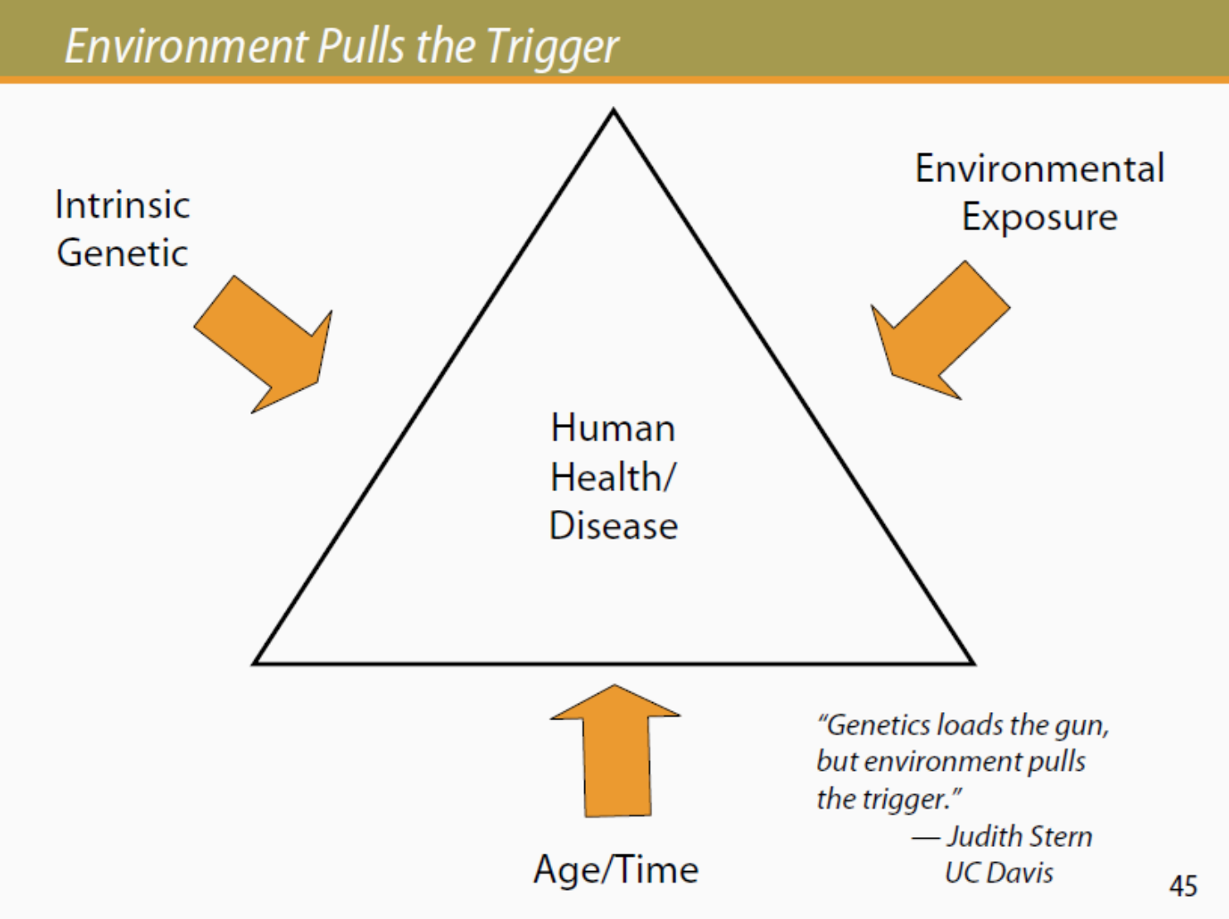

Slide 16
Multicausal Theories
…… While the epidemiologic triad serves as a useful model for many diseases, it has proven inadequate for cardiovascular disease, cancer, and other diseases that appear to have multiple contributing causes without a single necessary one.
Several other models that attempt to account for the multifactorial nature of causation have been proposed.

Slide 17
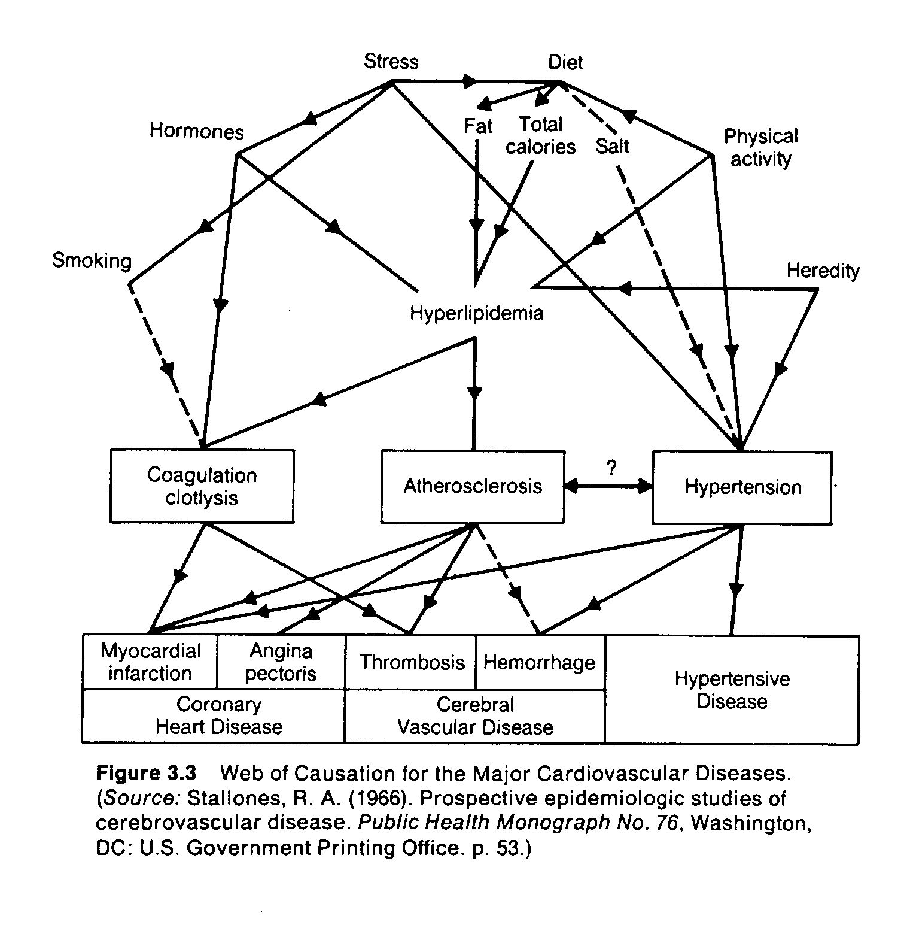
Web of Causation (Multicausal theory) for Major Cardiovascular Diseases
Notes:
Web of Causation for the Major Cardiovascular Diseases. (Source: Stallones, R.A. (1966). Prospective epidemiologic studies of cerebrovascular disease. Public Health Monograph No. 76, Washington, DC: U.S. Government Printing Office. p. 53.)

Slide 18
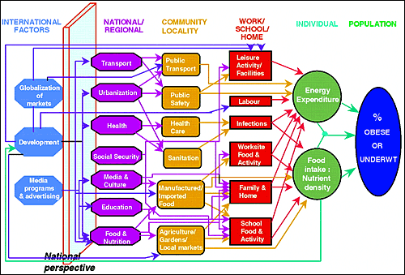
Multicausal theory for Obesity

Slide 19
Concept of Disease Occurrence ….Etiology of a disease
The sum of all factors that contribute to the occurrence of a disease
Agent factors +Host factors +Environmental factors = Etiology of a disease
The factor which can be modified, interrupted or nullified is most important.

Slide 20
Causal Relationships
A causal pathway may be direct or indirect
In direct causation, A causes B without intermediate effects (very rare)
In indirect causation, A causes B, but with intermediate effects
In human biology, intermediate steps are virtually always present in any causal process

Slide 21
Factors for disease causation
Sufficient factors: one that inevitably produces disease (the presence of the factor always result in disease).
Necessary factors: without which disease does not occur, but by itself, it is not sufficient to cause disease (the disease will not occur without the presence of the factor)

Slide 22
Types of Causal Relationships
Four types possible:
  Necessary & sufficient
  Necessary, but not sufficient
  Sufficient, but not Necessary
  Neither Sufficient nor Necessary

Slide 23
I. Necessary & Sufficient
Without that factor, the disease never develops (factor is necessary)
and in presence of that factor, the disease always develops (factor is sufficient).
Rare situation.
Factor A
Disease

Slide 24
II. Necessary, but not Sufficient
Multiple factors are required, often in specific temporal sequence (cancer, initiator then promoter). Infectious diseases also (Infection with HIV is necessary but not sufficient to cause AIDS).
Factor A
Factor C
Factor B
Disease

Slide 25
III. Sufficient, but not Necessary
Various factors independently can produce the disease (Either radiation or benzene exposure can each produce leukemia without the presence of the other).
Factor A
Factor C
Factor B
Disease
OR
OR

Slide 26
IV. Neither sufficient nor Necessary
More complex model.
Probably most accurately represents causal relationships that operate in most chronic diseases.
Factor A
Factor B
Disease
Factor C
Factor D
Factor E
Factor F
OR
OR

Slide 27
IV. Neither sufficient nor Necessary
Public health action does not depend on the identification of every cause of a disease.
Disease prevention can be accomplished by blocking any single factor from any combination of causes.
For example, elimination of smoking would prevent lung cancer, although some lung cancer would still occur to people who never smoked but have the right combination of other risk factors.

Slide 28

Community medicine:
Register your attendance with your university number
Make sure that the settings of your phone allow tracking location
Go to settings > privacy> location> services> make sure that location services is ON

