Slide 1
Dental terminology
Dr Dina Taimeh

Slide 2
Dental terminology
Maintaining communication between dentists and staff
Designing and executing treatment plans
Maintaining patients records

Slide 3
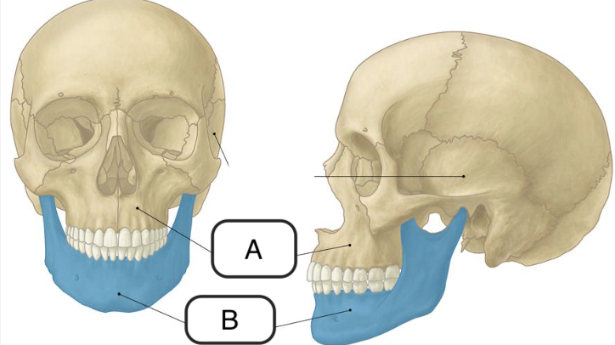
Face and mouth
A: Maxilla
B: Mandible
C: Temple
D: Temporomandibular joint (TMJ)
E: Anterior
F: Posterior
Teeth??
C
D
E
F
Notes:
Maxilla: The bones that form the upper part of the jaw, the roof of the mouth, and parts of the eye socket and nose. The maxilla holds the top teeth in place and supports muscles involved in chewing and facial expressions. It is a major bone in the face. Also called upper jaw.
Mandible: The mandible is the largest and strongest bone in the face. It forms the lower part of the jaw and part of the mouth. The mandible is the only moveable bone of the skull and is attached to muscles involved in chewing and other mouth movements. It also holds the bottom teeth in place. Also called lower jaw bone
Temple: The area just behind and to the side of the forehead and the eye
The temporomandibular joints (TMJ) are the two joints connecting the jawbone to the skull.
Anterior: In human anatomy, has to do with the front of a structure, or a structure found toward the front of the body.
Posterior: In human anatomy, has to do with the back of a structure, or a structure found toward the back of the body

Slide 4
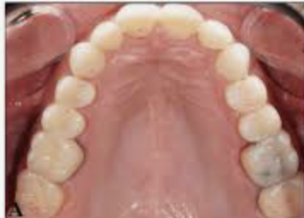
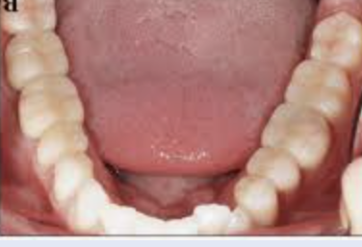
Teeth and related structures
Maxillary arch
Mandibular arch
Palate
Floor of the mouth
Quadrant
Notes:
Arch: The curved composite structure of the natural dentition and the ridge
Palate: The hard and soft tissues forming the roof of the mouth that separates the oral and nasal cavities.
Floor of the mouth: a small horseshoe-shaped region located beneath the tongue
Quadrant: One of the four equal sections into which the dental arches can be divided; begins at the midline of the arch and extends distally to the last tooth.

Slide 5
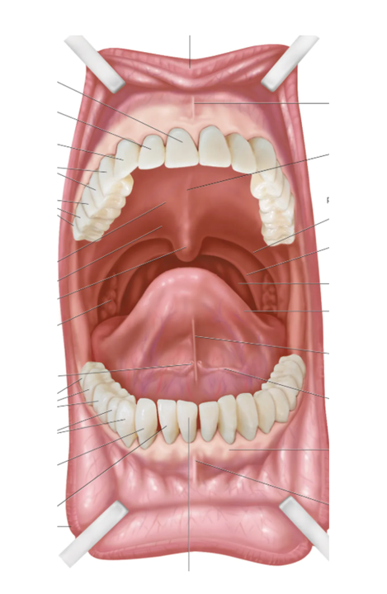
Teeth and tongue
Teeth
Labial | Buccal
Palatal | Lingual
Mesial | Distal
Occlusal
Tongue
Ventral | Dorsal
Lateral
Notes:
The labial surface is the aspect of the anterior teeth that faces towards the lips
The buccal surface is the aspect of the posterior teeth that is directed toward the cheeks.
The palatal surface of a tooth is directed toward the palate
The lingual surface is the aspect of a tooth that faces the tongue.
The mesial surface of a tooth is the the direction towards the anterior midline in a dental arch
The distal surface refers to the direction towards the last tooth in each quadrant
The occlusal surface refers to the chewing surface of the teeth, specifically the top surface of the molars and premolars
Ventral surface of the tongue is the under surface of the tongue, which is connected to and closest to the floor of the mouth
Dorsal surface of the tongue is the top of the tongue, which is closest to the roof of the mouth.
Lateral surface of the tongue is the side of the tongue, and there is one on the right and one on the left of the tongue

Slide 6
Dental specialities
Endodontics
Prosthodontics
Oral and maxillofacial radiology
Oral and maxillofacial surgery
Oral and maxillofacial pathology
Oral medicine
Orthodontics
Paediatric dentistry
Periodontics

Slide 7
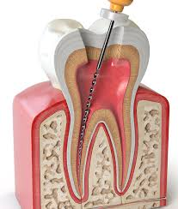
Dental specialities
Endodontics: is the dental specialty which is concerned with the morphology, biology, physiology, pathology and regeneration of the human dental pulp.

Slide 8
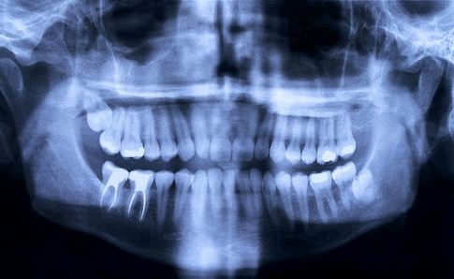
Dental specialities
Oral and Maxillofacial Radiology is the specialty of dentistry which provides imaging and interpretation of images of the facial skeleton, the teeth and the soft tissues.

Slide 9
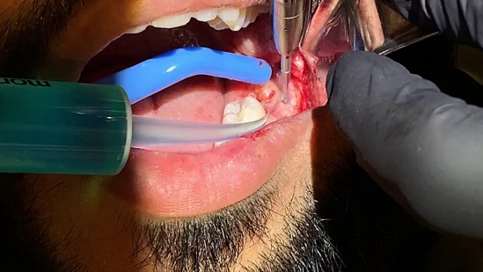
Dental specialities
Oral and Maxillofacial Surgery is involved in all aspects of the diagnosis and surgical care of the mouth, jaws, skull, face, head and neck, as well as associated structures and their reconstruction.

Slide 10
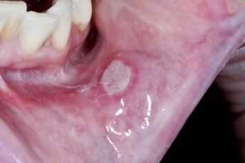
Dental specialities
Oral Medicine is the specialty of dentistry responsible for the oral health care of medically complex patients and for the diagnosis and management of medically related disorders or conditions affecting the oral and maxillofacial region.
The diagnosis and nonsurgical management of oral mucosal and salivary gland disease, orofacial pain, and dental treatment of patients with medical disorders.

Slide 11
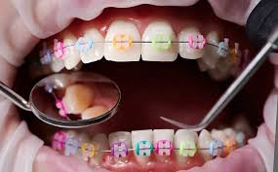
Dental specialities
Orthodontics is a specialized dental discipline that focuses on the prevention, diagnosis and treatment of misaligned teeth and jaws, known as malocclusion.

Slide 12
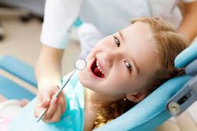
Dental specialities
Pediatric Dentistry is an age-defined specialty that provides both primary and comprehensive preventive and therapeutic oral health care for infants and children through adolescence, including those with special health care needs.

Slide 13
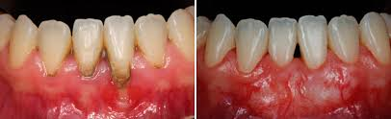
Dental specialities
Periodontics is the specialty of dentistry that encompasses the prevention, diagnosis and treatment of diseases of the supporting and surrounding tissues of the teeth or their substitutes and the maintenance of the health, function and esthetics of these structures and tissues.

Slide 14
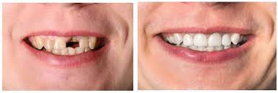
Dental specialities
Prosthodontics is one of the branches of dentistry that deals with the replacement of missing teeth and the associated soft and hard tissues by prostheses.

Slide 15
Dental specialities
Oral and Maxillofacial Pathology is the specialty of dentistry and discipline of pathology that deals with the nature, identification, and management of diseases affecting the oral and maxillofacial regions. It is a science that investigates the causes, processes, and effects of these diseases.

Slide 16
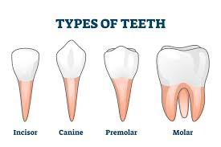
Types of Teeth and Their Function
Incisors: used for cutting food.
Canines: sharp teeth designed for tearing food.
Premolars (bicuspids): assist in grinding and tearing food.
Molars: used for grinding food into smaller particles.

Slide 17
Common Dental Procedures and Terms
Extraction: Removal of a tooth.
Restorations: Procedures like fillings to repair decayed or damaged teeth.

Slide 18
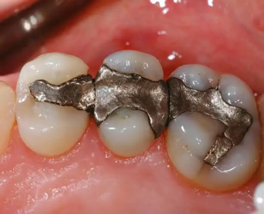
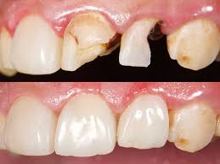
Dental Materials terms
Amalgam: A silver-colored dental filling material made of a combination of metals.
Composite Resin: A tooth-colored filling material used for restorations.

Slide 19
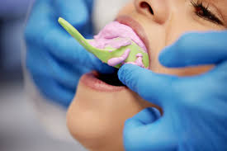
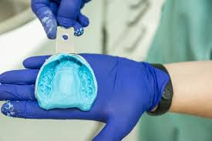
Dental Materials terms
Impression: A mold taken of the teeth and oral structures for making restorations or appliances.

Slide 20
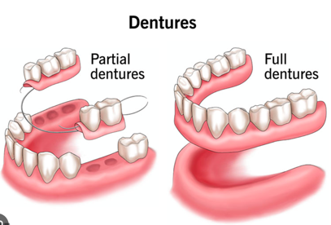
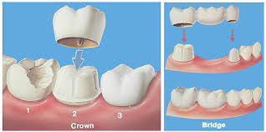
Dental Materials terms
Crown: A cap placed over a tooth to restore its shape and function.
Bridge: A dental prosthesis used to replace one or more missing teeth by anchoring to adjacent teeth.
Denture: A removable prosthetic device replacing multiple missing teeth.

Slide 21
Thank you!

