Slide 1

Basic Concepts Of PHC

Slide 2
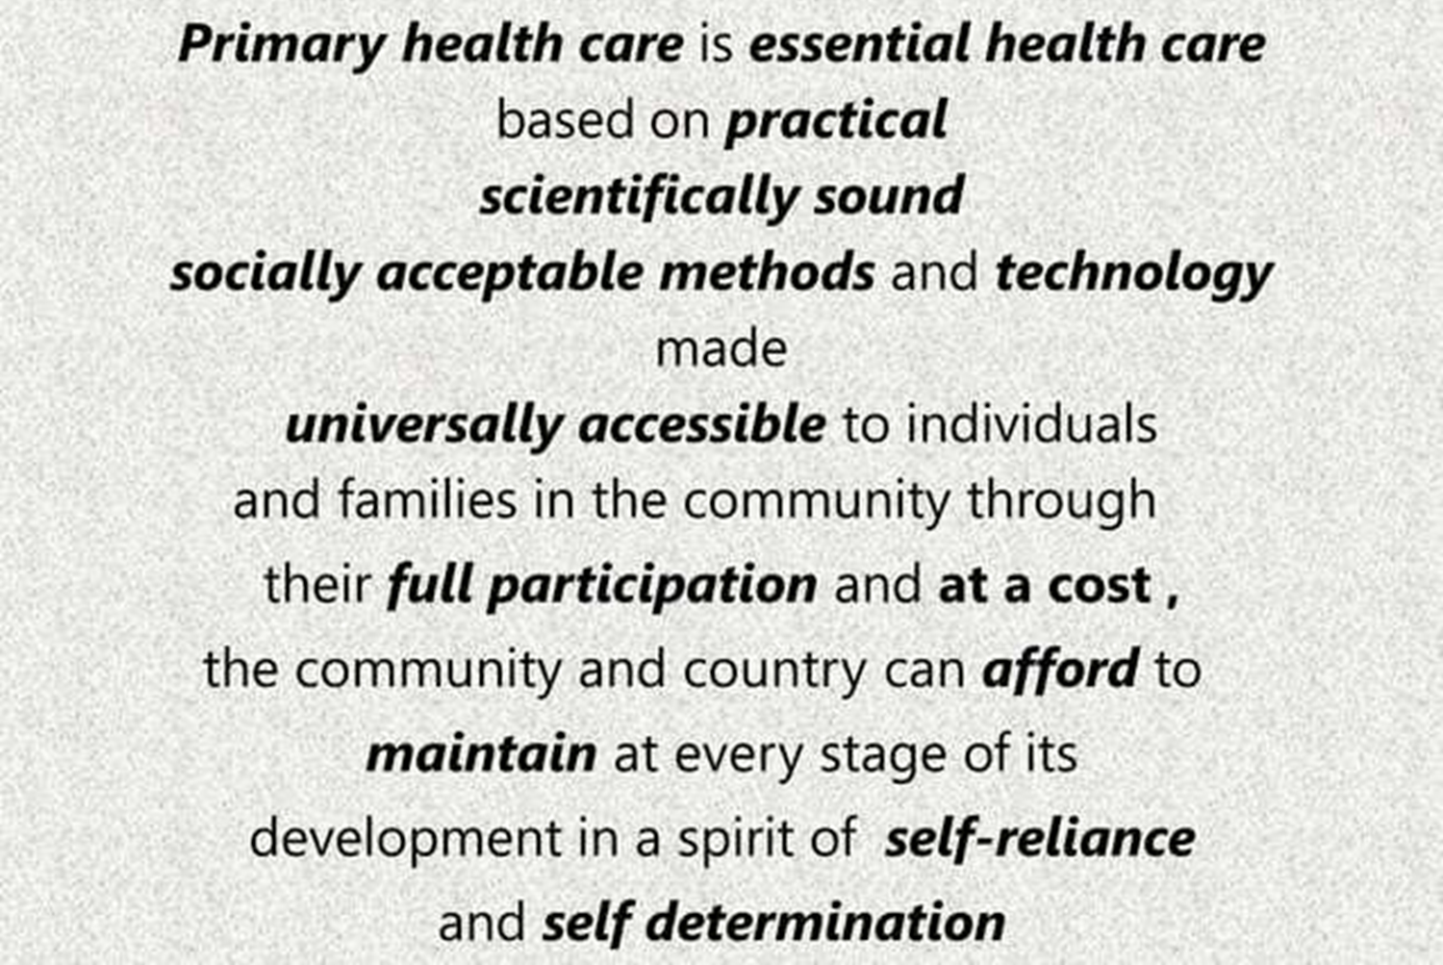
What is primary Health Care ?

Slide 3
Primary healthcare is:
-Essential healthcare (E)
-Make universally accessible to individuals (U)
- Acceptable to them (A)
- Through their full participation (P)
At a cost, the community and country can afford (C).
It is where short-term health issues are resolved, where the majority of chronic health conditions are managed, where health promotion and education efforts are undertaken and where patients in need of more specialized services are connected with care.

Slide 4
Principles Of PHC
Social equity ( equitable distribution)
Nation- wide coverage (universal coverage)
Appropriate Technology
Intersectoral coordination (multisectoral approach)
Community participation

Slide 5
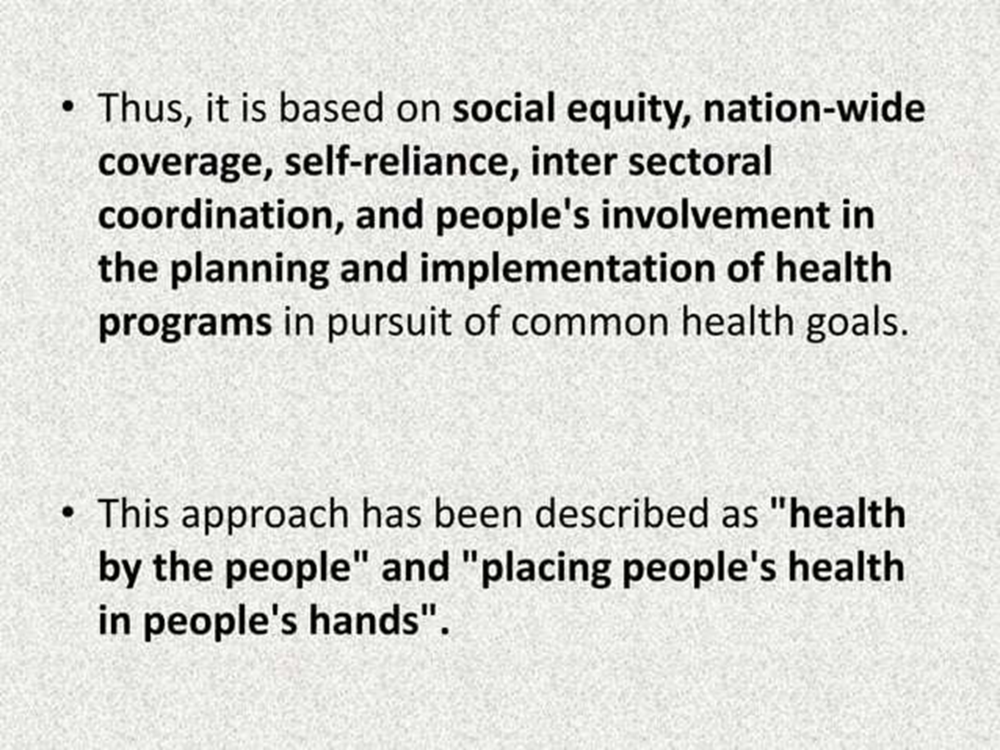

Slide 6
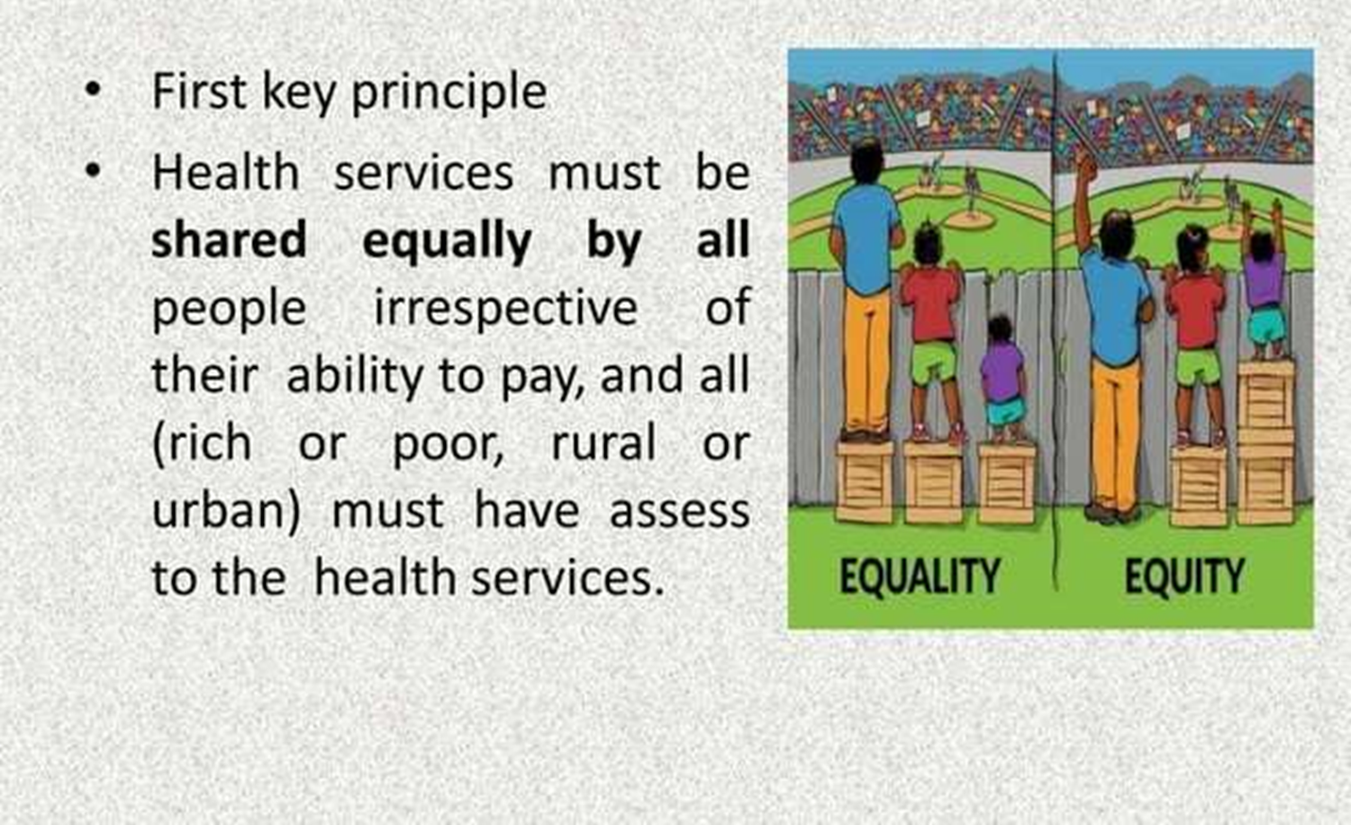
Social equity

Slide 7
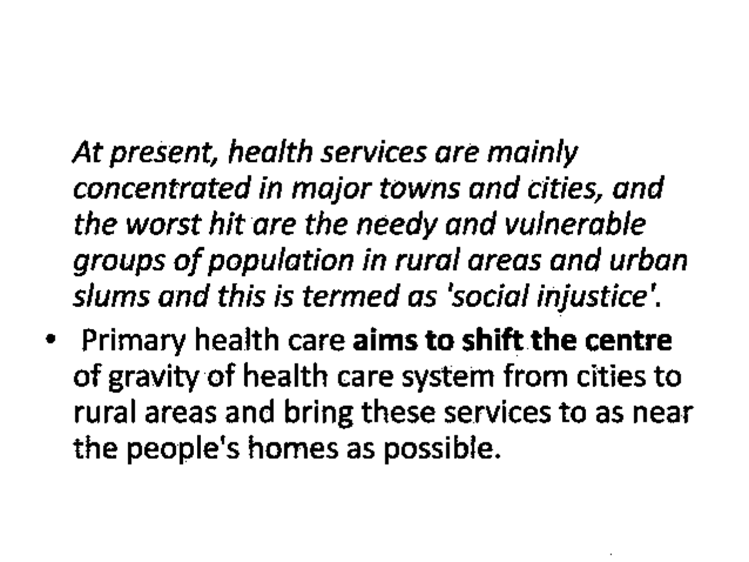

Slide 8
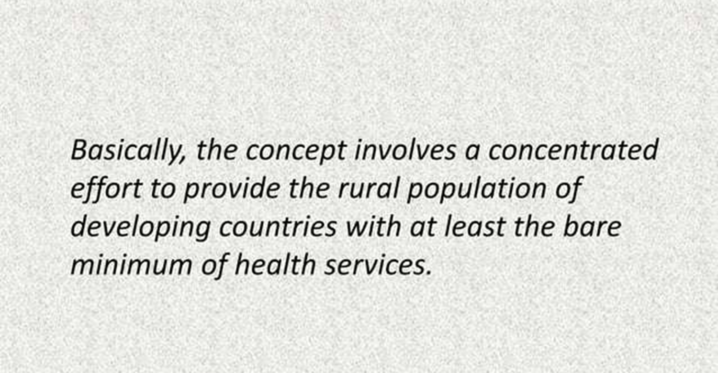

Slide 9
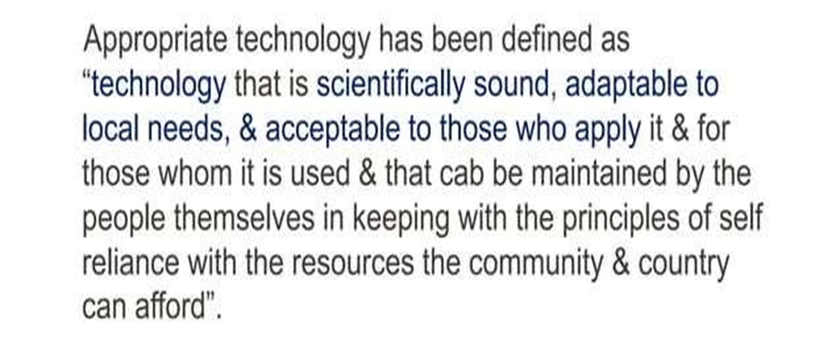
Appropriate Technology

Slide 10

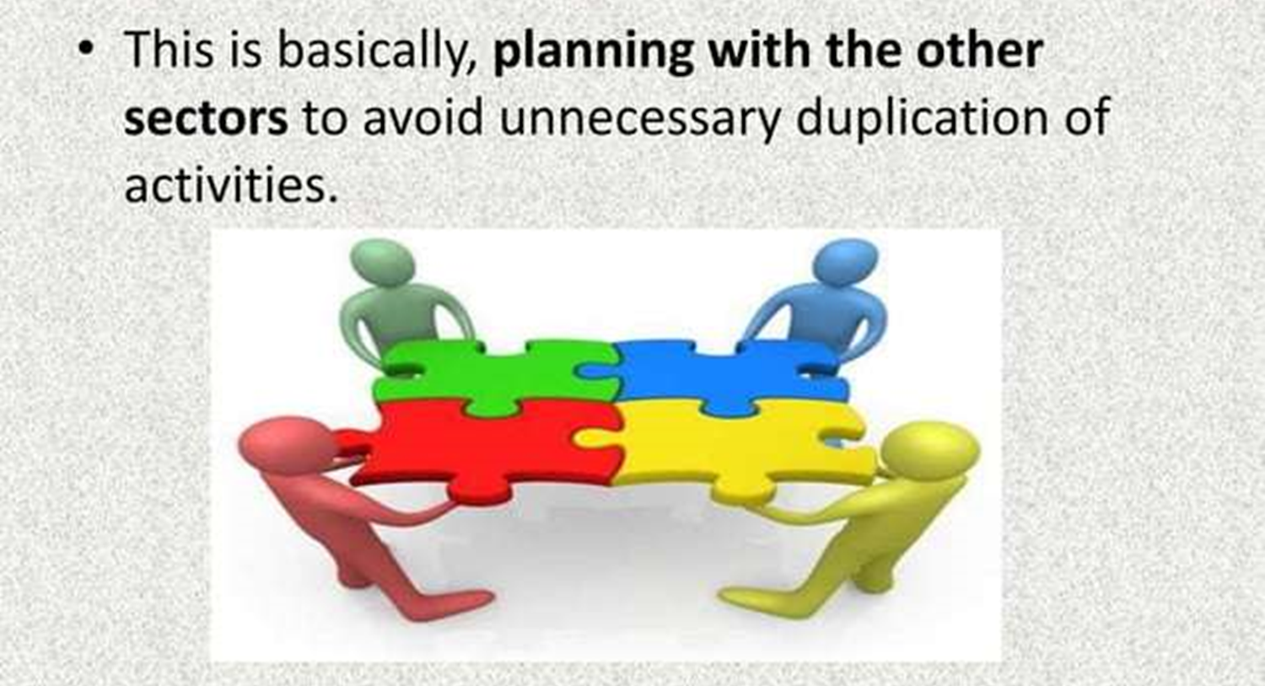
Intersectoral coordination

Slide 11
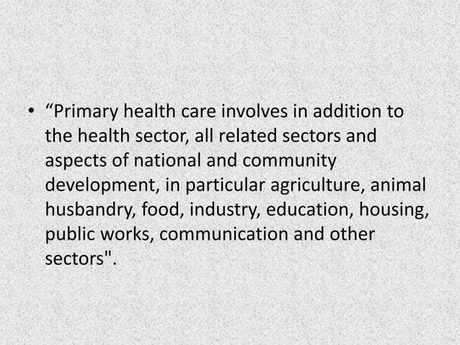

Slide 12
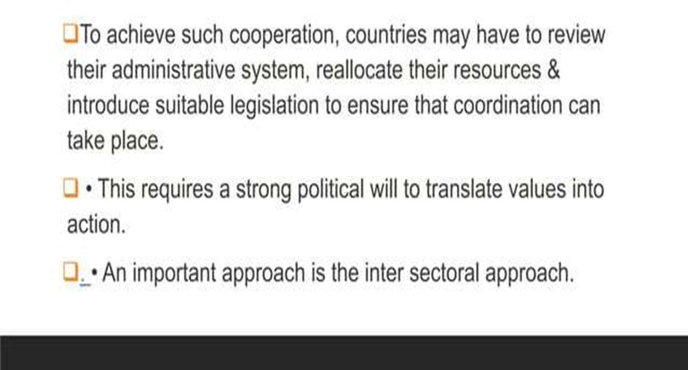

Slide 13
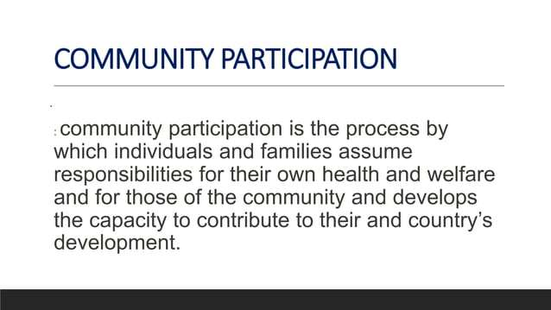
Community participation

Slide 14
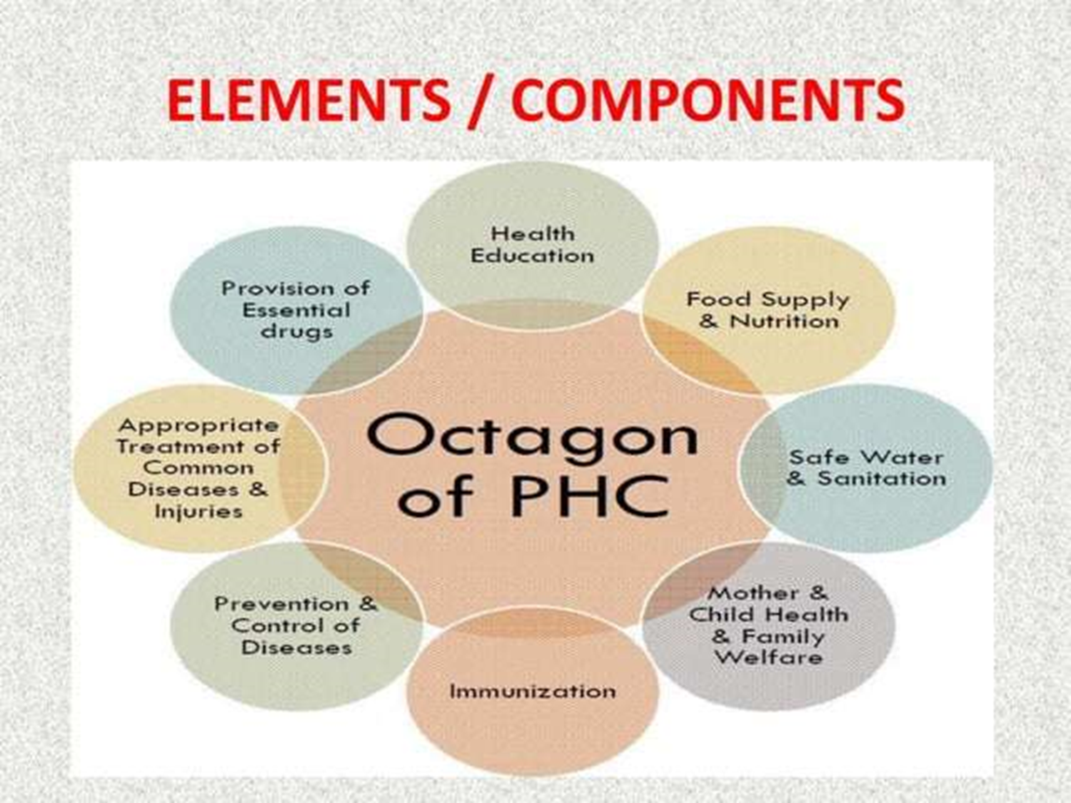
ELEMENTS/ COMPONENTS OF PHC

Slide 15
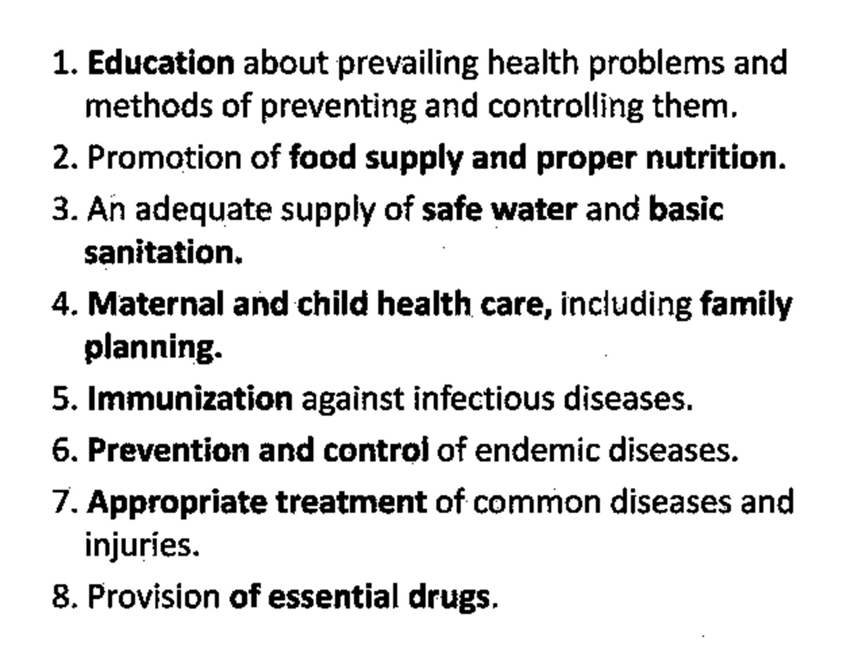

Slide 16
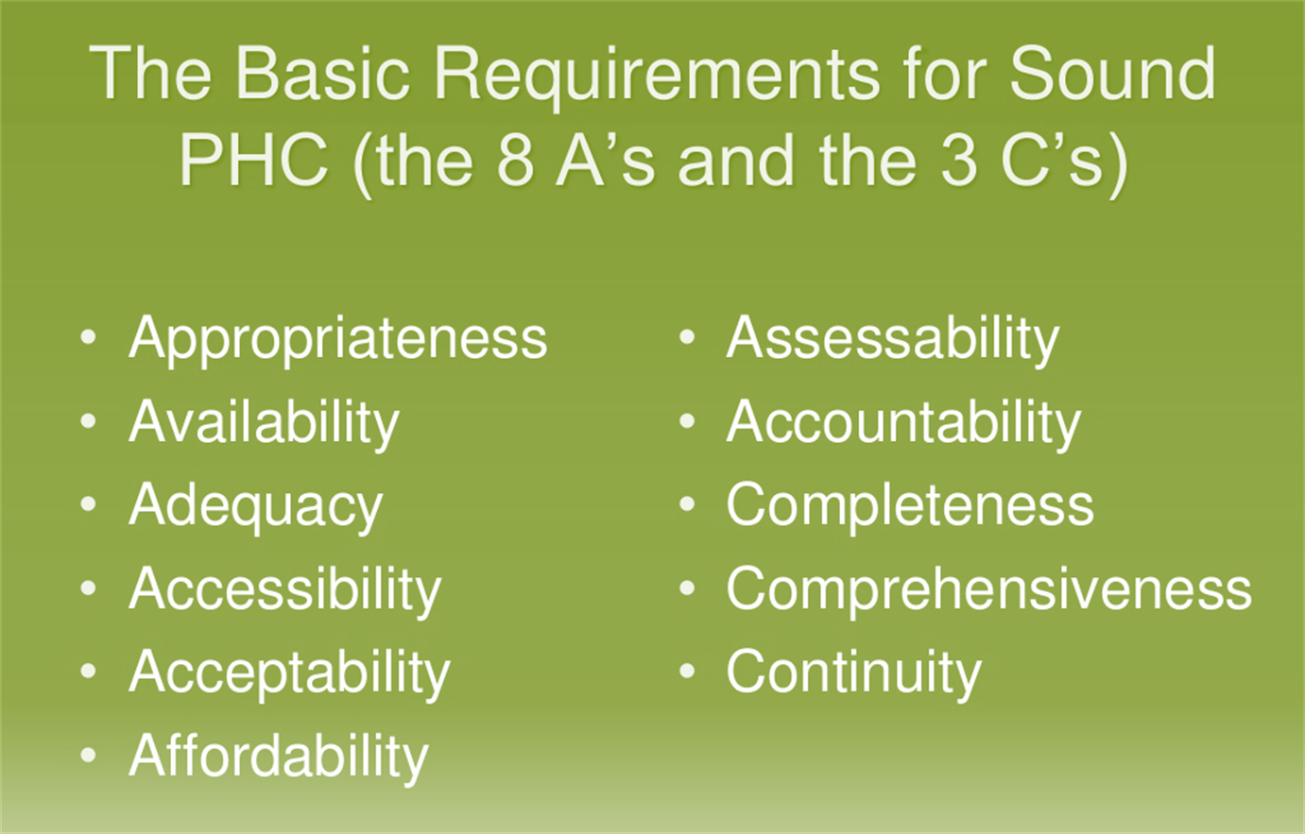
Basic Requirements for Sound PHC

Slide 17
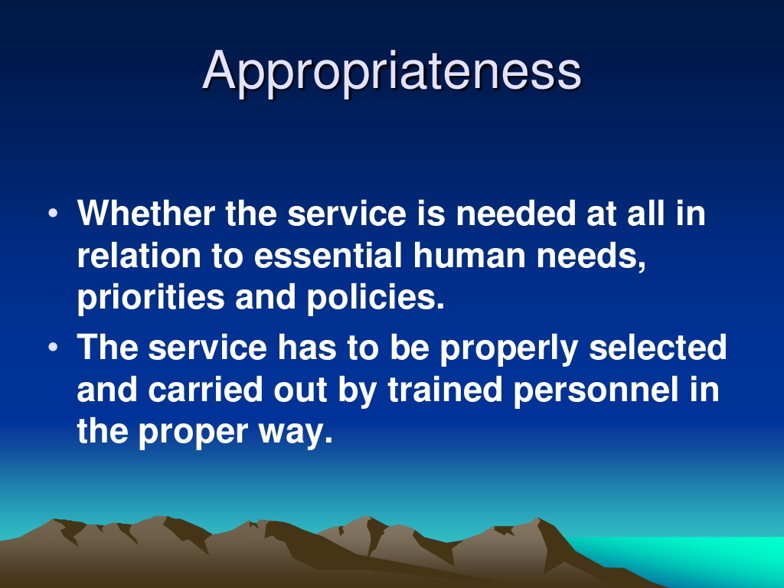

Slide 18
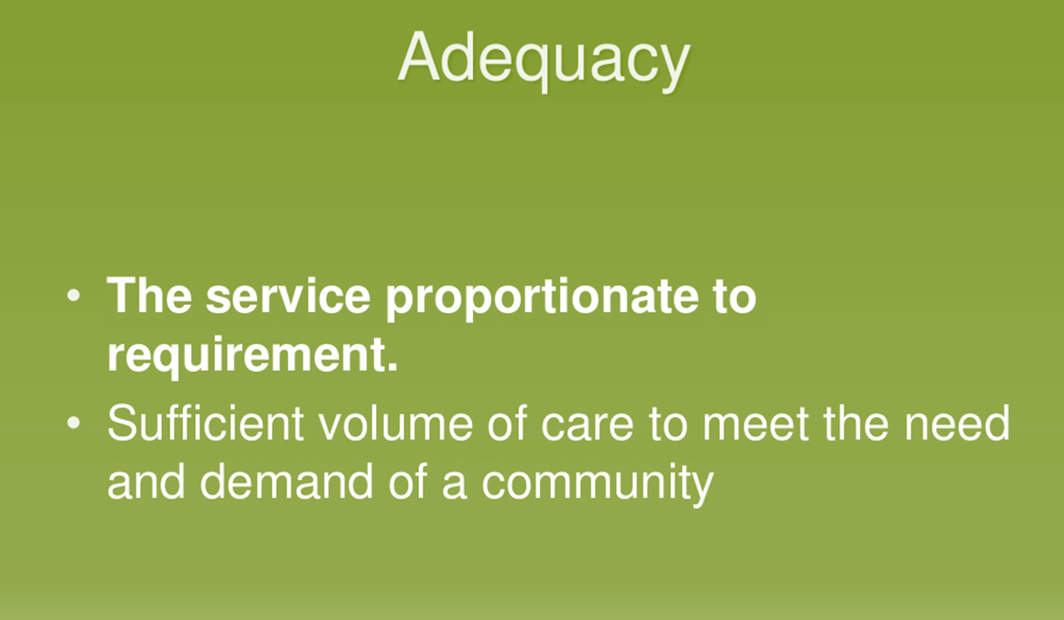
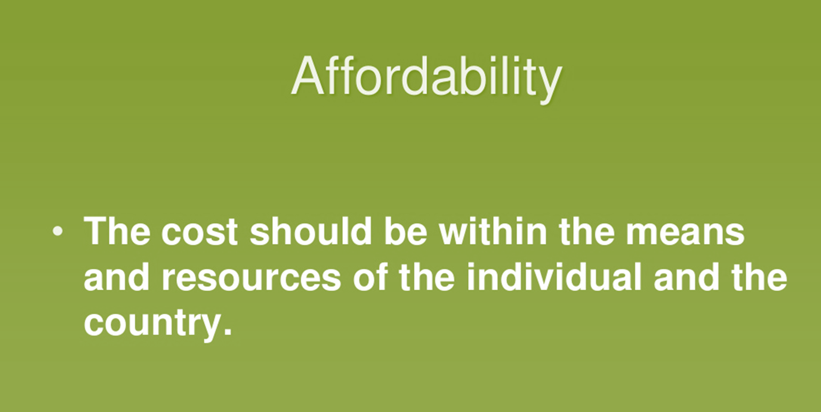

Slide 19
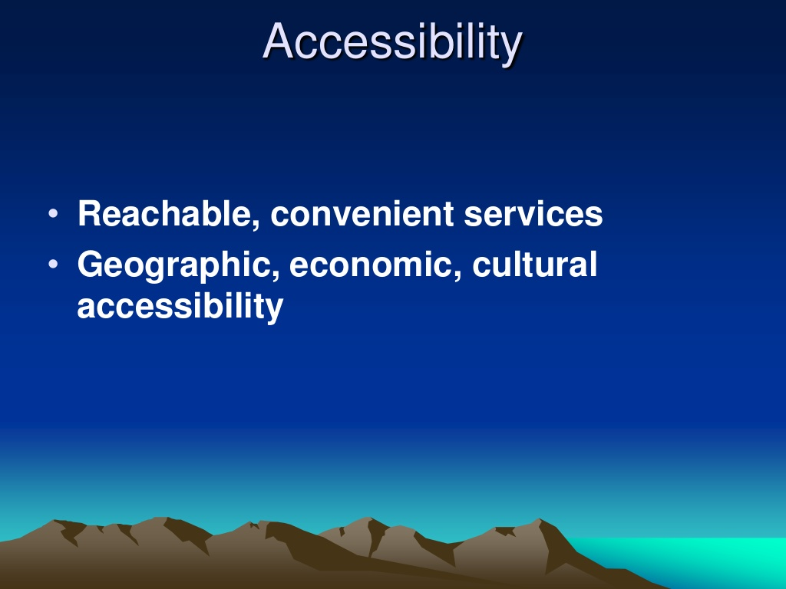
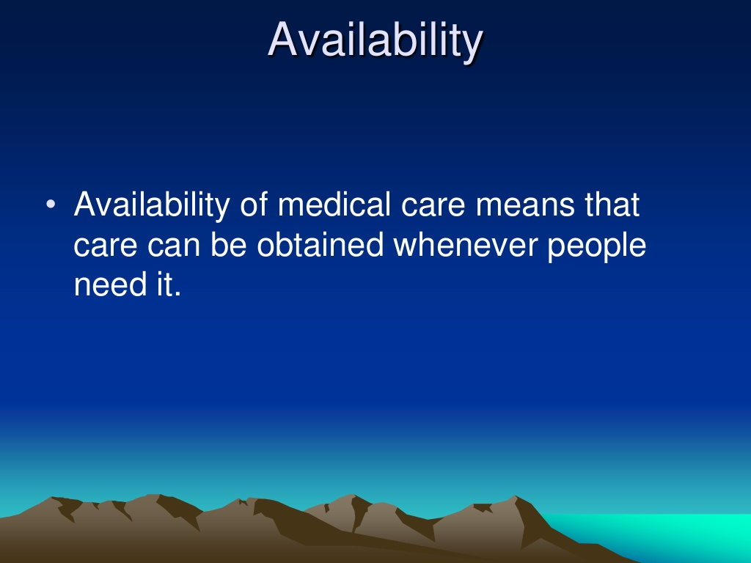

Slide 20
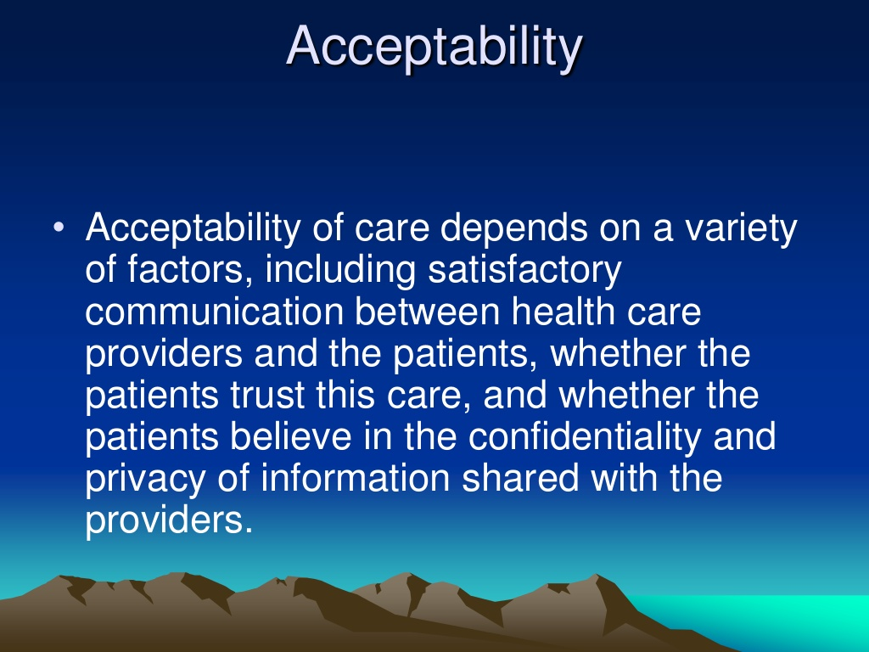

Slide 21
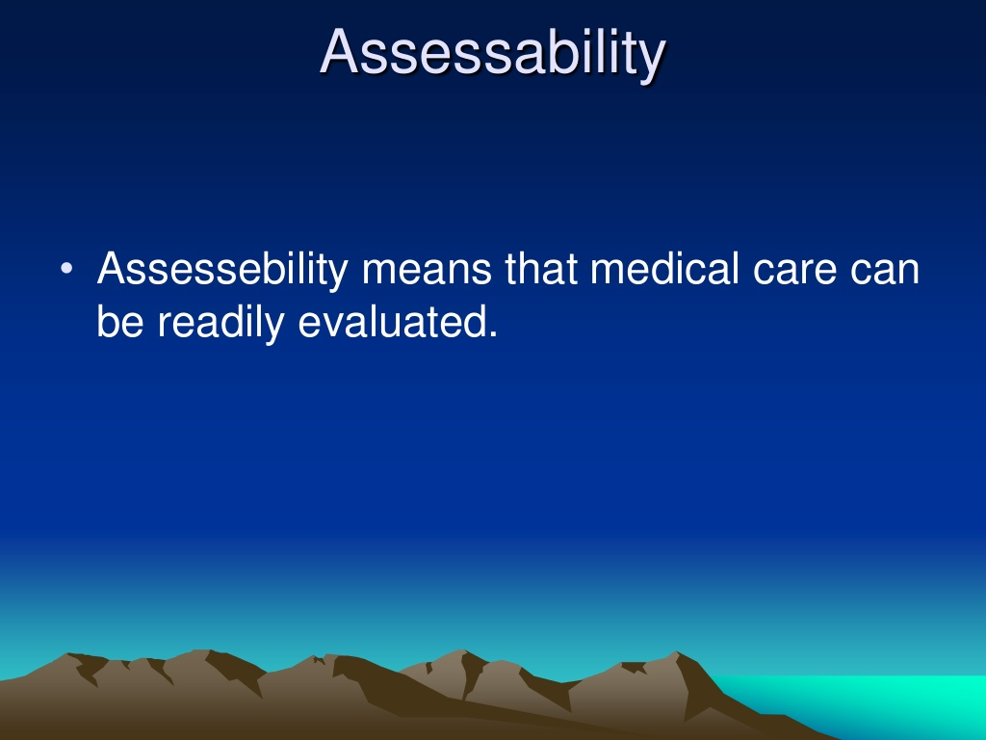
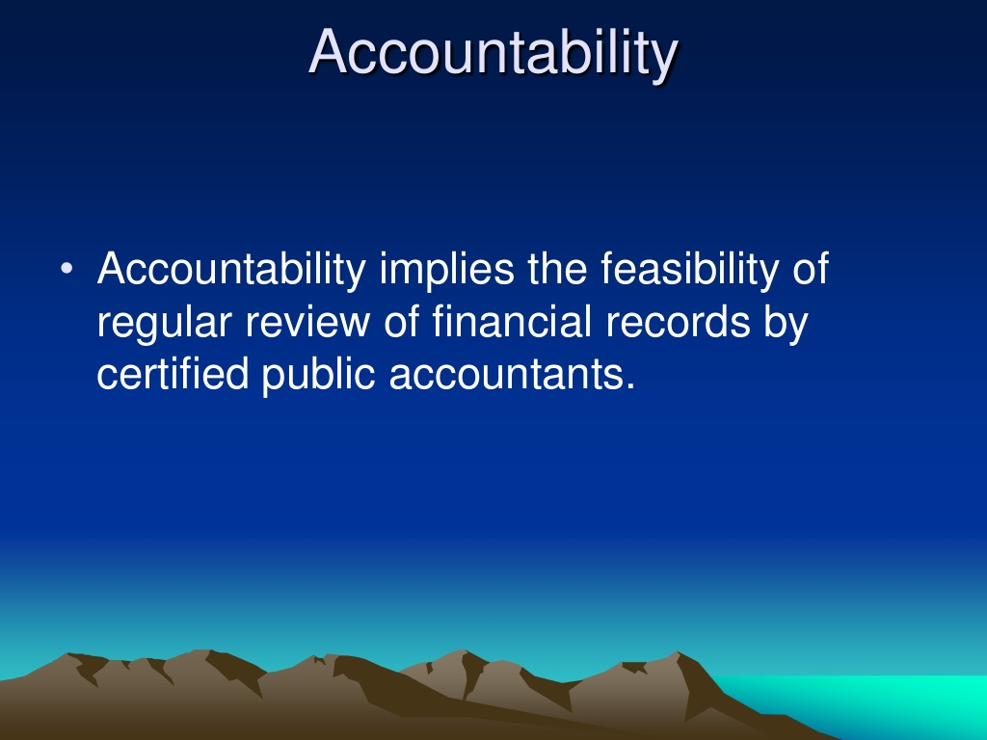

Slide 22
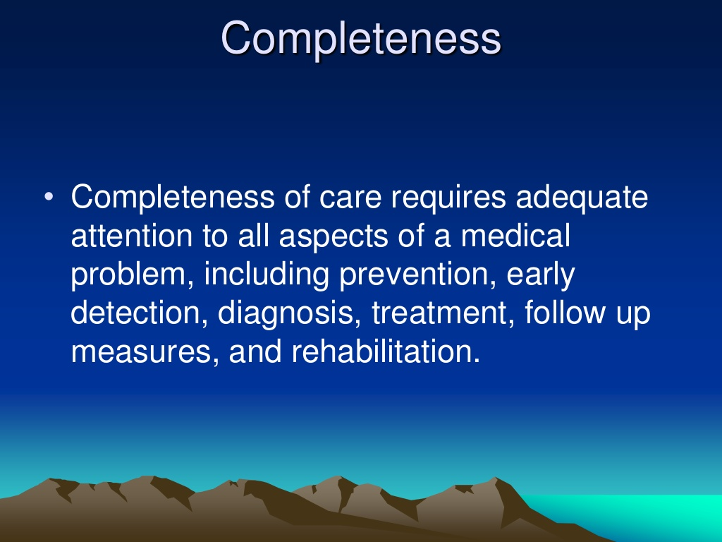

Slide 23
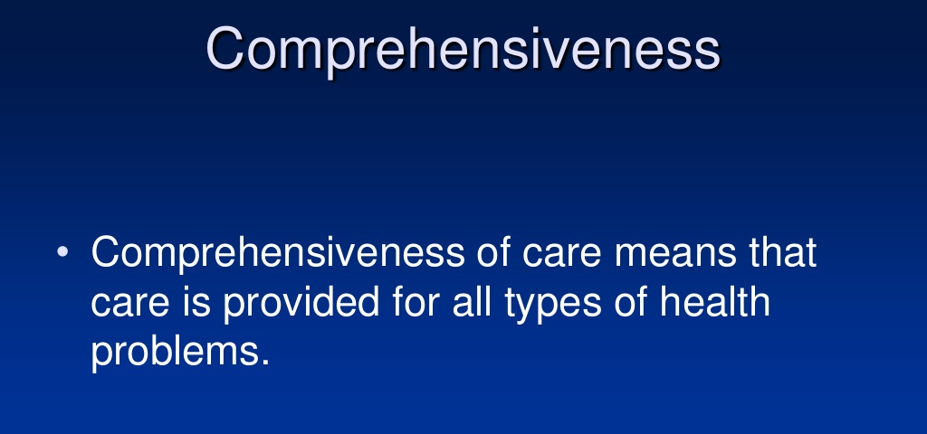

Slide 24
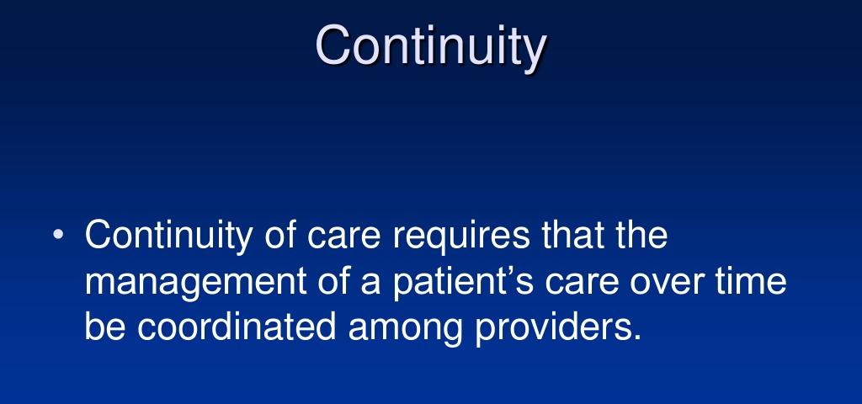

Slide 25
Primary Health Care Reform
Medical model Primary Health Care
Treatment • Health promotion
Illness • Health
Cure • Prevention, care, cure
Episodic care Continuous care
Specific problems • Comprehensive care
Individual practitioners Teams of practitioners
Health sector alone • Intersectoral collaboration
Professional dominance • Community participation
Passive reception • Joint responsibility

Slide 26
THANK YOU

