Slide 1
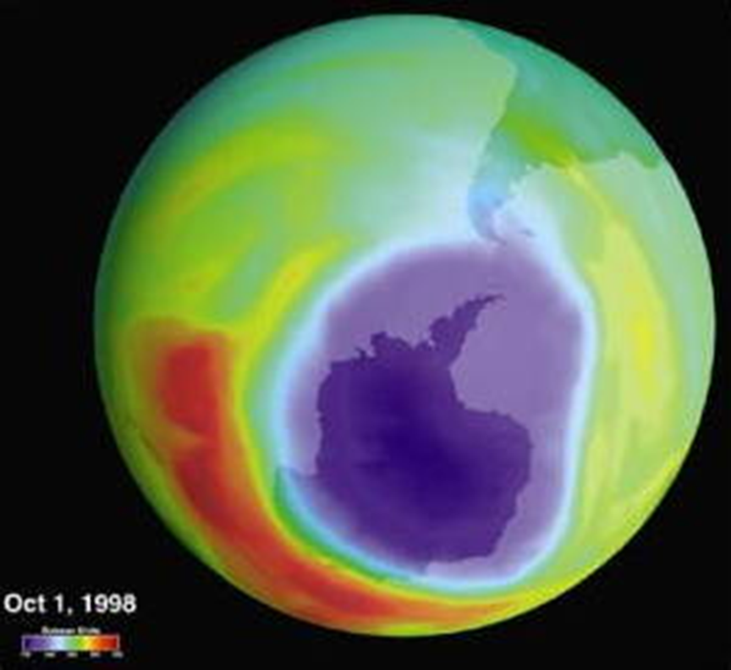

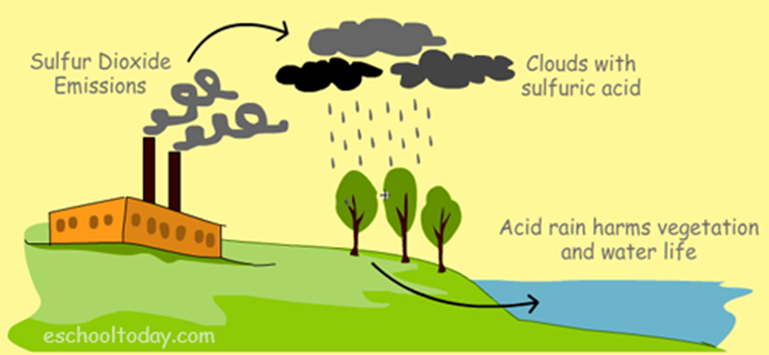
Air Pollution

Slide 2
Facts about air pollution
It is the deadliest form of pollution, killing millions of people each year.
Air pollution is a major environmental threat and one of the main causes of death among all risk factors, ranking just below hypertension, tobacco smoking and high blood glucose. WHO estimates that, globally, air pollution is responsible for about 7 million premature deaths per year
Research shows that close links between air pollution and incidence of illness and death due to COVID-19.
In 2019, 99% of the world’s population was living in places where the WHO air quality guidelines levels were not met: in places where air pollution exceeds safe limits (WHO)

Slide 3
Household air pollution was responsible for an estimated 3.2 million deaths per year in 2020, including over 237 000 deaths of children under the age of 5.
Around 2.4 billion people cook and heat their homes with polluting fuels worldwide (around a third of the global population) cook using open fires or inefficient stoves fueled by kerosene, biomass (wood, animal dung and crop waste) and coal, which generates harmful household air pollution.
Household air pollution exposure leads to noncommunicable diseases including stroke, ischemic heart disease, chronic obstructive pulmonary disease (COPD) and lung cancer.
This makes air pollution the second leading cause of NCDs globally after tobacco.
There is also evidence of links between household air pollution and low birth weight, tuberculosis, cataract, nasopharyngeal and laryngeal cancers.

Slide 4
Ambient (outdoor) air pollution is estimated to have caused 4.2 million premature deaths worldwide in 2019.
95% of deaths caused by air pollution occur in low- and middle- income countries.
People living in low- and middle-income countries disproportionately experience the burden of outdoor air pollution with 89% (of the 4.2 million premature deaths) occurring in these areas.

Slide 5
Significance of the Problem
Air pollution is a threat also for public health economy as it imposes enormous global health costs representing 6.1% of the global gross domestic product (more than US$ 8 trillion in 2019).
Parts of Africa, Eastern Europe, India, China and the Middle East are the biggest regional danger spots.
Ambient (outdoor) air pollution mortality is due to exposure to fine particulate matter, which causes cardiovascular and respiratory disease, and cancers in both cities and rural areas (WHO,2019)
for outdoor air pollution related premature death:
68% of these deaths were due to ischemic heart disease and strokes
28% of deaths were due to chronic obstructive pulmonary disease or acute lower respiratory infections
4% of deaths were due to lung cancer

Slide 6
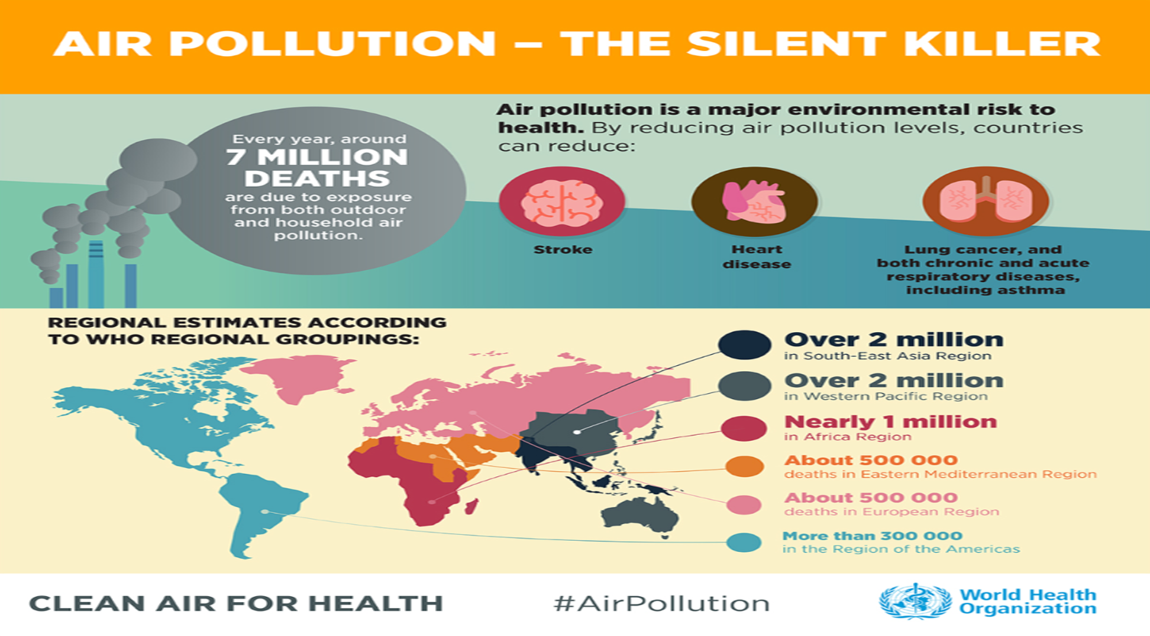


Slide 7
Definitions
What is Air Pollution?
The type of Pollution that occurs when gases, dust particles, fumes (or smoke) or odors are introduced into the atmosphere in a way that makes it harmful to humans, animals and plants.

Slide 8
Air pollutants are airborne gases, particles, and aerosols that are added to the atmosphere by natural events or human activities in concentrations that threaten the well-being of organisms or disrupt the orderly functioning of the environment.
Primary air pollutants pollute the air when emitted directly into the atmosphere.
Secondary air Pollutants are created by chemical reactions between primary air pollutants in the atmosphere. May involve sunlight or a catalyst.

Slide 9
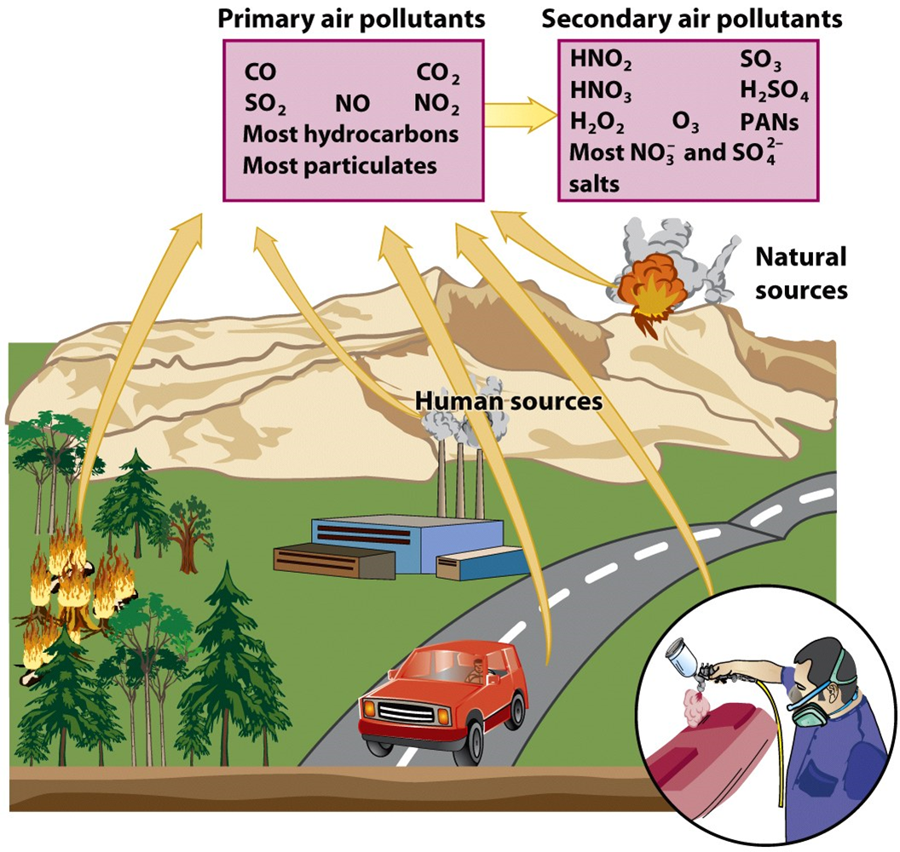

Slide 10
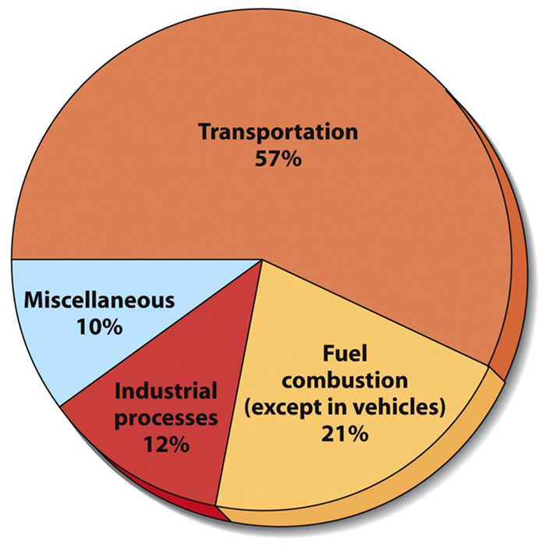
What are the sources of air pollution?
Major sources of air pollution include inefficient modes of transport (polluting fuels and vehicles), inefficient combustion of household fuels for cooking, lighting and heating, coal-fired power plants, agriculture, and waste burning.
Some air pollutants are also greenhouse gases and with significant climate impacts. This further affects the burden of morbidity and mortality caused by air pollution.

Slide 11

The most common air pollutants
Oxides of Carbon
Volatile Hydrocarbons (VOC’s)
Oxides of Nitrogen
Sulfur Compounds
Photochemical Smog
Suspended Particulates (aerosols)

Slide 12
1. Oxides of Carbon
Oxides of Carbon: odorless, colorless
1. Carbon dioxide (CO2):
fourth most common atmospheric gas (naturally)
produced from oxidation of hydrocarbons (burning fuel, solid waste, trees, …).
asphyxiant
greenhouse gas (contributes to global worming)
2. Carbon monoxide (CO):
toxic in low concentrations,
produced by incomplete combustion of fossil fuels.

Slide 13
2. Volatile Hydrocarbons: (VOC’s)
Volatile Hydrocarbons
Methane (A greenhouse gas): Mostly natural sources (marshes, ruminant animals, rice paddies, trees), (livestock manure and agricultural practices, decay of organic waste in landfills, production of coal and natural gas).
2. Benzene, tetrachloroethylene, gasoline, formaldehyde, many others: products of chemical industry used as solvents, in paints, and as cleaning agents.
All may form secondary pollutants that irritate eyes and damage respiratory system (photochemical smog).

Slide 14
3. Oxides of Nitrogen
1. Nitric Oxide (NO)
Produced by soil microbes
Forms NO2 in combination with oxygen in atmosphere
2. Nitrous Oxide (N2O)
Natural and man made sources
Anesthetic
Greenhouse gas
3. Nitrogen Dioxide (NO2)
NO2 is a gas that is commonly released from the combustion of fuels in transportation and industrial sectors.
Contributes to heart, lung, liver and kidney diseases at high concentration
Responsible for brownish haze (photochemical smog)
Forms nitric acid in rainwater (acidic rain)

Slide 15
4. Compounds of Sulfur
Sulfur dioxide (SO2) is a colorless gas that is readily soluble in water. It is predominantly derived from the combustion of fossil fuels for domestic heating, industries and power generation.
1. Sulfur Oxides (SO2, SO3, SO4):
volcanoes, sea spray, combustion of fossil fuels (coal)
Irritate respiratory passages (SO2)
Form acidic aerosols, acid rain (SO3, SO4), damages lakes, forests, steel and stone structures.
2. Hydrogen Sulfide (H2S)
Gas produced in anaerobic environment. It is colorless with bad odor “rotten egg”, (sewer gas). It is highly toxic (eye irritant and asphyxiant) and extremely flammable.

Slide 16
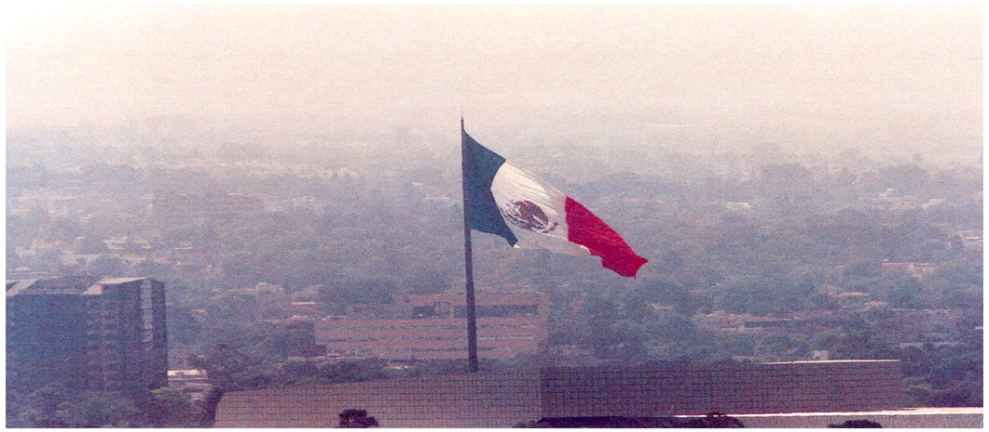
5. Photochemical Smog
Forms in bright sunlight from:
nitrogen oxides
Hydrocarbons (VOCs)
oxygen
Interact chemically to produce powerful oxidants like ozone (O3) and peroxyacetyl nitrate (PAN).
These secondary pollutants are damaging to plant life and lead to the formation of photochemical smog (smoke + fog).
PAN and ozone are primarily responsible for the eye irritation so characteristic of this type of smog, in addition to reducing visibility.

Slide 17
Ozone(O3)
Tropospheric Ozone
Man- made pollutant in the lower atmosphere
Ozone at ground level – not to be confused with the ozone layer in the upper atmosphere – is one of the major constituents of photochemical smog and it is formed through the reaction with gases in the presence of sunlight( Secondary air pollutant).
Exposure to excessive ozone can cause problems breathing, trigger asthma, reduce lung function and lead to lung disease.
Stratospheric Ozone
Essential component that screens out UV radiation in the upper atmosphere
Man- made pollutants (ex: CFCs*) can destroy it.
*CFC’s are gases used in refrigeration and in pressured spray cans.

Slide 18
6. Suspended Particles ,or Particulate mater (PM):
different solid or liquid particles suspended in air, like dust, dirt, smoke, and liquid droplets. The major components of PM are sulfates, nitrates, ammonia, sodium chloride, black carbon(soot), mineral dust
PM affects more people than any other pollutant.
The most health-damaging particles are those with a diameter of 10 microns or less, (≤ PM₁₀), which can be inhaled and lodge deep inside the lungs and then can penetrate the blood stream.
Greatest threat to health among air pollutants.
Chronic exposure to particles contributes to the risk of developing cardiovascular and respiratory diseases, as well as of lung cancer.

Slide 19
Consequences of air pollution
(Climate changes)
As climatic conditions change, more frequent and intensifying weather and climate events are observed, including storms, floods, droughts and wildfires. Other Climatic change :
Global warming
Acid deposition
Agricultural effects
These weather and climate hazards affect health both directly and indirectly, increasing the risk of deaths, noncommunicable diseases, the emergence and spread of infectious diseases, and health emergencies

Slide 20
Global Warming:
global warming is the result of human practices like emission of Greenhouse gases(fossil fuel use) and deforestation
These gases possess heat trapping capacity that are needed to create greenhouse effect so that this planet remains warm for people to survive.
During past several decades, the accumulation of greenhouse gases have grown rapidly, which means more heat gets trapped in the atmosphere and few of these gases escapes back into the space.
The earth’s temperature has increased by 0.8 degrees Celsius over the past century.

Slide 21
Global warming leads to rising temperatures of the oceans and the earth’ surface causing:
Melting of polar ice caps
Rise in sea levels
Unnatural patterns of rain such as flash floods,
excessive snow or desertification in other areas, changing seasons, change in weather scenario, and occurrence of new diseases.

Slide 22
Agricultural effects
Air pollution can seriously affect the growth of plants
it’s easy to find chemical residues in plants that grow alongside highways
also, the huge increase in atmospheric carbon dioxide now causing global warming and climate change is expected to have a major impact on the world's agriculture(reducing crop yields in some places but potentially increasing yields elsewhere).

Slide 23
Acid Deposition
Sulfur dioxide and nitrogen dioxide emissions react with water vapor in the atmosphere and form acids that return to the surface as either dry or wet deposition (droplets).

Slide 24
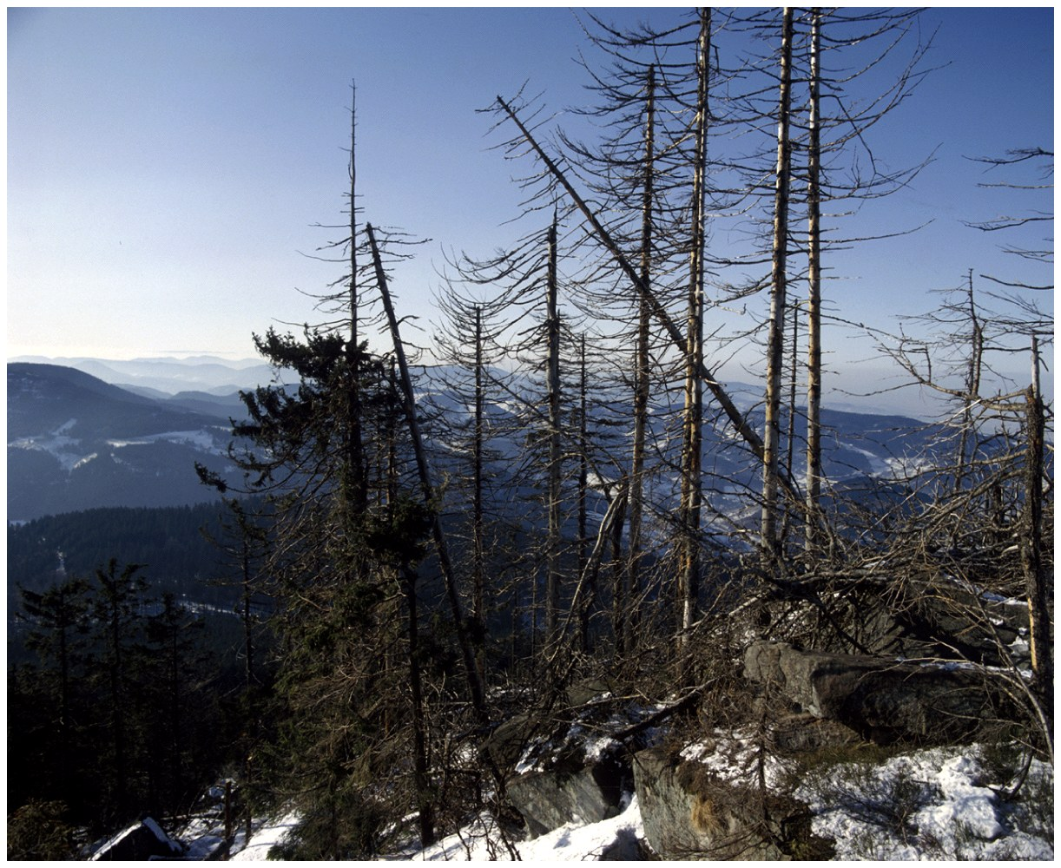
Effects of Acid Deposition
Damages lakes and streams
Declining Aquatic Animal Populations
Thin-shelled eggs prevent bird reproduction
Damages building and objects
Forest decline (deforestation)
Ex: Black forest in Germany (50% is destroyed)
# Air pollution can seriously affect the growth of plants. It is easy to find chemical residues in plants that grow alongside highways.

Slide 25
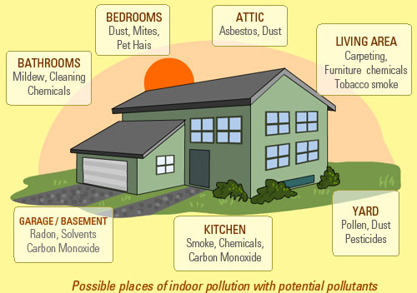
Indoor Air Pollution
Nearly 50% of pneumonia deaths among children under five are due to particulate matter inhaled from indoor air pollution.
Both women and men exposed to heavy indoor smoke are 2-3 times more likely to develop COPD

Slide 26
Common indoor air pollutants include:
Tobacco smoke: This is smoke burning cigarettes or exhaled smoke by people smoking.
Biological Pollutants: These include allergens such as pollen from plants, hair from pets, fungi and some bacteria.
Radon (Rn) :is a radioactive gas that is naturally emitted from the ground. It can be trapped in basements of building and homes in the absence of inadequate ventilation or evacuation systems. The gas is known to cause cancer after exposure over a period.
Carbon Monoxide: Carbon monoxide is produced when fuels such as gas, kerosene, coal or wood is incompletely burned or with lack of indoor ventilation.

Slide 27


What can countries do to reduce air pollution?
developing sustainable transport in cities
implementing solid waste management
providing access to clean household fuels and cookstoves
developing market for renewable energies and energy efficiency
implementing industrial emissions reductions.
Laws and Regulations.
Raising awareness and changing human behavior

Slide 28

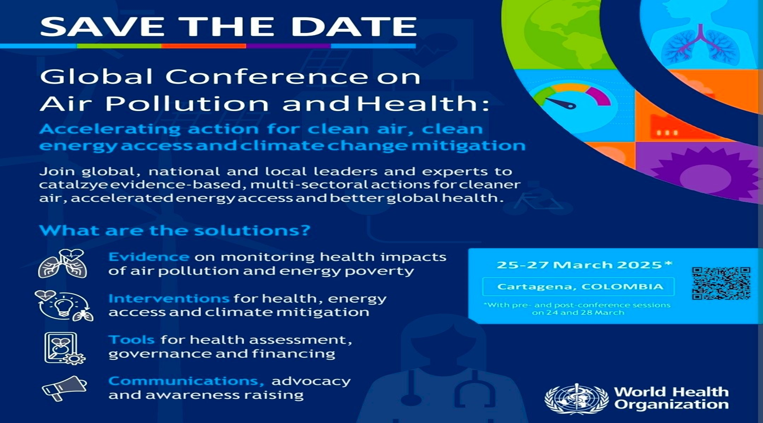

Slide 29
THE END

